Slide 1
ANAWFOS: IHAN – OMG WTF? NAA!

Slide 2
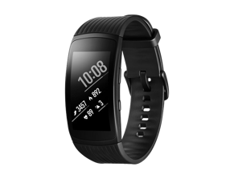
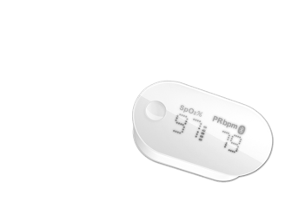
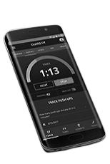
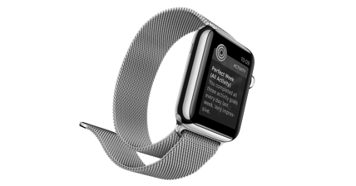
A HISTORIC CHANGE
Who creates the data in the future?
Data collected by individuals / unregulated data
Well-being and the economy
Data collected by professionals / regulated data
1980
1990
2000
2010
2020

Slide 3
The momentum is right now…
#GDPR General Data Protection Regulation
#EIDAS EU regulation on electronic identification and trust services for electronic transactions
#PSD2 Payment Services Directive
Notes:
The EU’s new General Data Protection Regulation (GDPR) will be applied in each member state on 25 May 2018. It starting premise is the right of each individual to their own data and the protection of privacy.
The new Payment Services Directive (PSD2) is to be implemented nationally by 13 January 2018 at the latest.
The EU’s Eidas directive (Electronic identification and trust services for electronic transactions in the internal market) is to be brought into force across the whole EU by August 2018.
In addition, Finland’s growth strategy is based to a significant extent on the development of ecosystems and platform economies!

Slide 4
IHAN® in nutshell
Establish key principles, rules & guidelines for human-driven Data exchange Platform. Build awareness and engage people across Europe
Test, develop and scale Platform to multiple industries and EU countries. Ensure interoperability through technology Proof-of-Concepts [IHAN® APPROVED]
Branding. Develop common Roadmap for fair Data exchange Method. Build Common Governance Model [IHAN® APPROVED]

Slide 5
IHAN® - how it works
End user
Service provider
Data provider
Data
Services
End user- Service
 | End User | Service Provider | Data Provider
Identity
Data
Consent
Services
Log
IHAN

Slide 6
IHAN® Services components
End user
Service provider
Data provider
Data
Services
End user- Service
 | End User | Service Provider | Data Provider
Identity
Data
Consent
Services
Log
Wallet of identifiers
End User Data Directory
Service Provider Data Directory
Data Provider Data Directory
Consent Directory
Service Order
Data Order
End User Service Directory
Service Provider Service Directory
Public Service Directory
End User Logs
Service Provider Logs
Data Provider Logs

Slide 7
Embedded IHAN® Services
End user
End user- Service
Service provider
Data
Data provider
“Data Source 1”
Services
“End user service”
User Interface
Data Out
Data Provider Data Directory
“Identity Wallet App”
Business Logic
Data In
API
Data Order
User Interface
Data Logic
Data Provider Logs
Business Logic
“Data Source 2”
Data Logic
Service Provider Data Directory
IHAN
End User Data Directory
Service Order
Service Provider Service Directory
Data Out
Data Provider Data Directory
Consent Directory
Service Provider Logs
API
Data Order
End User Service Directory
End User Logs
Data Provider Logs
Public Service Directory

Slide 8
Pilot Project 1 creates initial components and services
 | End User | Service Provider | Data Provider
Identity
Data
Consent
Services
Log
Wallet of identifiers
End User Data Directory
Service Provider Data Directory
Data Provider Data Directory
Consent Directory
Service Order
Data Order
End User Service Directory
Service Provider Service Directory
Public Service Directory
End User Logs
Service Provider Logs
Data Provider Logs

Slide 9
Pilot Project 2 creates alternative and adds components. More IHAN® services added
 | End User | Service Provider | Data Provider
Identity
Data
Consent
Services
Log
Wallet of identifiers
Wallet of identifiers
End User Data Directory
Service Provider Data Directory
Data Provider Data Directory
Consent Directory
Service Order
Data Order
End User Service Directory
Service Provider Service Directory
Public Service Directory
End User Logs
Service Provider Logs
Data Provider Logs
End User Logs

Slide 10
Pilot Project 3 adds more components. More services to IHAN® layer
 | End User | Service Provider | Data Provider
Identity
Data
Consent
Services
Log
Wallet of identifiers
Wallet of identifiers
End User Data Directory
Service Provider Data Directory
Data Provider Data Directory
Consent Directory
Service Order
Data Order
End User Service Directory
Service Provider Service Directory
Public Service Directory
End User Logs
Service Provider Logs
Data Provider Logs
End User Logs

Slide 11
Pilot Project n creates alternative and adds its own. IHAN® Service layer complete
 | End User | Service Provider | Data Provider
Identity
Data
Consent
Services
Log
Wallet of identifiers
Wallet of identifiers
End User Data Directory
Service Provider Data Directory
Data Provider Data Directory
Service Provider Data Directory
Data Provider Data Directory
Consent Directory
Service Order
Data Order
End User Service Directory
Service Provider Service Directory
Public Service Directory
End User Logs
Service Provider Logs
Data Provider Logs
End User Logs

Slide 12
For IHAN® pilot projects we are seeking EITHER ALREADY ongoing projects or projects that are ready for a quick launch.

Slide 13
Workshop groups
1
EIDAS
2
IHAN Number
3
Identity Wallet

Slide 14
EIDAS

Slide 15
eIDAS and IHAN
Why eIDAS ?
Legal certainty
Base for new solutions and services
Demand for qualified trust services
Why IHAN ?
Personal data in the focus
Regulation changes
My data, my control
eIDAS and IHAN
IHAN solutions do not concentrate on identity management BUT they are based on a strong identification mechanism
eIDAS could provide a reliable EU wide solution to support IHAN revolution!

Slide 16
Questions for this session
Experiences from eIDAS (or similar) implementation projects
Success stories, anyone?
War stories
Challenges
Best practices
Suggestions and ideas how to boost eIDAS and other EU level projects
?

Slide 17
IHAN Number

Slide 18
IHAN® number
IHAN® number (string) combines MyIdentity-string and MyDataIdentity-string, which is in service/data provider’s possession
IHAN® number (string) creates an unique relationship-string for MyIdentity and MyDataIdentity
MyIdentity-string might be generated in various methods (DID, URI, UUDI etc), but is unique globally and refers to virtual/digital identity. This can be verified by someone or not.
MyDataIdentity-string might be generated in any way, but must be unique globally. This covers all MyData which someone holds for certain services. One service provider might have several MyDataIdentity-strings, one for each service
Notes:
The best, cheapest or most environmentally friendly mobility solution for everyone, based on data accumulated on their mobility habits and needs (e.g. traffic volumes, transport modes used by the individual, routes, prices, etc.)
Help for the promotion of well-being based on one's own health data with the help of a well-being analyst (e.g. nutrition habits, self-collected data on physical exercise, genome data, monitoring of well-being, health data, etc.)
The individual can perceive alternatives, for example, if he/she inherits forests, but does not have knowledge of forestry (e.g. forest surveys, logistics solutions, weather data, measurement of production process, etc.)

Slide 19
IHAN® number – why?
You can always prove that MyData is really mine and is related to one of my identities and actually, by the end of the day, relates to MyIdentity
Notes:
The best, cheapest or most environmentally friendly mobility solution for everyone, based on data accumulated on their mobility habits and needs (e.g. traffic volumes, transport modes used by the individual, routes, prices, etc.)
Help for the promotion of well-being based on one's own health data with the help of a well-being analyst (e.g. nutrition habits, self-collected data on physical exercise, genome data, monitoring of well-being, health data, etc.)
The individual can perceive alternatives, for example, if he/she inherits forests, but does not have knowledge of forestry (e.g. forest surveys, logistics solutions, weather data, measurement of production process, etc.)

Slide 20
IHAN® number – questions?
Do you see need for IHAN® number?
Does IHAN® Number exist already? What are they?
Are there projects, which deals similar concept? What are they?
Are you interested in to participate work to define IHAN® number?
Notes:
The best, cheapest or most environmentally friendly mobility solution for everyone, based on data accumulated on their mobility habits and needs (e.g. traffic volumes, transport modes used by the individual, routes, prices, etc.)
Help for the promotion of well-being based on one's own health data with the help of a well-being analyst (e.g. nutrition habits, self-collected data on physical exercise, genome data, monitoring of well-being, health data, etc.)
The individual can perceive alternatives, for example, if he/she inherits forests, but does not have knowledge of forestry (e.g. forest surveys, logistics solutions, weather data, measurement of production process, etc.)

Slide 21
Identifiers
Identity unknown to external parties, known only by me
privateID
Data object (a person)
Individual / physical entity
Identity known by a mutual agreement, but not verified by 3rd party
agreedID
Identity verified by a trusted 3rd party
verifiedID

Slide 22
Identifiers
Organization
organizationID
Legitime data possessor
Application
applicationID
Legitime service provider
Web address
urlID
Device
deviceID

Slide 23
Identifiers
Data about data object
dataID

Slide 24
IHAN number
URI = scheme:[//authority]path[?query][#fragment]
authority = [userinfo@]host[:port]
f
(( privateID
agreedID
verifiedID)
dataID ))
Generates asymmetric key-pair: Master key and Private key
Master key known to both parties
Private key known only by a person (data object)
Data object can prove the relationship to the data by using IHAN number

Slide 25
Identity Wallet

Slide 26
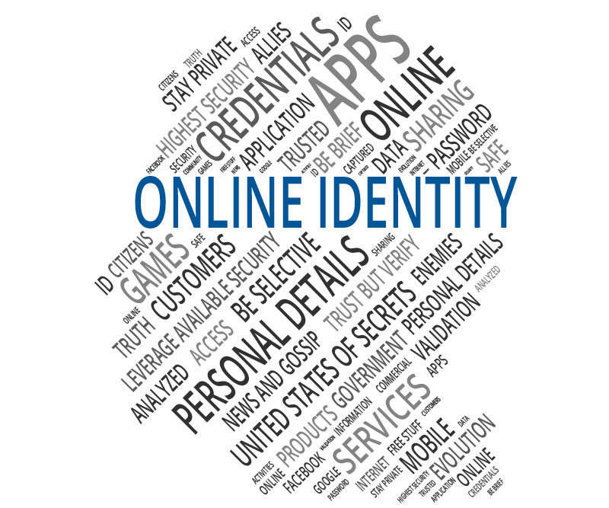
Your data is your identity

Slide 27
Your identity is your data

Slide 28
You have countless online identities …in multiple roles

Slide 29
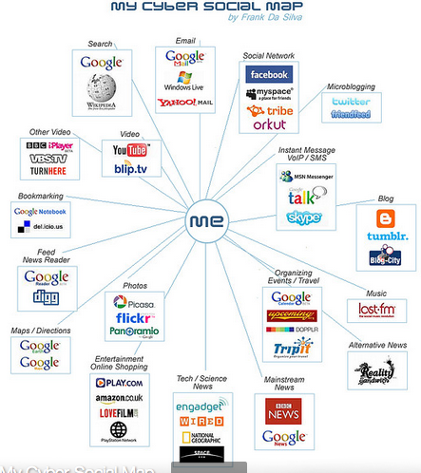
All of these identities need to be connected to you

Slide 30
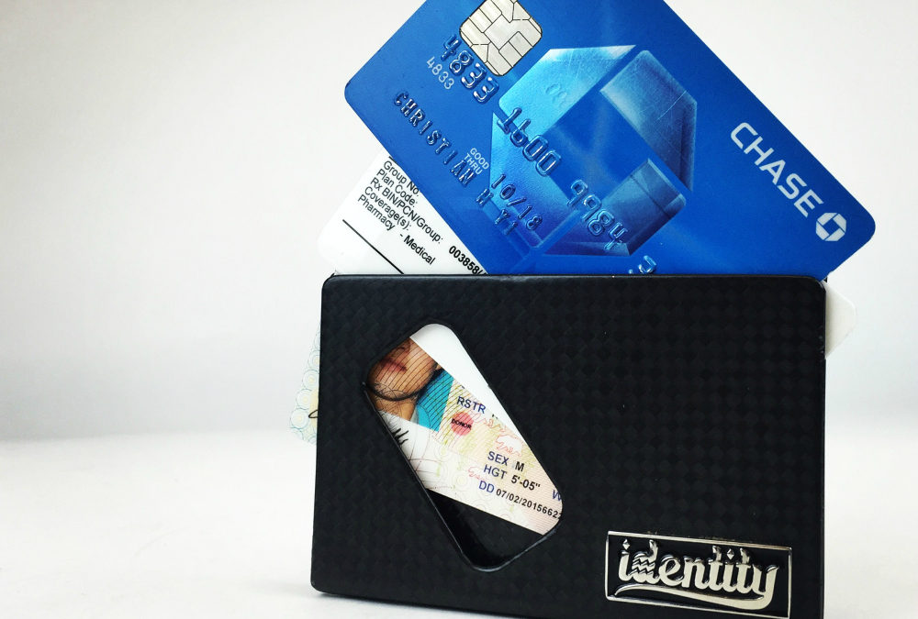
Identity Wallet is the Answer
42 is also the Answer

Slide 31
Wallet of identifiers
Authentication
Collaboration with existing authentication solutions and development work
Strong authentication
Two factor authentication
Dezentralized authentication
OAuth, OpenID, OpenID Connect
Distributed Ledger Technology
FIDO, UAF, U2F
Uniform Resource Indentifier, Uniform Resource Locator
IHAN number
Data
Credentials
Wallet
Various authentication mechanism
Various URI/URL of data
Credentials
Combination of an individual and URI of data = IHAN number?
Cryptography
Interfaces, protocols, APIs

Slide 32
IHAN number
URI = scheme:[//authority]path[?query][#fragment]
authority = [userinfo@]host[:port]
f
(( privateID
agreedID
verifiedID)
dataID ))
Generates asymmetric key-pair: Master key and Private key
Master key known to both parties
Private key known only by a person (data object)
Data object can prove the relationship to the data by using IHAN number

Slide 33
Identity Wallet
Secure collection of IHAN numbers
f
(( privateID
agreedID
verifiedID)
dataID ))
Each connected to relevant dataID
URI = scheme:[//authority]path[?query][#fragment]
organizationID
primary access mechanism
network location
applicationID
urlID
deviceID

Slide 34
Identity Wallet
One ”card” per Data Source or Service Provider
IHAN number (MyID and dataID)
Master key
Private key (encrypted by MyWallet key)
Service description
Data description
Service provider
Data provider
Metadata
IHAN number (MyID and dataID)
Master key
Private key (encrypted by MyWallet key)
Service description
Data description
Service provider
Data provider
Metadata
MyID may be verified, agreed or private
IHAN number (MyID and dataID)
Master key
Private key (encrypted by MyWallet key)
Service description
Data description
Service provider
Data provider
Metadata
IHAN number (MyID and dataID)
Master key
Private key (encrypted by MyWallet key)
Service description
Data description
Service provider
Data provider
Metadata
MyWallet key
Biometric
Hardware
Secured seed
IHAN foundation secured blockchain secured hash
Deterministic wallet
IHAN number (MyID and dataID)
Master key
Private key (encrypted by MyWallet key)
Service description
Data description
Service provider
Data provider
Metadata
IHAN number (MyID and dataID)
Master key
Private key (encrypted by MyWallet key)
Service description
Data description
Service provider
Data provider
Metadata
IHAN number (MyID and dataID)
Master key
Private key (encrypted by MyWallet key)
Service description
Data description
Service provider
Data provider
Metadata
IHAN number (MyID and dataID)
Master key
Private key (encrypted by MyWallet key)
Service description
Data description
Service provider
Data provider
Metadata
IHAN number (MyID and dataID)
Master key
Private key (encrypted by MyWallet key)
Service description
Data description
Service provider
Data provider
Metadata
Other

Slide 35
Identity Wallet– questions?
Do you see need for holistic Identity Wallet?
Do identity wallets exist already? What are they?
Are there projects, which deals similar concept? What are they?
Are you interested in to participate work to define Identity Wallet?
Notes:
The best, cheapest or most environmentally friendly mobility solution for everyone, based on data accumulated on their mobility habits and needs (e.g. traffic volumes, transport modes used by the individual, routes, prices, etc.)
Help for the promotion of well-being based on one's own health data with the help of a well-being analyst (e.g. nutrition habits, self-collected data on physical exercise, genome data, monitoring of well-being, health data, etc.)
The individual can perceive alternatives, for example, if he/she inherits forests, but does not have knowledge of forestry (e.g. forest surveys, logistics solutions, weather data, measurement of production process, etc.)

Slide 36
Wrap-up

Slide 37
Next steps and best way to get involved

Slide 38
sitra.fi | seuraavaerä.fi
@sitrafund

