Slide 1
MyData 2018
Relations, frictions and
all the mice

Slide 2
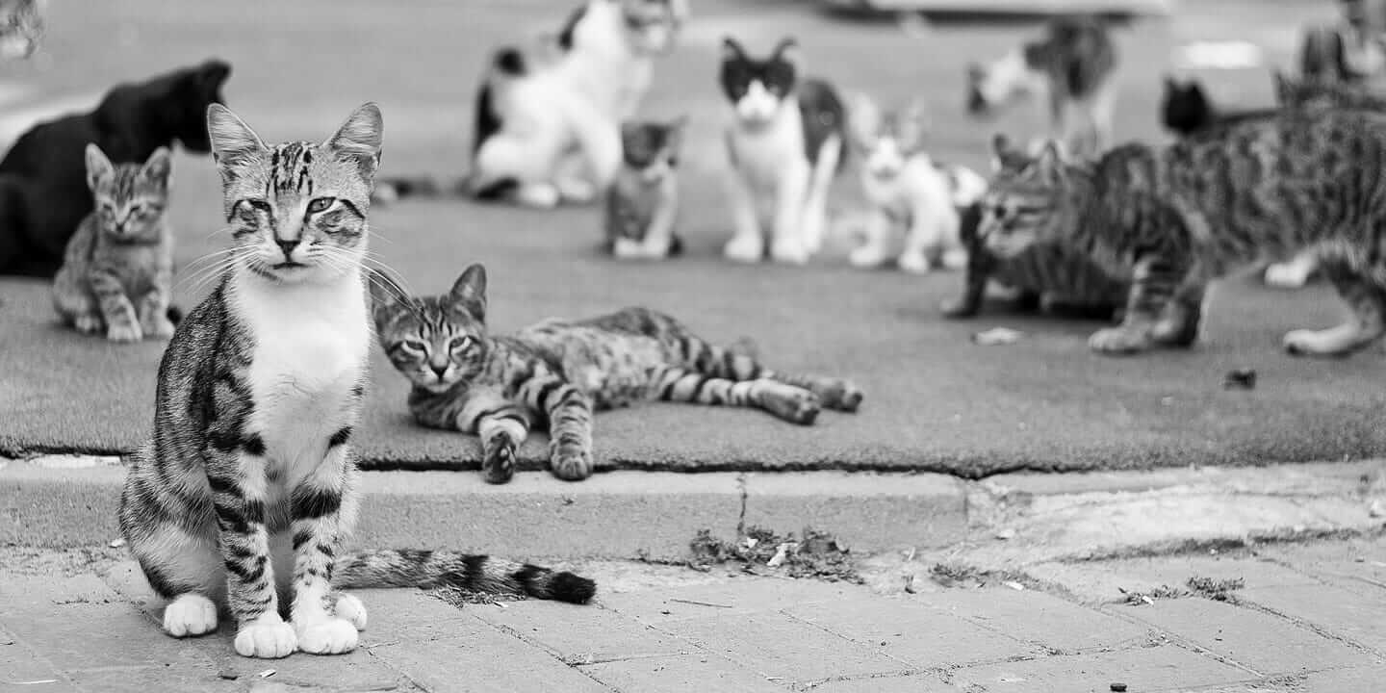

Slide 3
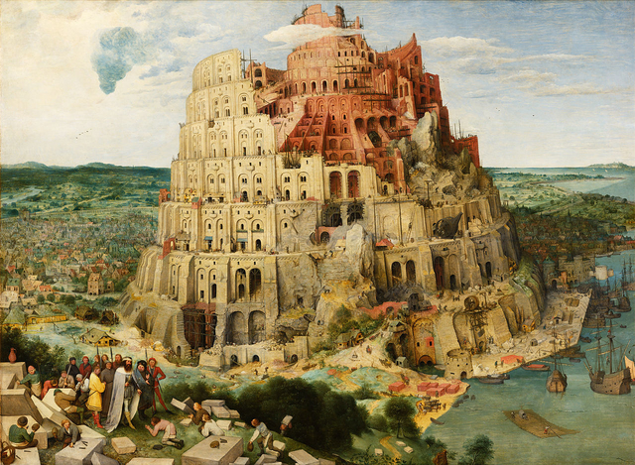

Slide 4
Which MyData?
actions
innovations
atoms
components?

Slide 6
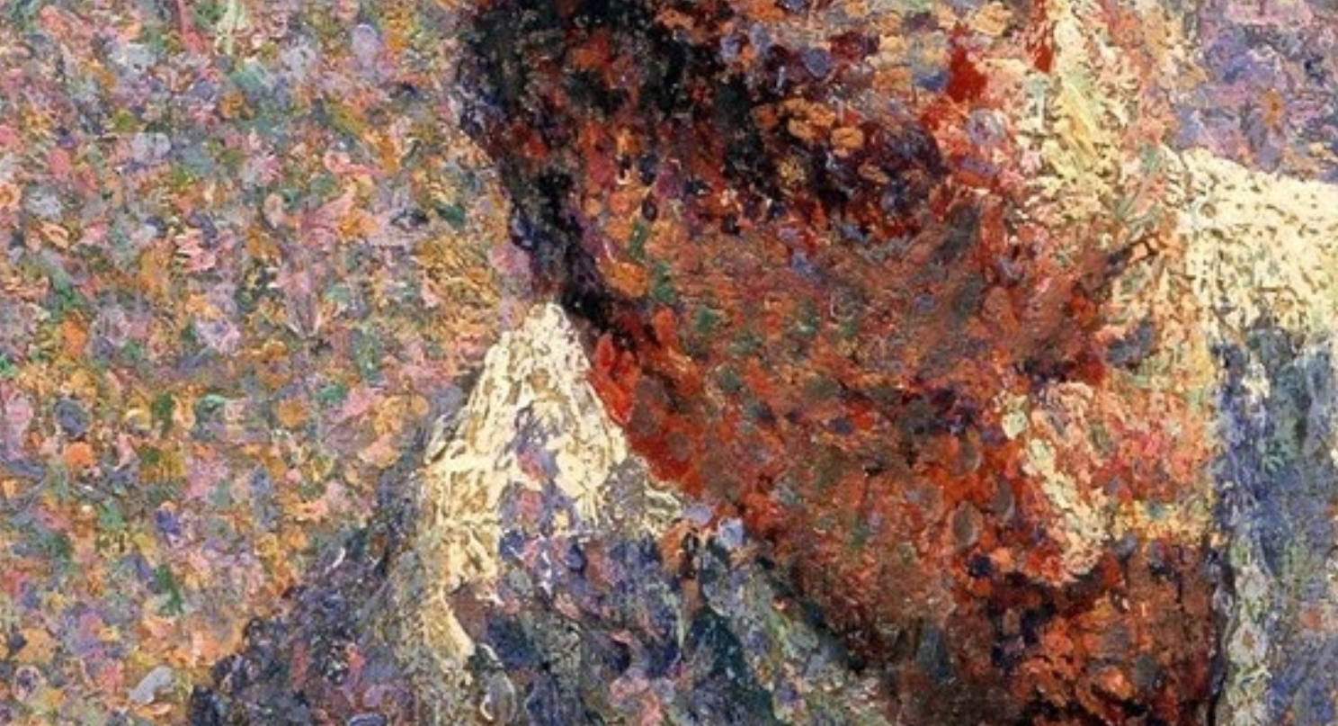

Slide 7
…or a wave
network
field?

Slide 8
MyData is a system
Data is a set of entanglements and relationships – many of the most important kinds of data are outside individual control
It connects networks of innovation around a set of interactions
the commons
government
MyData/OurData
security
commercial
research

Slide 9
e.g.
Portability is
a point: an apparatus for the transfer of data to a new provider
a process: a continuous ability to access and reuse one’s data

Slide 10
e.g.
Identity is
a set of data points which can be stored, ordered and accessed under controlled conditions
a relational process of mutual shaping by individuals, communities, states, institutions, organisations

Slide 11
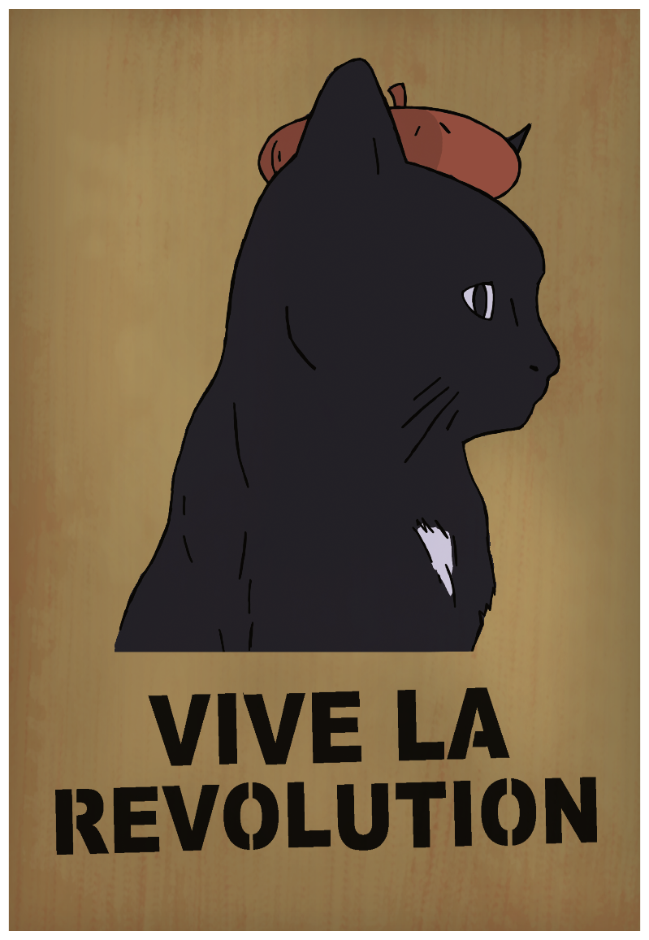
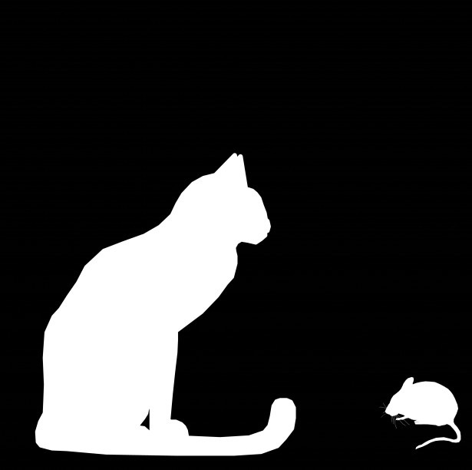
Aims?
Revolution
Resistance
Reform

Slide 12
Revolution…
turns from a powerful idea into a movement
is oppositional
and disruptive

Slide 13
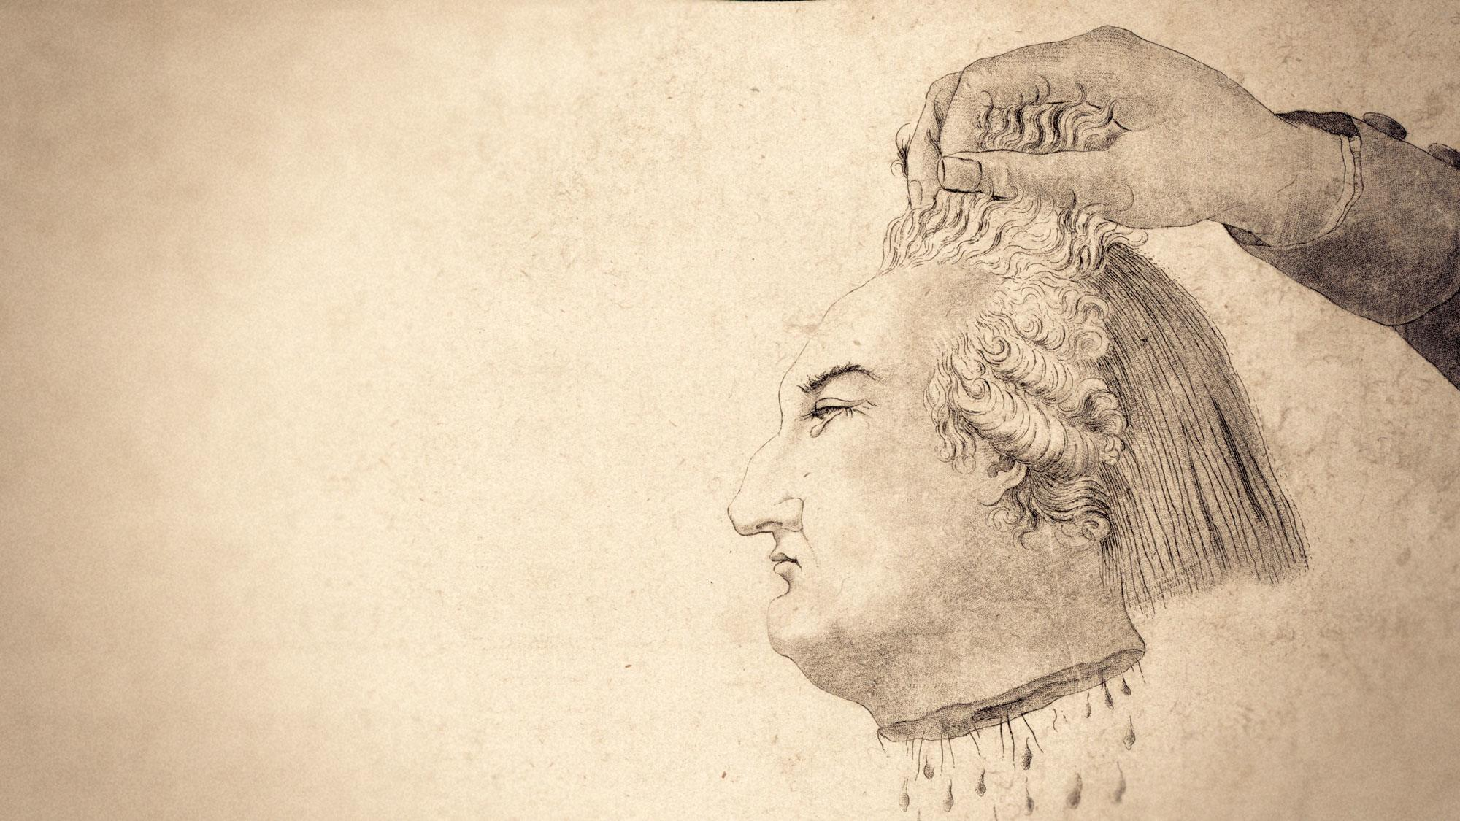

Slide 14
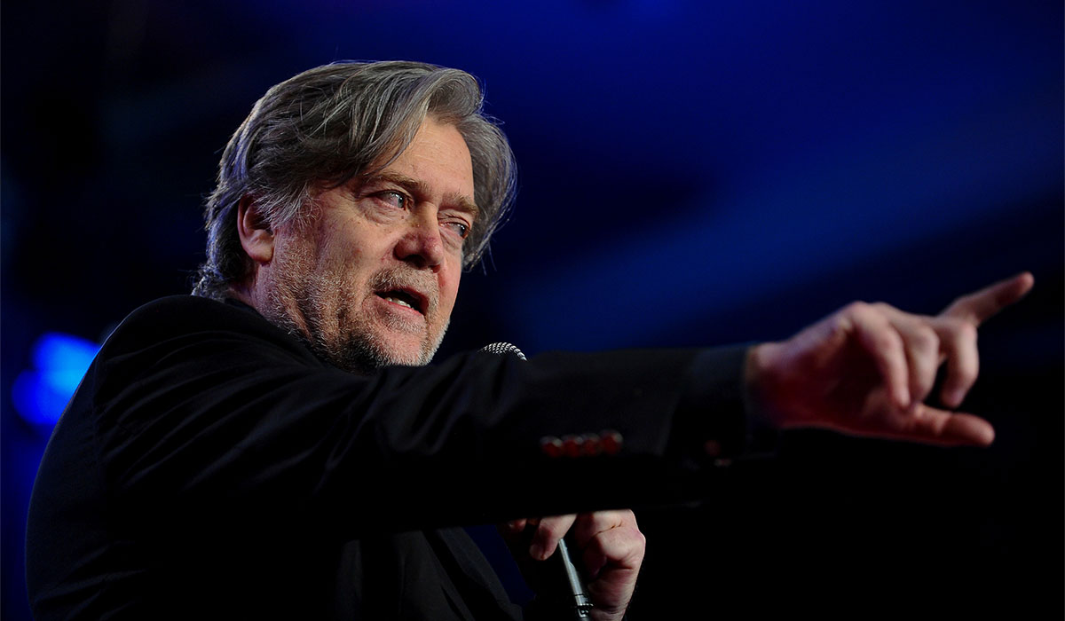
MyData as resistance?
‘Big tech’s data should be … put in a public trust. They can use it, and people can opt in and opt out. That trust is run by an independent board… it just can’t be that big tech are the sole proprietors of this data… I think this is a public good.’

Slide 15
So, reform?
Reform…
is achieved by organisations, coalitions and networks
requires engagement with institutions, law and politics
needs a broad network with consensus about central issues

Slide 17
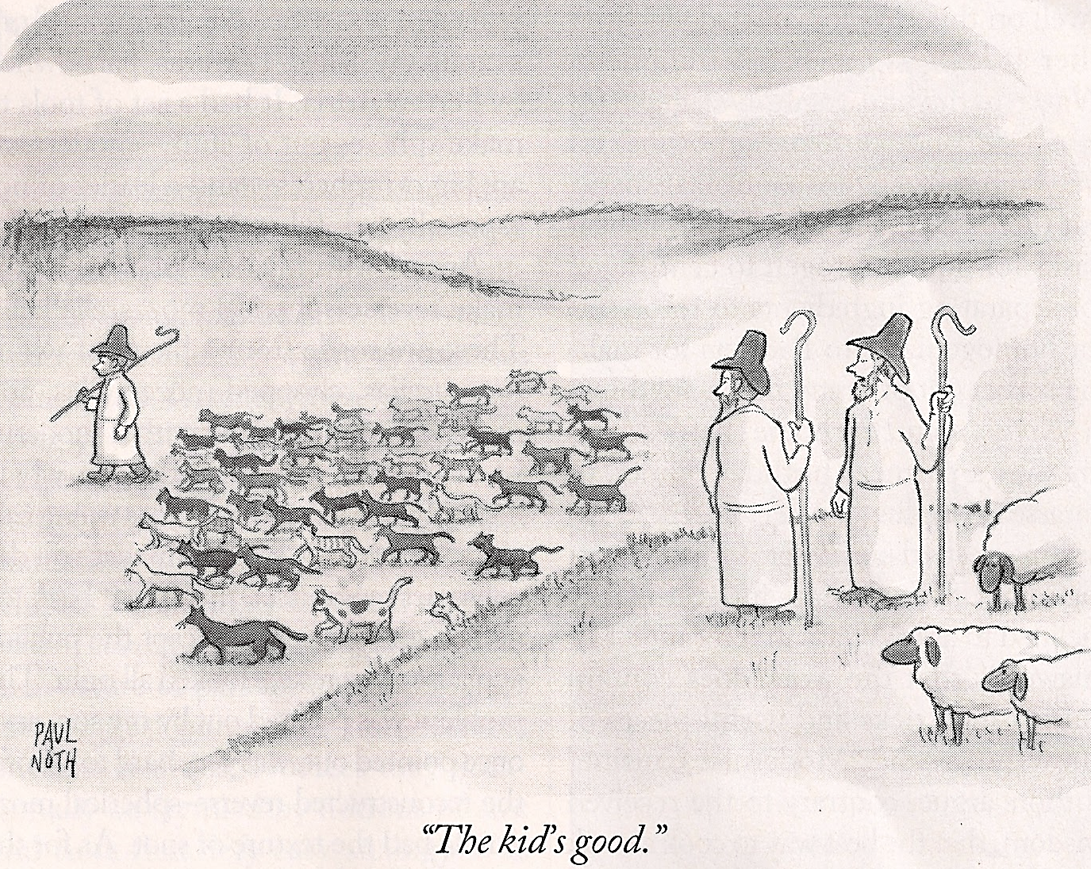
What is the MyData that can create reform?

Slide 18
Questions from this year
who will implement it?
where will it happen?
how will it be realised?
what do we agree on?
what do we disagree on?
what are we missing?
what can we not understand yet?

Slide 19
Who will do it?
mydata
tech
legal
social
business
MyData + OurData
GAFAs?
government?
data brokers?

Slide 20
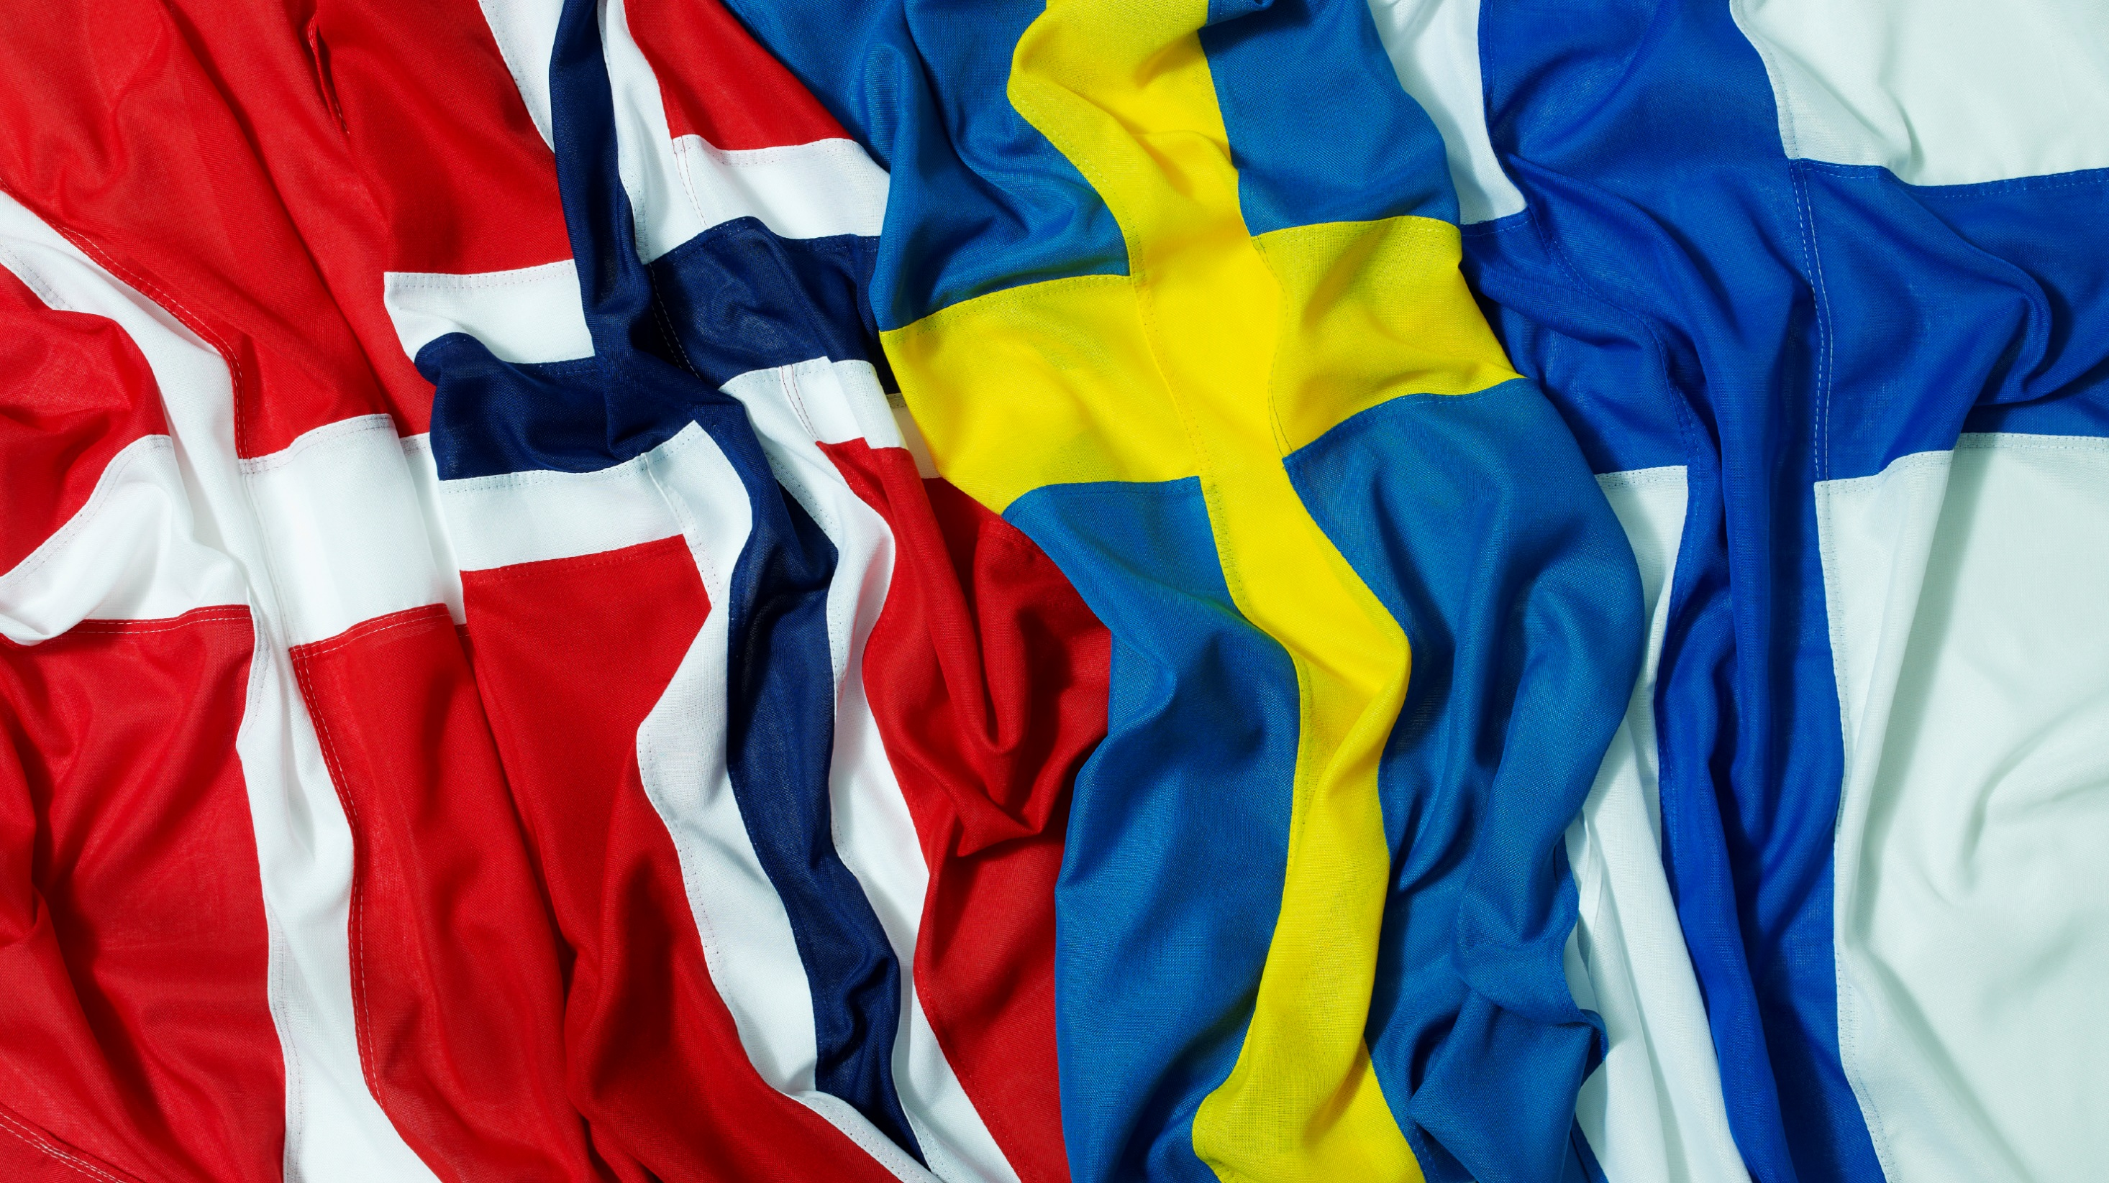
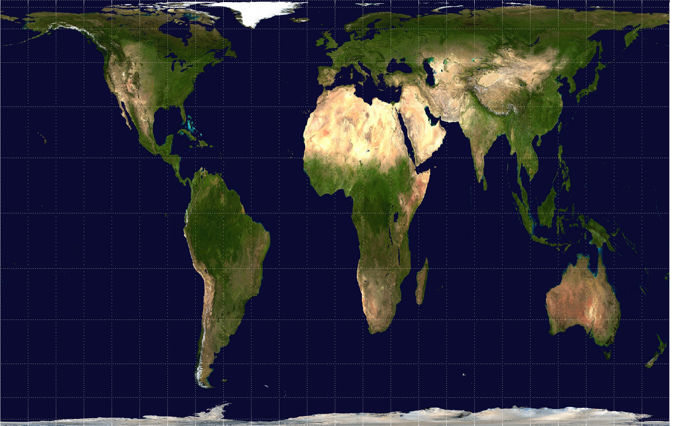
Where will it be?
‘what is my digital home?’
can MyData be implemented in radically different political/market configurations?
how much equality/literacy does it require?
is MyData going to be primarily urban?

Slide 21
How will it be done?
(or, where did the clouds go?)

Slide 22
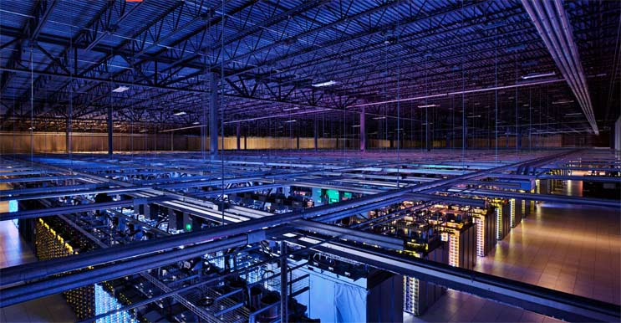
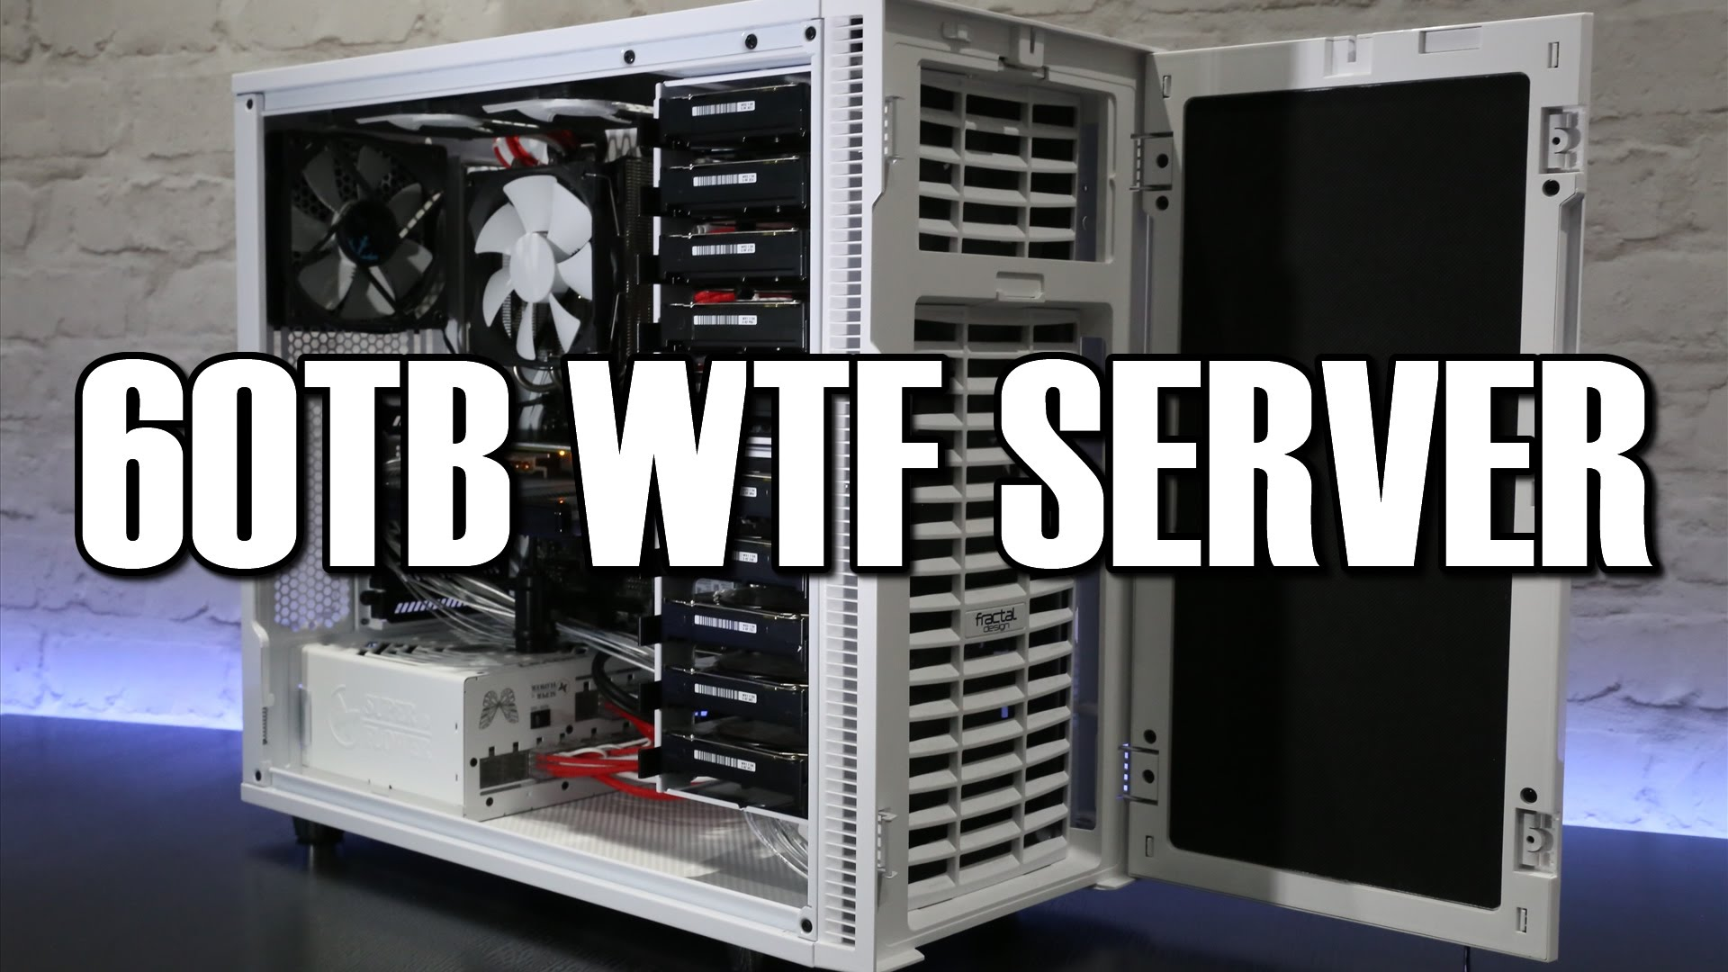

Slide 23
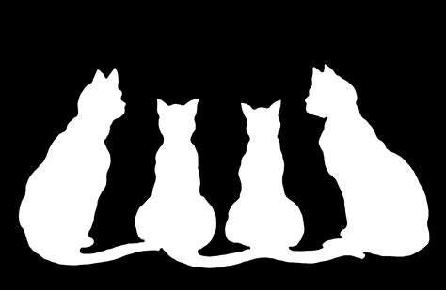
Consensus
agency is central to understanding what to build and how to build it
‘we’ vs. ‘I’ is becoming less important – data takes on value in company
identity and identification are central to getting other important tech built
use cases around environment and health are leading the way

Slide 24
Frictions
where does AI belong in a MyData world?
privacy’s meaning is changing:
‘people are not interested in privacy’
‘control not privacy’
group visibility will be as important as individual
what’s personal data?
what do we want to decentralise? And what are the implications if we succeed?
‘MyData cannot make everyone happy at the same time’

Slide 25
e.g.
Consent is great!
Consent
creates agency and empowers the user
acknowledges that we are rational
creates understanding of what will happen next
is legally robust

Slide 26
Tensions
trust as feature vs. trust as bug
MyData and AI: ‘Mydata is dead - welcome ”ethical AI middleman”’
pro-human uses of data and environmental sustainability
unity and diversity: flat world of mydata, vs. superdiverse reality including passive data subjects

Slide 27
what we need to learn next
governance and law: what’s the place of trust(s), cooperatives and other new data governance models? How can we know – what kind of discussion needs to take place?
if data isn’t property, what is it? (labour, general intellect, raw material, right, duty, commons…)
how to make sure data feeds into (medical, social) systems that tell the truth about us and build a world we want (data can tell any story)
do we have a position on guarding against exploitation? Discussions of data prostitution
history. tools, precedents, markets, resource allocation, resource definitions… ‘you may not be interested in politics but politics is interested in you’

Slide 28
Next steps
time to learn from other places – how will MyData become global?
who are MyData’s allies, who can teach lessons about history and what not to do?
what traction can MyData have on obtained/captured data? On inference?
shape convenings so social experts learn tech and vice versa

Slide 29
The edges
Sustainable computing
Edge places
AI
superdiversity
Edge people
politicians

Slide 31
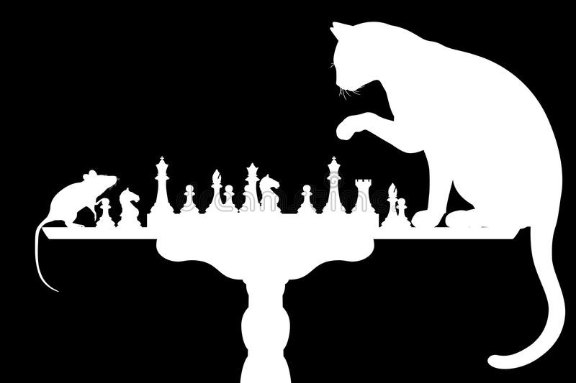
Thank you!
Especially to the collaborators:
Minna, Daniel, Tuukka, Shaz, Sean, the OurData track, Heidi, Marlies, Matti, Yki, Will, Richard, Pernille, Sarah, Manon, Marie-José, Anna, Jesse, Esko…
Images: redshift, noupe.com, holger lippmann, Breughel, Maximilien Luce, alphacoders, Bibliothèque Nationale de France, national review, shareblu, i.ytimg.com, pcdoctorwestchester.com, datacenterfrontier, freepik.com, Wikimedia commons, chc,uk, pexels, pinterest

