Slide 1
GDPR regulation and data portability of crowdsourcing users
Tuula Pääkkönen
Information Systems Specialist
National Library of Finland, DH-Projects
MyData 2018 conference, 29-31.8.2018
Lightning talk!

Slide 2
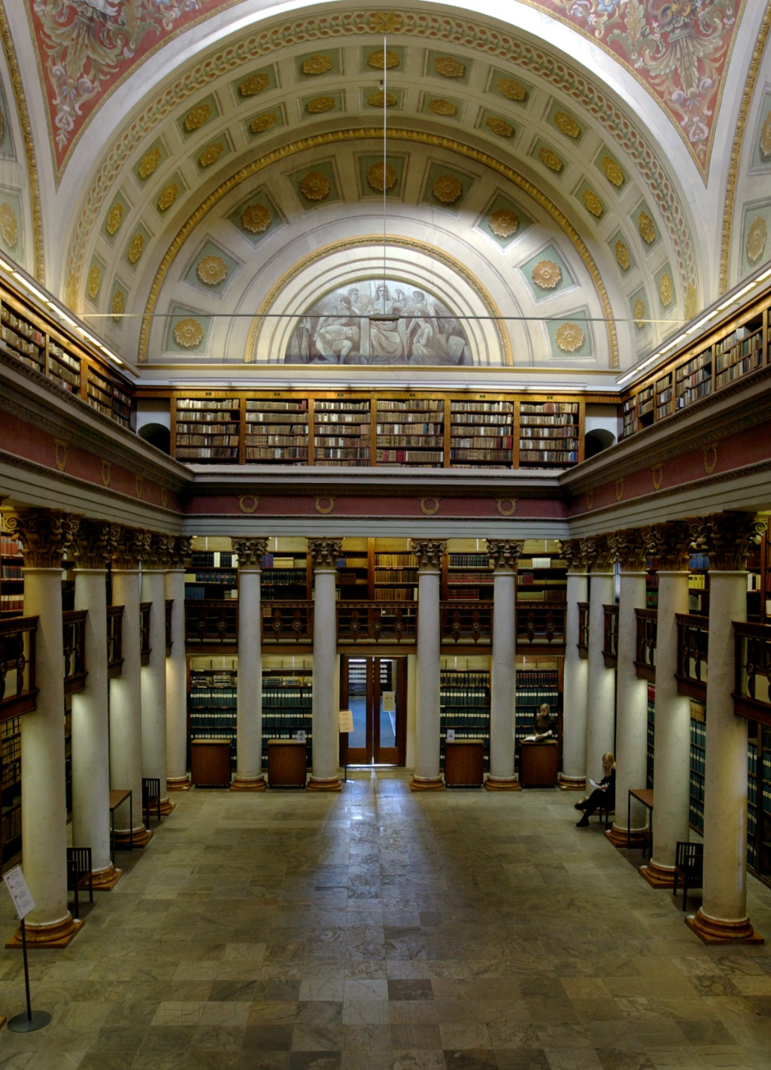
The National Library of Finland
Founded 1640 (as part of Turku Academy Library)
Nowadays: Independent Institute under University of Helsinki
http://kansalliskirjasto.fi
@natlibfi
Notes:
Units of the NLF
Library Network Services
Research Library
Tasks: Ensuring availability of information & promoting the preservation and use of Finland’s cultural heritage

Slide 3
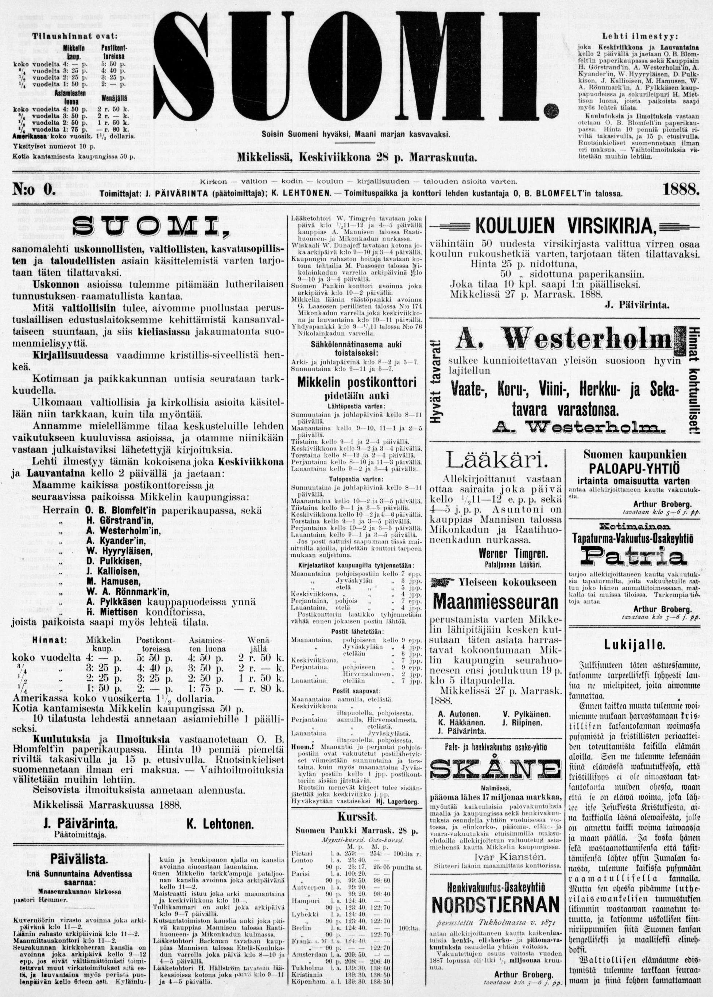
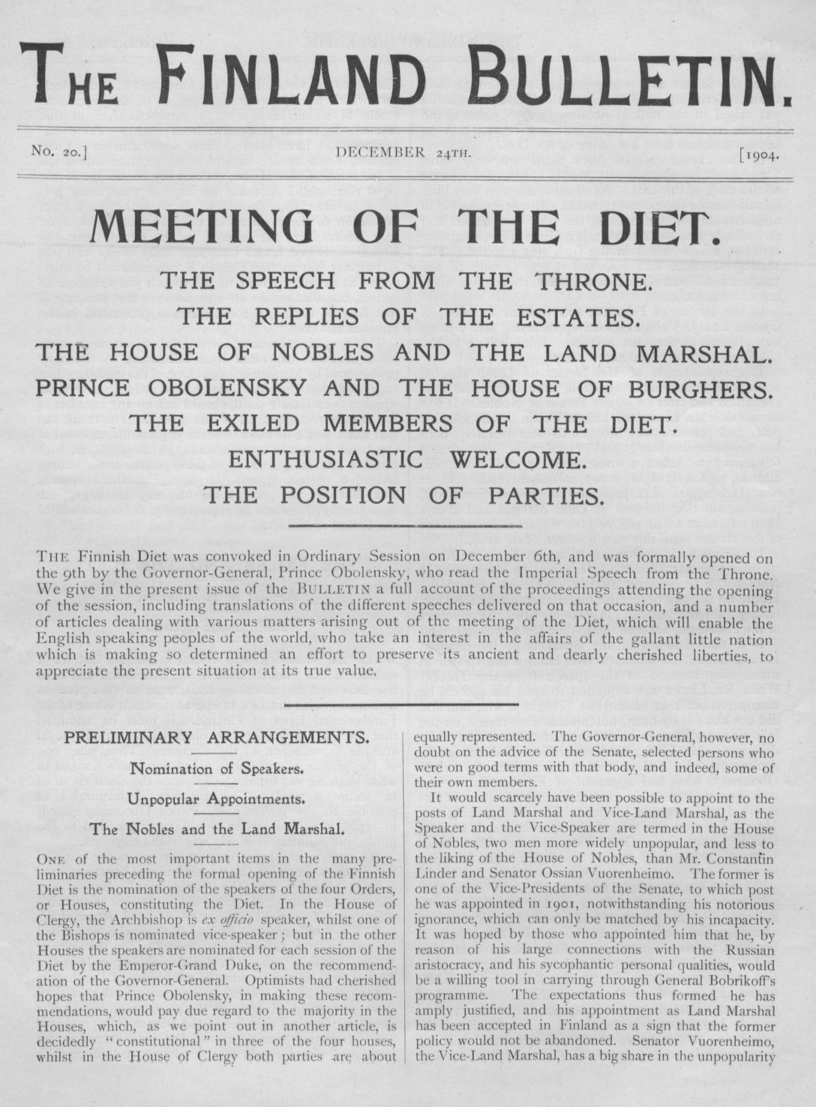
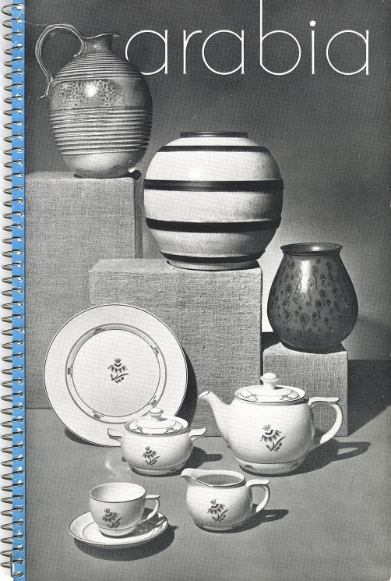
Digi.nationallibrary.fi - Materials
Newspapers
Journals
Ephemera
130.000 pages, 100%
Nearly 7 million pages,
49 % available via public internet
Nearly 7 million pages, ~60% available via public internet
Notes:
Newspapers: 3M pages, 1.9M in free web use: ~60%
Journals : ~6M pages, 1M in free web use : ~20%
Ephemera : 129.473 pages : free web use : 100%

Slide 4
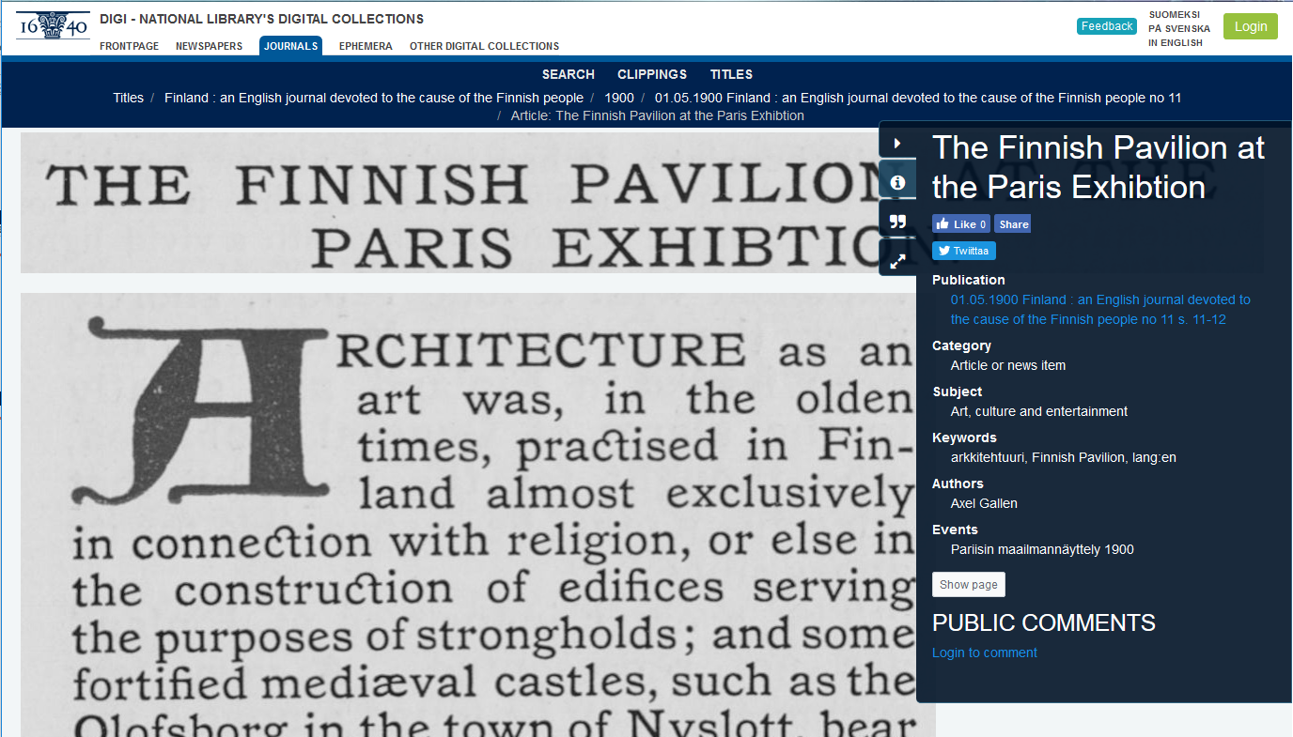
Crowdsourcing with digitized newspapers
Digitized papers from 1771- onwards
Users can login & create a clipping of an interesting article, illustration, ad & collect these to own scrapbook

Slide 5
Situation now
There are few thousand users, who have created an account
100.000 clippings
The most active ones have done 1000s , most < 10.
Login: social media or digi-specific account
Haka-authorization, which universities in Finland use.
Rights to clippings are same as to the actual material.
E.g. for year 2018 until year 1929, clippings can be made & viewed.

Slide 6
Data portability & GDPR?
Data portability – how far , how much?
E.g. You can export metadata of the created clippings
Things to consider (copyright regulations, library specifics)
Act on the deposit and conservation of cultural materials»

Slide 7
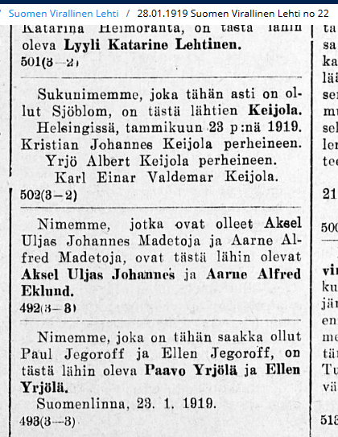
Thank you!
Notifications of name changes
In the Official Journal.
https://digi.kansalliskirjasto.fi/sanomalehti/binding/1301372?page=1&term=Nimenmuutos

