Slide 1
Permissioned Data
An Introduction to the JLINC Protocol
MyData 2018

Slide 2
Notice & Consent doesn’t scale
The control we get from modern privacy regulations is like a distributed denial of service (DDoS) attack on our brains. From the second you boot up any device, you’re gifted with “control” over information in the form of privacy policies, terms of use, and pop-up banners—for each and every website or app you visit or use. Eventually your eyes gloss over and that control does you little good. Your critical faculties just crash, and you give up.
Hartzog, Woodrow. Privacy’s Blueprint: The Battle to Control the Design of New Technologies (p. 65). Harvard University Press
Consent…

Slide 3
Permissioned Data can scale
Alice and Bob share data using permissions set by Alice NOT terms and conditions set by Bob.
Permissions are cryptographically signed and recorded in JSON-LD. This is a technical implementation of meaningful consent.

Slide 4
The Implementation
Alice sets permissions
JLINC applies them in Bob’s system

Slide 5
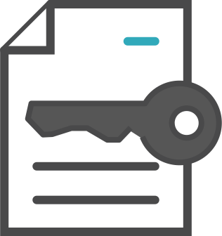
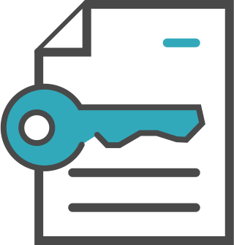
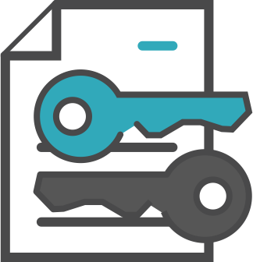
Technology & Data Exchange
The JLINC Internet protocol connects separate services for the User and the Business
Standard Terms = SISA
Sign SISA
User Service
Business Server
Sign SISA
Signed SISA
record held
Signed SISA
record held
Audit Server
Customer Business
An audit trail can be recorded on any database, log, ledger or blockchain.
The system can generate a cryptographically signed consent receipt on demand
5

Slide 6
The protocol will be an open standard
https://protocol.jlinc.org
https://sisa.jlinc.org/html/v1/

Slide 7
Questions?
JLINC is in active beta and would love MyData 2018 participants to sign up and try as either an individual (Alice) or as an organization (Bob)

