Slide 1
Decentralized Identifiers and Self-Sovereign Identity Standards
Kim Hamilton Duffy, CTO
Learning Machine
www.learningmachine.com
Co-chair W3C Credentials Community Group

Slide 2
How I got involved in SSI
Learning Machine and Self-Sovereign Identity (SSI)
Blockcerts, jointly developed by Learning Machine and MIT Media Lab
Open source, open standard ecosystem
Recipient-owned, long-lived, blockchain-anchored credentials
Open Badges and Verifiable Credential Alignment
DID Method Specification implementation (BTCR — details later in talk)
W3C CCG and SSI
DID Specification
DID Method Specifications and registry
DID and Verifiable Credential ecosystem / incubation
Signature (proof) suites and registries
Advanced credit: Thanks to SSI Meetup (http://ssimeetup.org/) for allowing slide reuse/remix (CC-BY-SA)
Notes:
OB: solved trust problem
In general incubate

Slide 3
AGENDA
Identity Models
Glance at DIDs
Standards of the SSI stack (and role of DIDs)
DID Method Specifications
BTCR Deep Dive
Q&A

Slide 4
IDENTITY MODELS

Slide 5
CENTRALIZED IDENTITY
Notes:
you are a supplicant (click)
your account lives with them
not necessarily your data (or metadata)
data silos - hack magnet

Slide 6
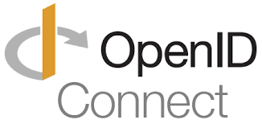
FEDERATED IDENTITY
Standards:
Notes:
use across systems (click)
pass the buck (click)
standards

Slide 7
SELF-SOVEREIGN IDENTITY
Notes:
ownership and control over all aspects of your id
privacy
choose what you share

Slide 8
DECENTRALIZED IDENTIFIERS (DIDS)
FUNDAMENTAL BUILDING BLOCK OF THE SSI STACK

Slide 9
NOT A DID
078-05-1120
Notes:
Dumb string
Collect this and other identifying info => problem

Slide 10
DID
cc2cd0ffde594d278c2d9b432f4748506a7f9f25141e485eb84bc188382019b6
Public Key
did:btcr:xkyt-fzgq-qq87-xnhn
Private Key
047d599d4521480d9e1919481b024f29d2693f272d19473dbef971d7d529f6e9
Notes:
Smart string, click
Prove you control
Can have many

Slide 11
DID DOCUMENT
DID Document
DID
did:btcr:xkyt-fzgq-qq87-xnhn
Notes:
Ability comes from DID Document
Look up
Other useful characteristics

Slide 12
SELF-SOVEREIGN IDENTITY STACK
STANDARDS AND SPECIFICATIONS
Notes:
SSI stack and role of DIDs

Slide 13
SSI STANDARDS AND SPECIFICATIONS
Verifiable Credentials
Verifiable Credentials
Credentials associated with a subject, issuer Decentralized Identifiers
DID Auth
DID Auth
How to authenticate with a DID
Universal Resolver
Universal Resolver
How to look up a DID Document from a DID
Rules for how a DID is registered, resolved, updated, and revoked on a specific ledger or network
DID Method Specs
DID Method Specs
DID Specification
DID Specification
Common data model, format, and operations
Notes:
Click, click
DID Spec: general rules of DID and DID Documents, enables interoperability, click
Method Spec: rules of a specific. Must conform, but may also innovate, click
Universal Resolver: across method specs, click
DID Auth: authenticate, click

Slide 14
Verifiable Credentials
DID SYNTAX
DID Auth
Universal Resolver
DID Method Specs
DID Specification
did:btcr:xkyt-fzgq-qq87-xnhn
Method-Specific Identifier
Generated as defined by the DID method specification
Method
Scheme
Notes:
DID Specification: DID syntax
CCG: Method registry

Slide 15
DID DOCUMENT
Verifiable Credentials
{
"@context": "https://w3id.org/did/v1",
"id": "did:example:123456789abcdefghi",
"publicKey": [{
"id": "did:example:123456789abcdefghi#keys-1",
"type": "RsaSigningKey2018",
"owner": "did:example:123456789abcdefghi",
"publicKeyPem": "-----BEGIN PUBLIC KEY...END PUBLIC KEY-----\r\n"
}],
"authentication": [{
"type": "RsaSignatureAuthentication2018",
"publicKey": "did:example:123456789abcdefghi#keys-1"
}],
"service": [{
"type": "ExampleService",
"serviceEndpoint": "https://example.com/endpoint/8377464"
}],
"created": "2002-10-10T17:00:00Z",
"updated": "2016-10-17T02:41:00Z",
"signature": {
"type": "RsaSignature2016",
"created": "2016-02-08T16:02:20Z",
"creator": "did:sov:8uQhQMGzWxR8vw5P3UWH1j#key/1",
"signatureValue": "IOmA4R7TfhkYTYW87z640O3GYFldw0
yqie9Wl1kZ5OBYNAKOwG5uOsPRK8/2 C4STOWF+83cMcbZ3CBMq2/gi25s=“
}
}
}
DID Auth
Universal Resolver
DID Method Specs
DID Specification
DID (for self-description)
Public keys (for verification)
Auth methods (for authentication)
Service endpoints (for interaction)
Timestamp (for audit history)
Signature (for integrity)
Notes:
Target of a DID string
Some common, some method-specific
Click

Slide 16
Verifiable Credentials
DID RESOLUTION
DID Auth
DID
did:btcr:xkyt-fzgq-qq87-xnhn
Universal Resolver
DID Method Specs
DID Method Spec
DID Specification
Universal Resolver
DID Document

Slide 17
DID AUTH AND VERIFIABLE CREDENTIALS
Verifiable Credentials
DID AUTH
Verifiable Credentials
DID Auth
(ANTHROPOMORPHISED)
Universal Resolver
Here is my decentralized identifier
Resolves the DID Document”
DID Method Specs
Creates proof
Prove you own it!
DID Specification
Here’s my proof!
LGTM
Checks
I want to rent a car
= Car rental agency
Show me your driver’s license
Finds VC from DL Issuer
Here you go!

Slide 18
VERIFIABLE CREDENTIALS
Verifiable Credentials
DID Auth
Universal Resolver
DID Method Specs
Verifiable Credential
{
"@context": "https://w3id.org/credentials/v1",
"id": "http://example.com/credentials/9283",
"type": [“VerifiableCredential”, “DriversLicense],
"issuer": “did:example:xyz9876",
"issuanceDate": "2013-01-19T05:28:04Z",
"claim": {
"id": "did:example:abcdef1234567",
“authorizedForVehicleClass": “A”,
"status": ...
},
"proof": { ... }
}
DID Specification
Issuer and Subject identified by DIDs
Prove this is your credential
Recover ownership, even if you lose your device
Notes:
Click, behind presentation
Generic, lightweight structure
Issuer, subject identified

Slide 19
HIGHLIGHTS
Can cryptographically prove ownership of credentials
Layered approach avoids past problems
Key lifecycle

Slide 20
DID METHOD SPECIFICATIONS
DEFINITION AND HIGH LEVEL SURVEY
Notes:
Look at DID Method specs and compare

Slide 21
DID METHOD SPEC DEFINES
Syntax
CRUD (Create, Read, Update, Delete) operations
Applies to DIDs and DID documents
Specifies distributed ledger (or blockchain)
Any method-specific elements

Slide 22
EXAMPLE DID METHOD SPECS
Why so many?
Sovrin
Veres One
IPID (IPFS-based)
Blockstack
uPort
BTCR (deep dive)
Different use cases
Different capabilities
Different economic model
Results in different implementation choices

Slide 23
DIFFERENT USE CASES
Ease of onboarding at-risk populations in a cost-effective way
Sovrin: Guardians
Veres One: Board of Governors
Ease of bootstrapping into DIDs
BTCR
Self-sovereign
You have a BTCR DID if you’ve ever transacted bitcoin!
Bridge existing systems
Blockstack ID

Slide 24
DIFFERENT CAPABILITIES
BASED ON METHOD-SPECIFIC PRIORITIES; CAN CHANGE OVER TIME
Sovrin:
Multi-signature, ZKP
Owner or guardian
Veres One:
OCAP
In general
Each method spec can introduce their own vocabulary/behavior
“service” varies greatly
Future:
Different recovery methods such as social recovery
Notes:
Corresponding to use cases

Slide 25
DIFFERENT LEDGERS
Sovrin
Public, permissioned blockchain
Fit-for-purpose
Veres One
Public, permissionless blockchain
Fit-for-purpose
Non-speculative — operations pay for cost of running the network
Consensus relies on leaderless elector collaboration
BTCR
Bitcoin blockchain
uPort
Ethereum
IPID
IPFS/IPNS
Notes:
Implementation: Corresponding to use cases and priorities

Slide 26
DIFFERENT TRUST AND COST MODELS
Permissioned/permissionless
Fit for purpose?
Who can run a validator node?
Can outsiders perform CRUD operations?
Economic incentives (who pays?)
In general, a fit-for-purpose blockchain can be cheaper to use…but not cheaper to run the network
Notes:
Building on…

Slide 27
DIFFERENT STORAGE SCHEMES
Sovrin
DID Document stored on ledger
Veres One
On- and off-chain variants supported
BTCR
DID Document is constructed: combines on- and off-chain data
uPort
Event log

Slide 28
DIFFERENT UPDATE MECHANISMS
IPID
Update IPNS pointer
BTCR
Create a Bitcoin TX, spending the previous TXOUT
Veres One
Call a REST endpoint

Slide 29
DEEP DIVE: BTCR METHOD SPEC

Slide 30
BTCR DID FORMAT
did:btcr:xkyt-fzgq-qq87-xnhn
References network (mainnet, testnet3), block height, and position
Bech32 encoded Transaction Position References
Proposed extensions
From this string, a BTCR DID resolver can partially generate a DID Document

Slide 31
CREATING A BTCR DID

Slide 32
UPDATING A BTCR DID

Slide 33
RESOLVING A BTCR DID
Build “implicit” DID from transaction
Lookup continuation DID Document
Build final “constructed” DID document

Slide 34
BTCR LIVE DEMO

Slide 35
WHY BTCR IS INTERESTING
Simple
Relies on Bitcoin blockchain (fit-for-purpose blockchain not needed)
Simple implementation, minimal feature set => easy to reason about
Useful baseline from which to understand with more advanced DID capabilities

Slide 36
GET INVOLVED AND LEARN MORE
W3C Credentials Community Group (CCG)
https://w3c-ccg.github.io/
Rebooting Web of Trust
http://weboftrust.info/
Internal Identity Workshop
https://www.eventbrite.com/e/internet-identity-workshop-iiwxxvii-27-2018b-tickets-45998232953
Blockcerts
https://www.blockcerts.org/
SSI Meetup
http://ssimeetup.org/
Kim Hamilton Duffy, CTO
@kimdhamilton
Learning Machine
www.learningmachine.com

Slide 37
BACKUP SLIDES

Slide 38
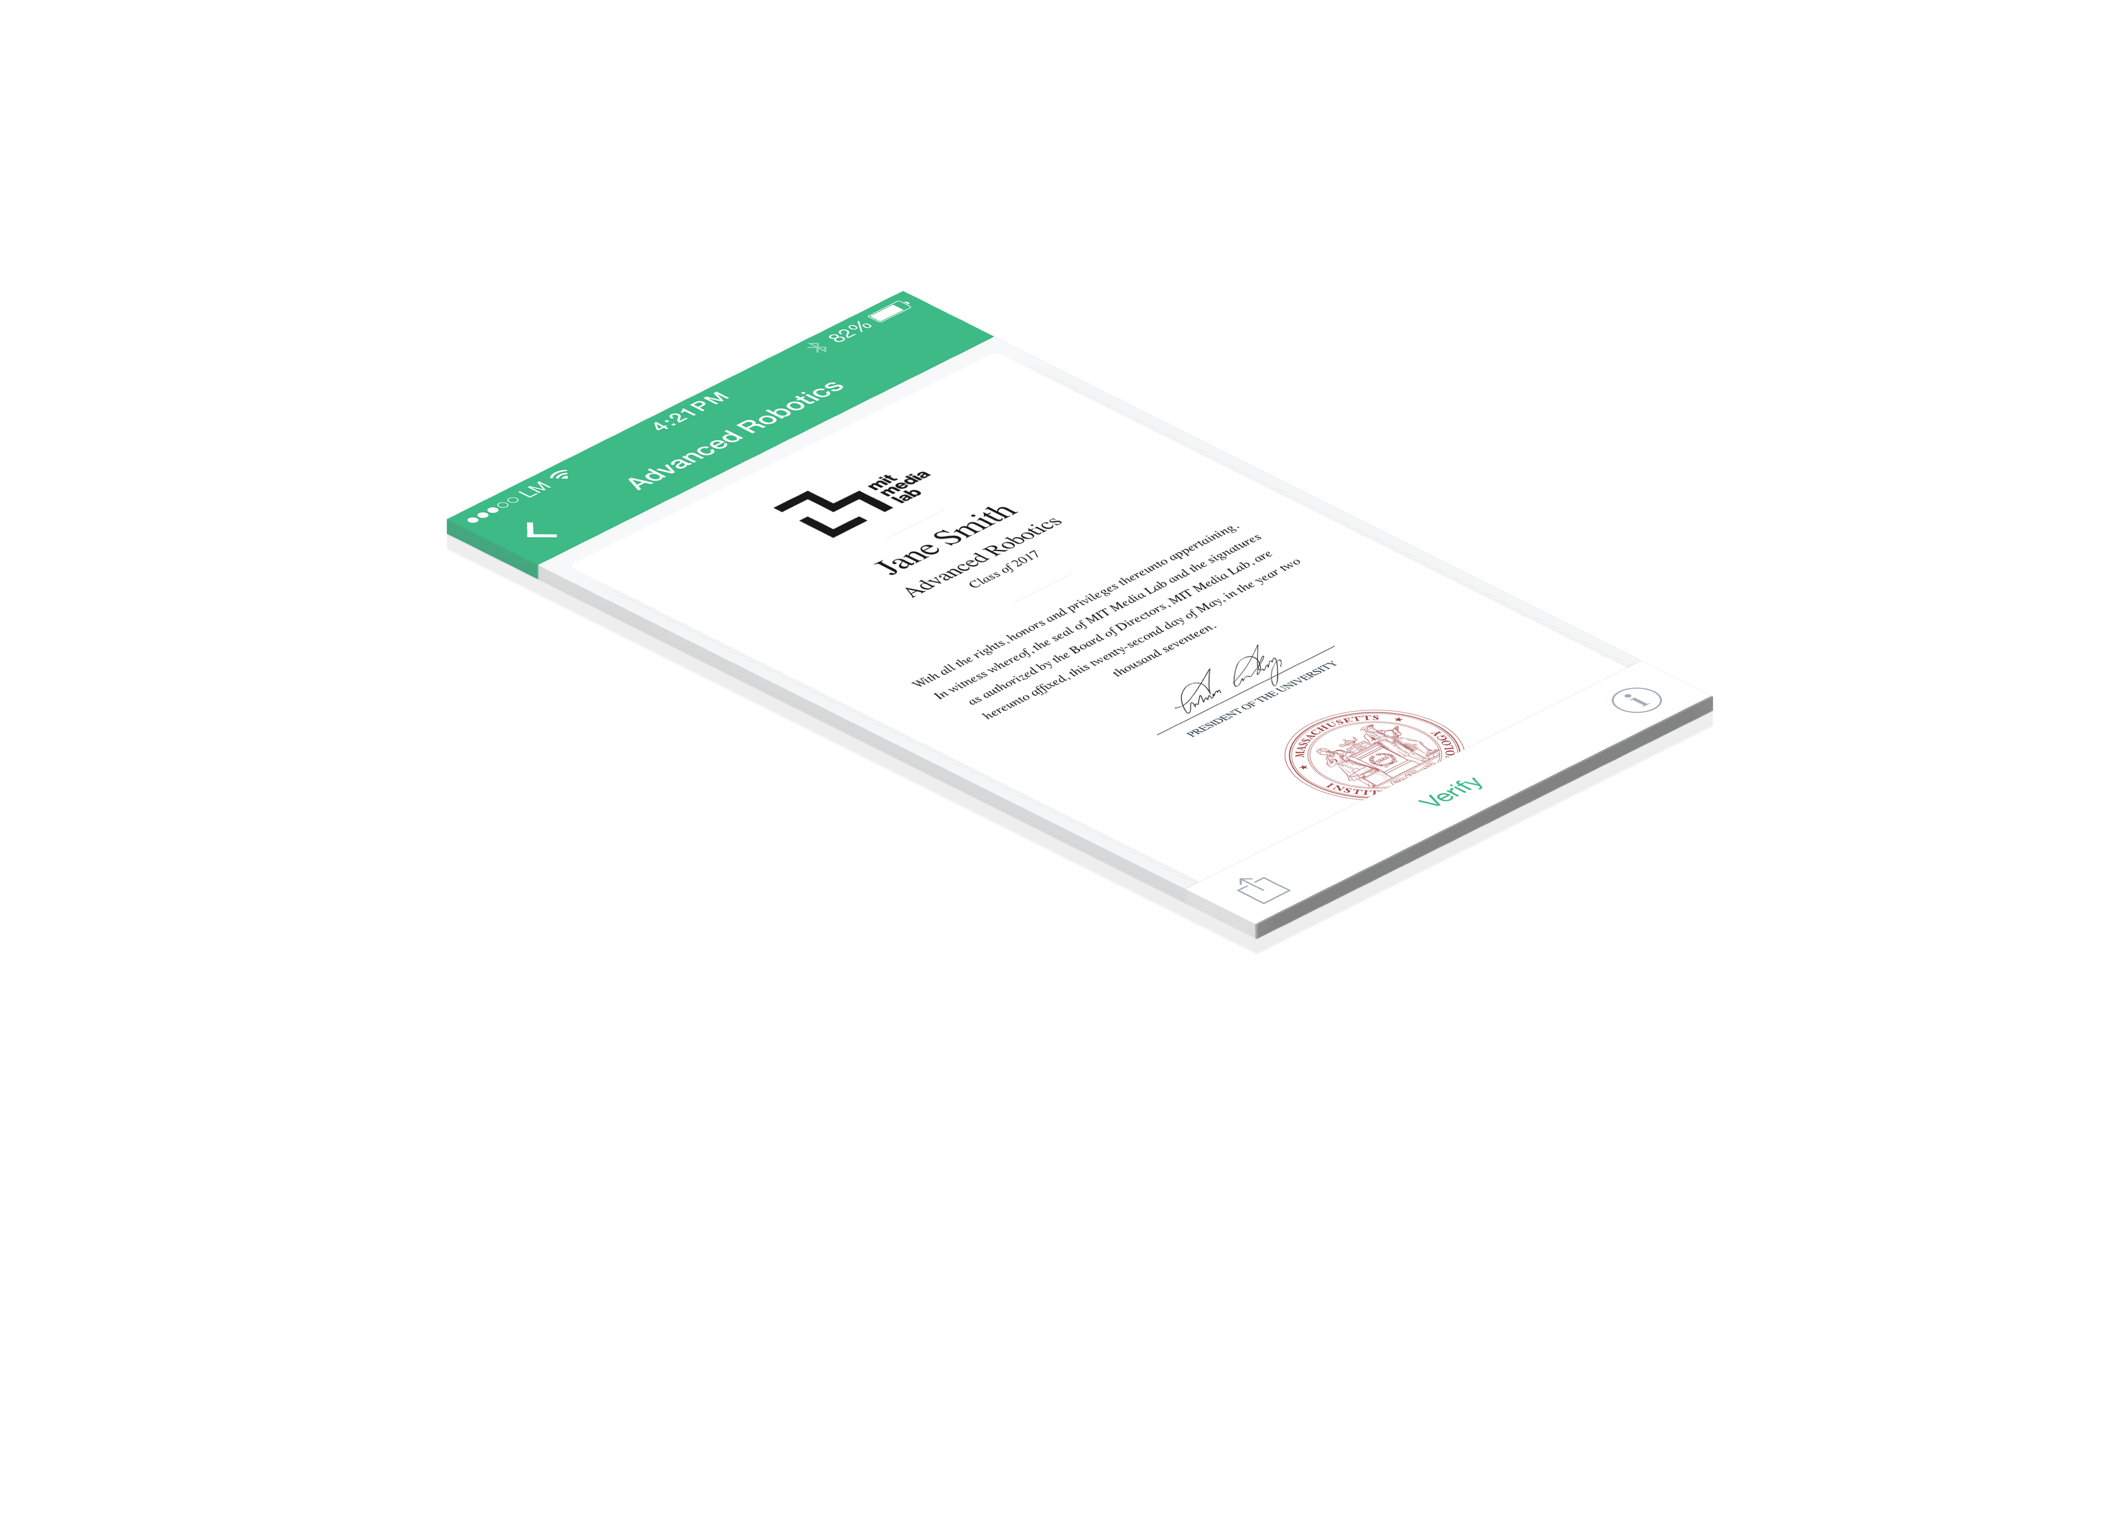
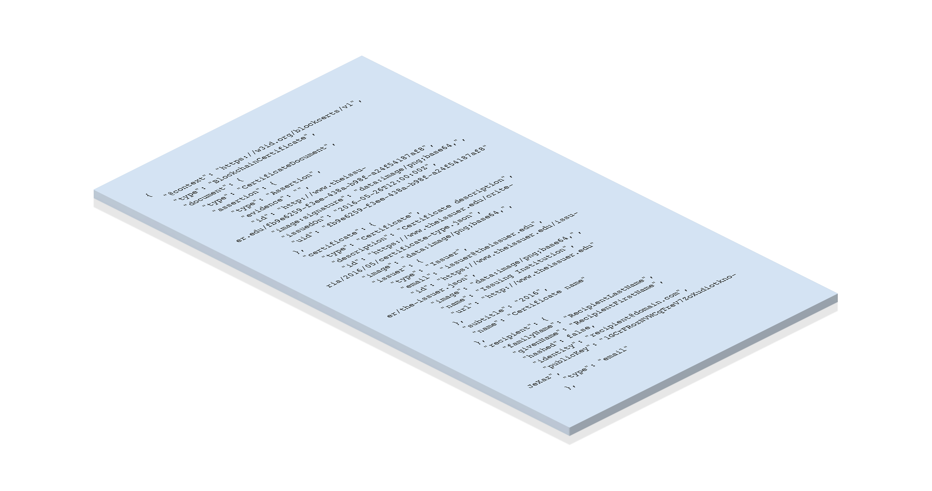
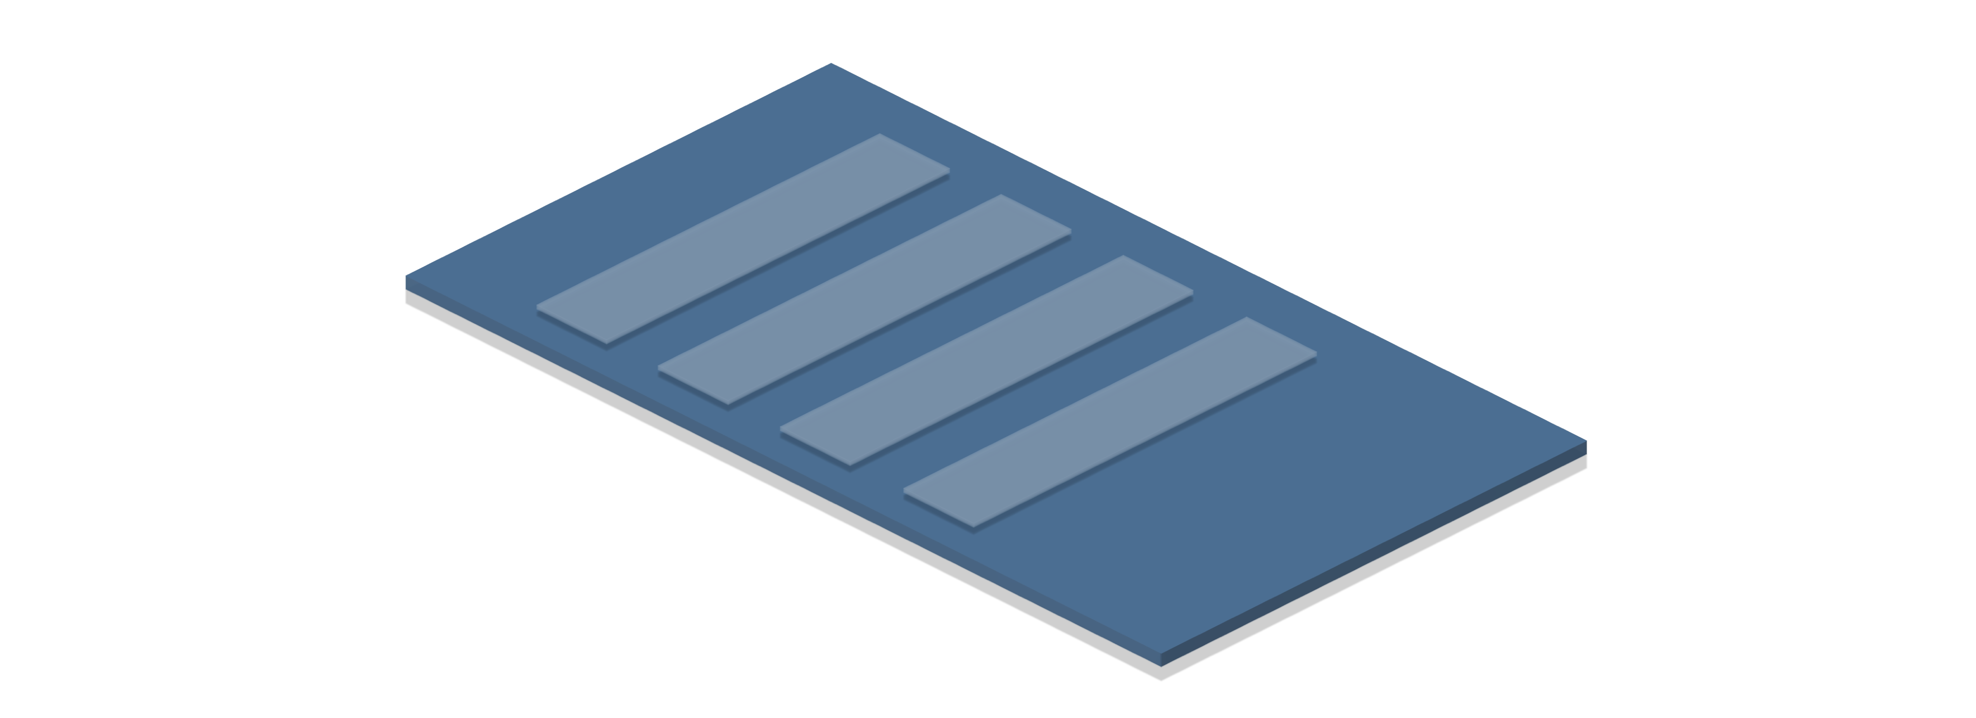
DIDS AND VERIFIABLE CREDENTIALS
DIDS AND VERIFIABLE CREDENTIALS
Verifiable Credentials
DID Auth
Universal Resolver
PRESENTATION
CONTENT
PROOF
DID Method Specs
DID Specification
Verifiable Credential
{
"@context": "https://w3id.org/credentials/v1",
"id": "http://example.com/credentials/9283",
"type": ["VerifiableCredential"],
"issuer": “did:example:xyz9876",
"issuanceDate": "2018-02-24T05:28:04Z",
"claim": {
"id": "did:example:abcdef1234567",
"achievement": “Certificate of Completion”,
"status": ...
},
"proof": { ... }
}
Prove this is your credential
Recover ownership of your credentials, even if you lose your device
Issuer and Subject identified by DIDs

