Slide 2

explores the future of the digital society,
to better anticipate the impact of the use of innovations on privacy and freedoms.

Slide 3
pilots experimentation projects (prototyps, PoCs…)
to better understand emerging digital uses.

Slide 4
creates links between CNIL and actors of the digital society (private companies, public institutions, activists, academics, civil society ...),
to better inform and guide them in the face of new issues linking ethics, freedoms, data and privacy.

Slide 5

The platform of a city
Smart cities, personal data and balance between public and private spheres.

Slide 6
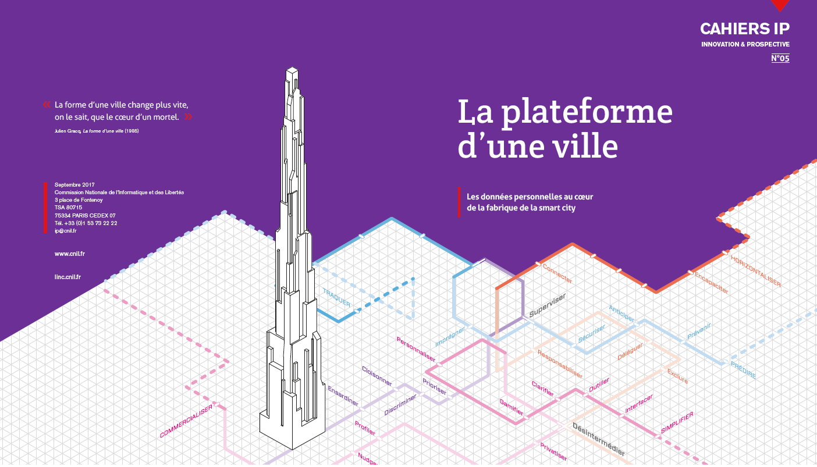

Notes:
RCR
Présentation rapide de la démarche : pourquoi smart city (et pourquoi pas smart city)

Slide 7
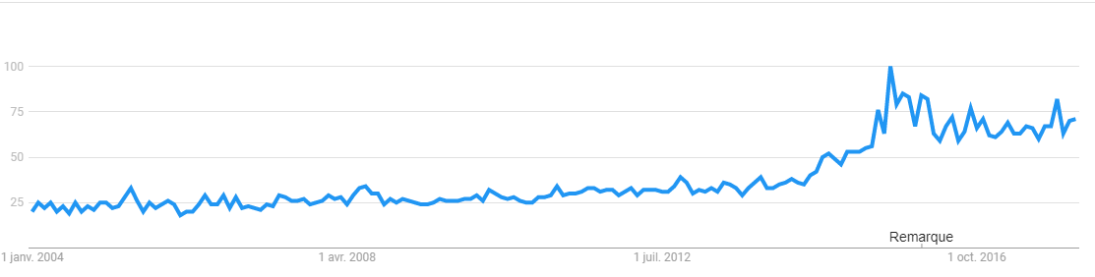
Smart city is a trending topic…
more than 40 000 references on Google Scholars,
16 millions results on Google Search engine,
1 million on Google News,
And a rising trending line on Google Trend for about 10 years.
Notes:
ODY

Slide 8

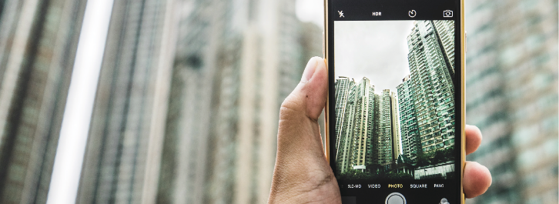
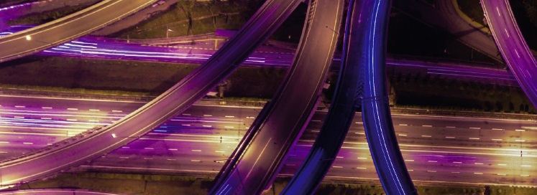


When business models
of platforms
transform the city
Liquid city :
who benefits from the flows ?
Towards an “incognito mode” in the public spaces
Notes:
ODY

Slide 9
The data-vs-service model invades the urban sector with "free" turnkey services.
Local government have become like "sharecroppers" of the urban field.
When business models
of platforms
transform the city

Slide 10
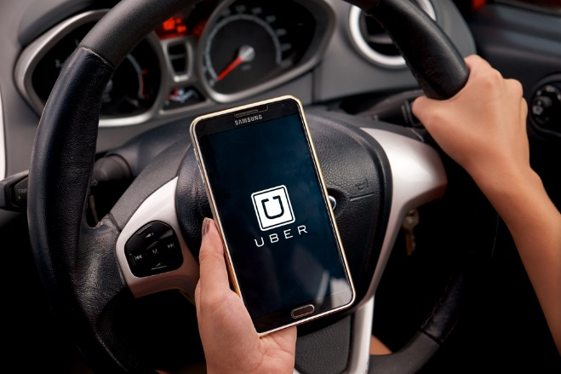


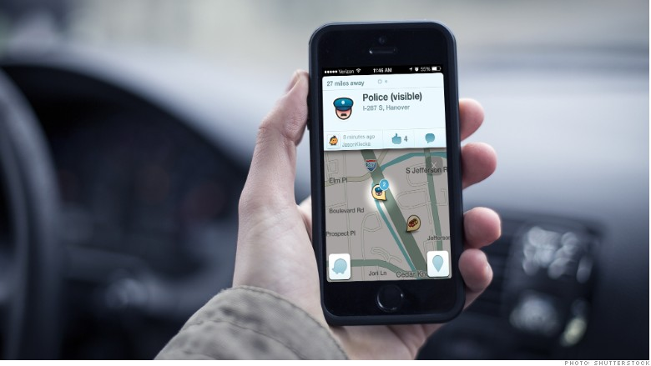
When business models of platforms
transform the city

Slide 11




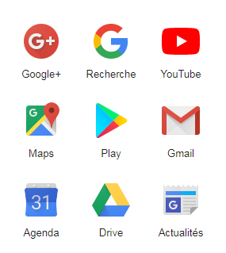

When business models of platforms
transform the city

Slide 12
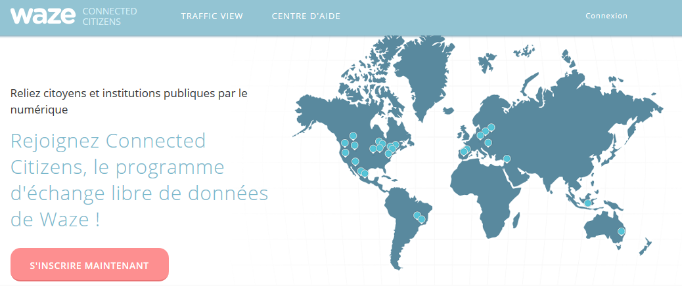

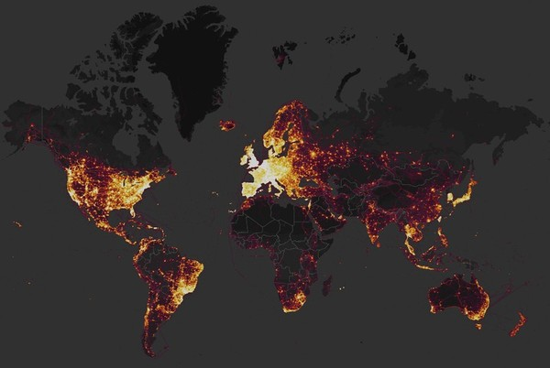
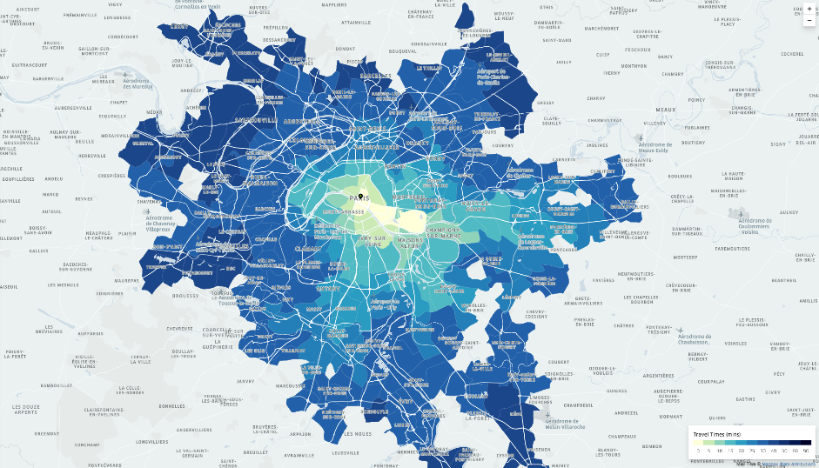
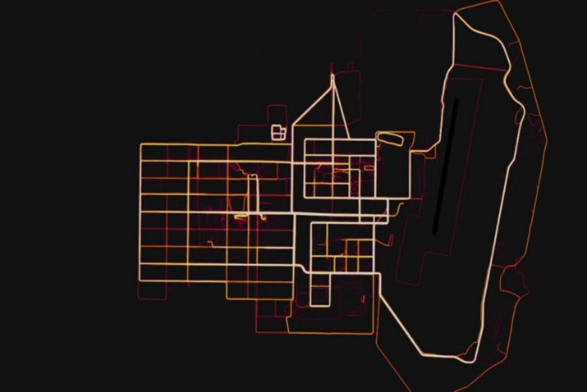

When business models of platforms
transform the city

Slide 13
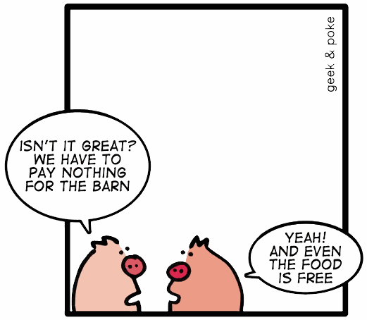
When business models of platforms
transform the city
The hidden side of urban services
What could be the Rousseauist “Social Contract” this kind of privatized cities ?
What control on their personal data will individuals have ?

Slide 14

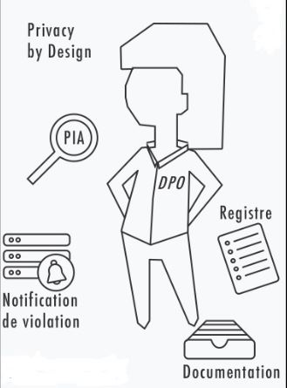

When business models of platforms
transform the city
Targeting criteria
Legal answers : Give back powers to local governements (and individuals) : DPO, anonymization, “extra-territoriality of GDPR”.
Recommandation :
Privacy Advisory Comitte
« territorialité de la personne »
Penalties
4%

Slide 15
The dream of optimizing every flows makes as if the city was a problem to be solved by technology.
The ideal inhabitant of the smart city seems to be either a robot or an AI!
Liquid city :
who benefits from the flows ?
Notes:
GDX

Slide 16
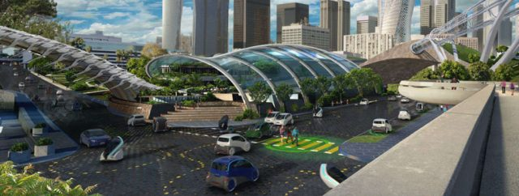

Liquid city : who benefits from the flows ?
Notes:
GDX

Slide 17


Liquid city : who benefits from the flows ?
Legal answers : Reintroducing the inhabitant-citizen with his rights and freedoms at the center of the game.
Recommandation :
Organize the return of data to the local governements.
Rights of data subjects
Information,
consent
rectification, erasure,
access,
rectification
+ portability
Portability
Strong link with MyData
Notes:
GDX

Slide 18
  In the connected city, anonymity becomes a privilege.
  Solutions that have not been widely accepted or successful on screen (checkbox, opt-out, cookie banners, incognito mode, etc.) are even less effective in the public space.
Towards an “incognito mode” in the public spaces
Notes:
ODY

Slide 19
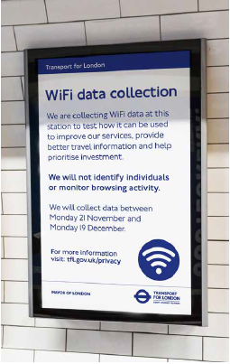
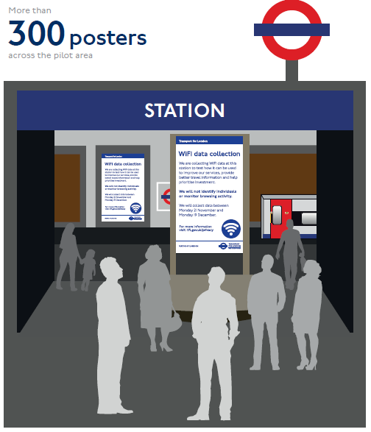
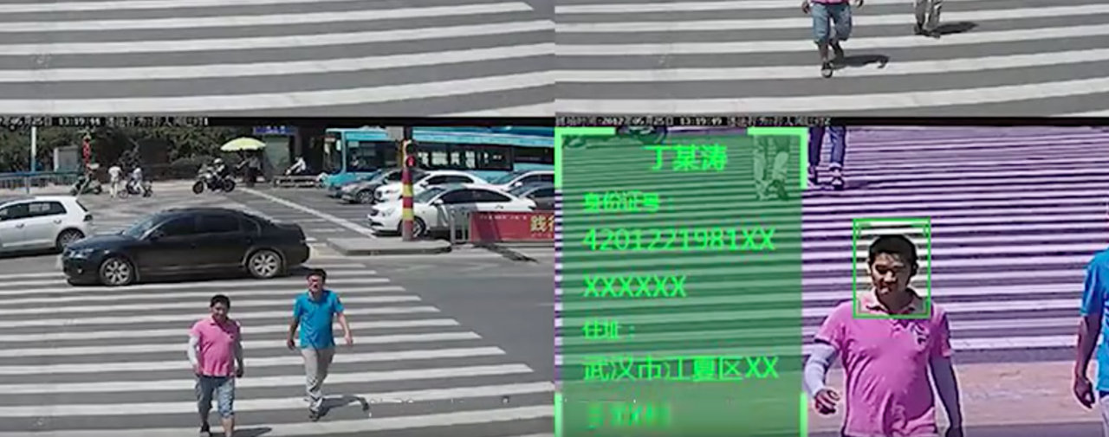
Towards an “incognito mode” in the public spaces
Notes:
ODY

Slide 20

Towards an “incognito mode” in the public spaces
Accountability
Legal answers :
- Encourage better anonymisation
Recommandation :
- Inventing technical features adapted to the urban world: towards a Do Not Track of connected objects.
- Raise capacities of control Ex post by data protection authorities.
Less formalities

Slide 21
Scenarios for data sharing that restore the balance between public and private spheres
  Data produced outside the organic scope of the public service (direct management, concession) would be valuable to fulfill missions of general interest.
  Design data sharing scenarios for public service missions, while respecting the rights of the data subjects.
Notes:
RCR

Slide 22
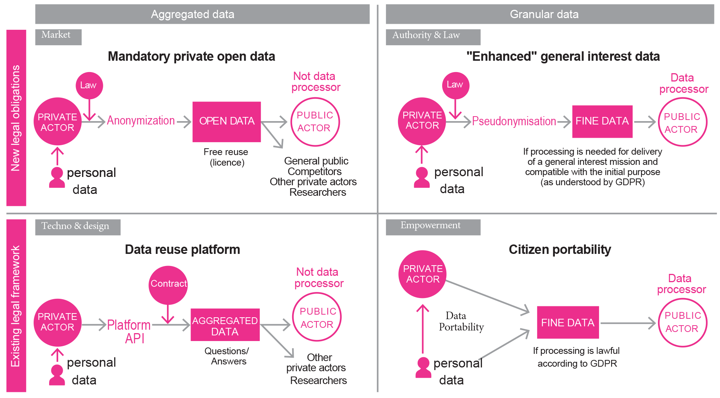
Scenarios for data sharing that restore the balance between public and private spheres
Notes:
RCR

Slide 23
Is on Twitter (@LINCnil) and Github (@LaboCNIL).
Follow us !

