Slide 2

explores the future of the digital society,
to better anticipate the impact of the use of innovations on privacy and freedoms.

Slide 3
pilots experimentation projects (prototyps, PoCs…)
to better understand emerging digital uses.

Slide 4
creates links between CNIL and actors of the digital society (private companies, public institutions, activists, academics, civil society ...),
to better inform and guide them in the face of new issues linking ethics, freedoms, data and privacy.

Slide 5
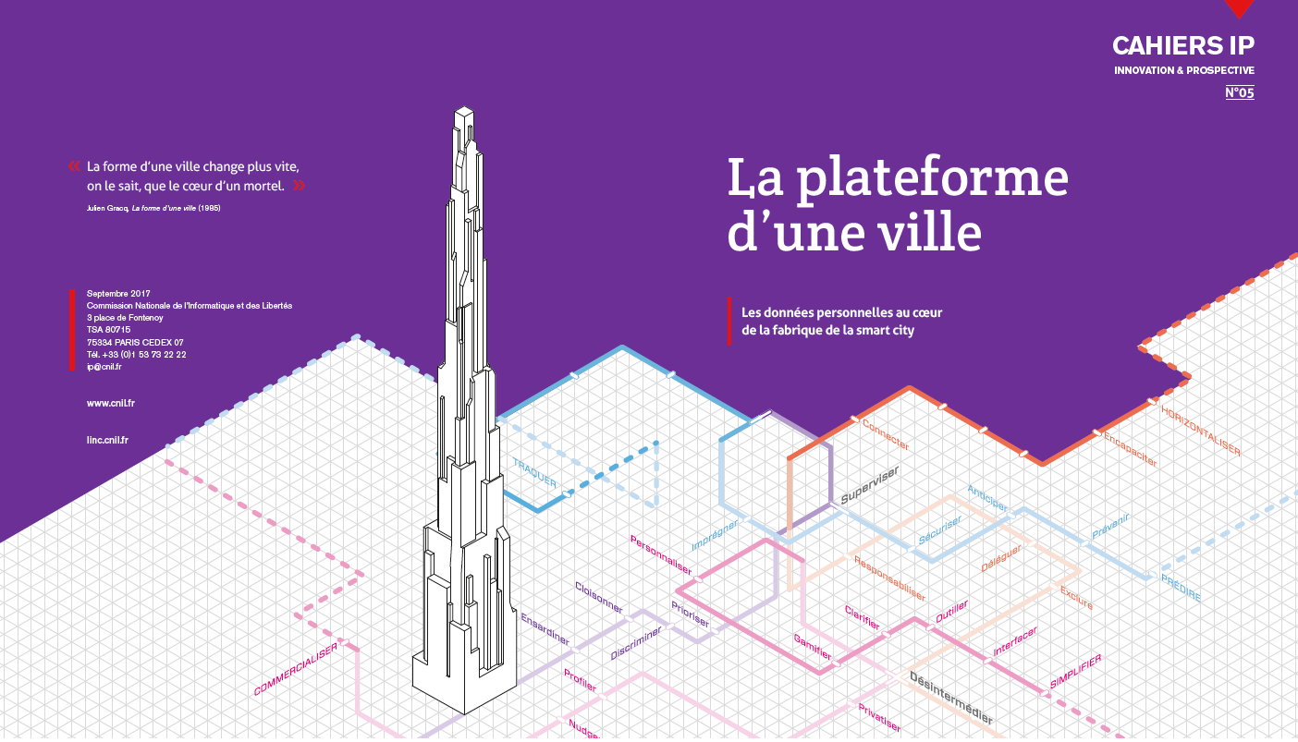
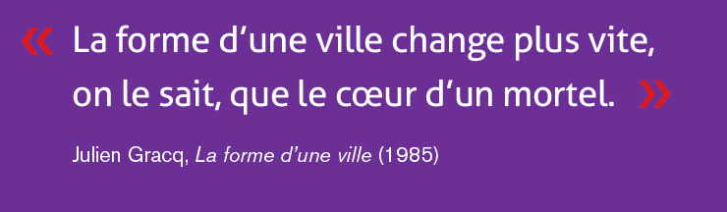
Notes:
RCR
Présentation rapide de la démarche : pourquoi smart city (et pourquoi pas smart city)

Slide 7



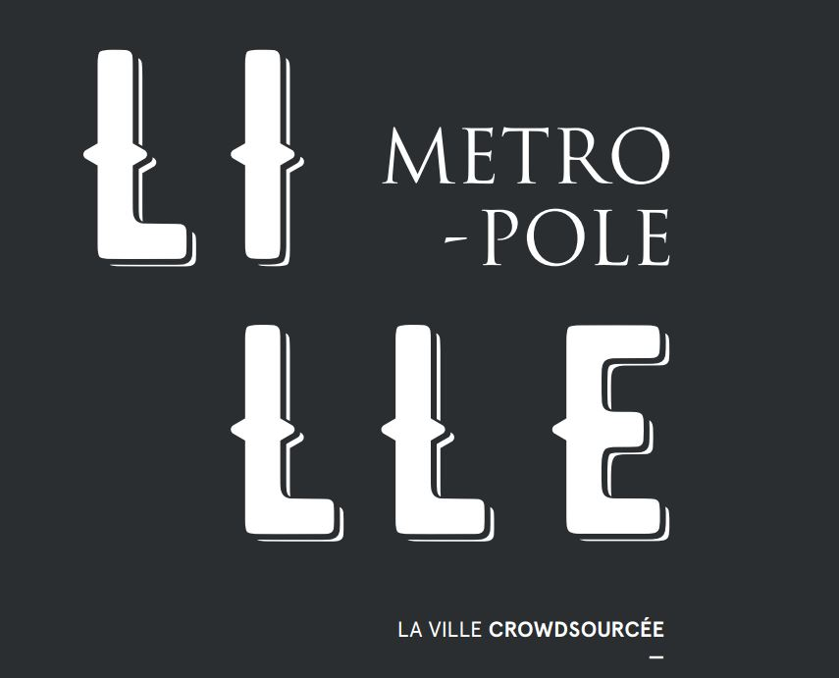



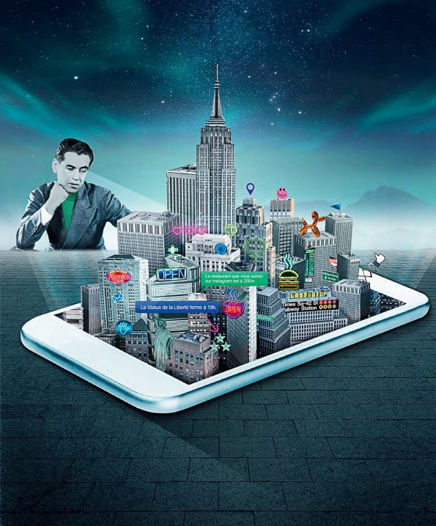


Notes:
ODY

Slide 8
City-as-experience : trip advisor + local government
Backed by the new municipality, CitySense is a not-for-profit initiative aimed at reconciling New Yorkers with their city through the creation of a personal assistant, hosted on smartphone and augmented reality devices. To adapt its services to each one, the platform gathers and crosses the data that it provides - on agreement - its users with the datas collected by the sensors and the APIs of the metropolis. Proactive tool, CitySense anticipates the questions of the inhabitants to offer them relevant and contextualized advice.
From administrative formalities to the latest fashionable restaurant, no aspect of everyday life for city dwellers escapes this concentrated artificial intelligence. "It's time to pay your taxes: how to get there" "Discover the ideal way to Central Park" "One of your friends is around" "Candidates' proposals for the next municipal elections" “at 200 m, a new restaurant with an excellent review published in the New Yorker ".
The city, this gigantic shambles, regains readability and attractiveness - as if CitySense offered the connected urban environment the opportunity to permanently display its best profile.
Much more than a conglomerate of practical services, this model comes to upset lifestyles and the perspectives of its users. By changing the account, the user can project himself into the skin of an inhabitant of another age, sex or socioprofessional category
and live a perfectly new experience
Notes:
ODY

Slide 9
City-as-a-service : tinder + microtasking + gamification of work
In 2027, the capital of Sichuan faces a new challenge: reconnect with the growth and economic dynamism that were his in the early 2010s. To achieve this, the town hall puts on a platform for connecting businesses and residents where everyone can find professional missions to match their skills and ambition.
Pillar of the Chinese business world, the "GuanXi" designates the intermediary of trust indispensable to the meeting of two individuals. Today, it is also the name of a digital service for connecting professionals.
Designed by the city of ChengDu, this new social network facilitates the reception and integration of foreign freelancers. Like a dating site, GuanXi offers a service where service providers are immediately informed of the corresponding calls for tenders, according to the parameters they provide and the criteria provided by companies looking for qualified subcontractors.
The interface uses a gamification process. Supported by augmented reality, the tool gives freelancers professional challenges issued by companies. Equipped with connected lenses sold all over the city, the candidates discover and take up the missions that are proposed to them by the algorithm of the service according to their agenda, their geolocation or their profile, turning into an adventure the activity professional of these freelancers of a new kind. First free, then paid according to the desired benefits (instant translation, data concealment, access to extended profiles ....).
Notes:
ODY

Slide 10
The crowdsourced city : civic bot to « stop » controversies and citizens grumpiness aggregation in a social movement.
At the end of 2027, the inhabitants of Lille discovered the artificial intelligence Marianne Reloaded, a civic bot that strengthened ties between the inhabitants and their elected officials. Basis for a renewal of trust in political life, the model, launched by the private company Civitar, actually emanates directly from the inhabitants of the city who financed and collectively shaped the tool during a crowdfunding campaign.
From now on, citizens can communicate their opinions, complaints and suggestions via instant messaging to the interface. The municipality takes the pulse of its citizens with ease and fluidity disconcerting.
Available on smartphone, the service is also offered in dedicated cabins where it is unveiled in the form of a holographic Marianne to exchange directly with its interlocutors.
By combining the testimonials of the latter with the local administrative data and the information collected by the city's sensors, the community optimizes its decision-making process in real time, anticipating the needs of Lille, neighborhood by neighborhood.
Notes:
ODY

Slide 11
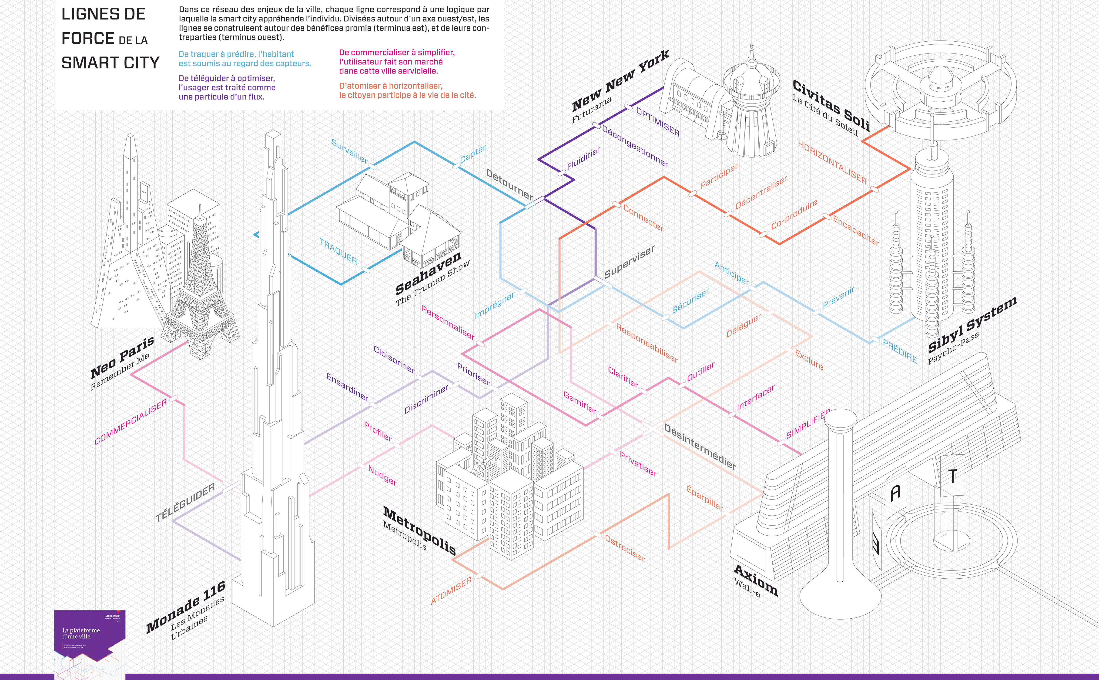
Notes:
GDX

Slide 12
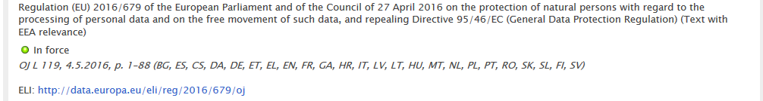
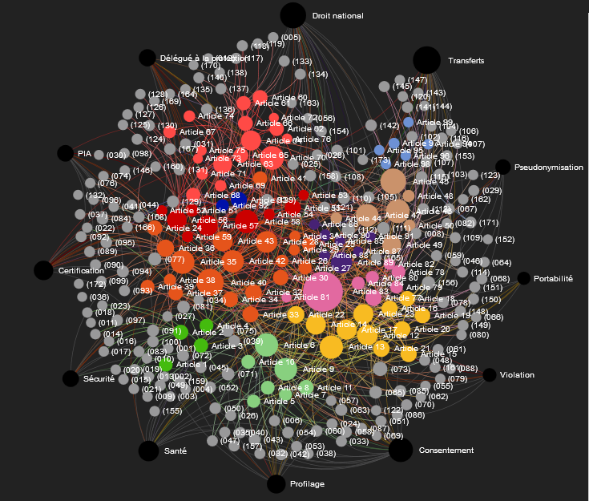
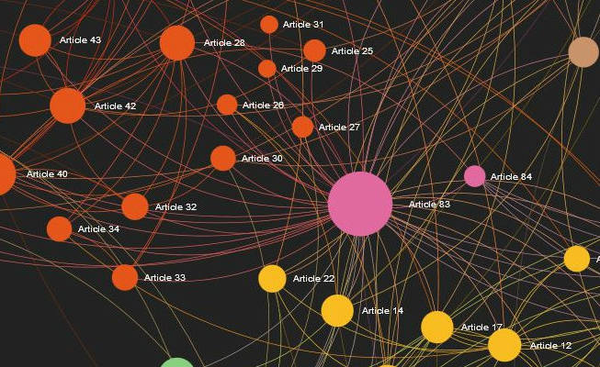
The GDPR : a revolution?
173 recitals
99 articles
61 000 words
400 000 characters
Notes:
Donc RGPD
Heure tourne…
Malgré entrée en vigueur différée pour permettre une bonne préparation…
Mais date pas un couperet pour CNIL ; les régulateurs eux-mêmes s’organisent
Point sur entrée en vigueur des textes nationaux
Il convient néanmoins de se préparer activement en cette dernière phase

Slide 13
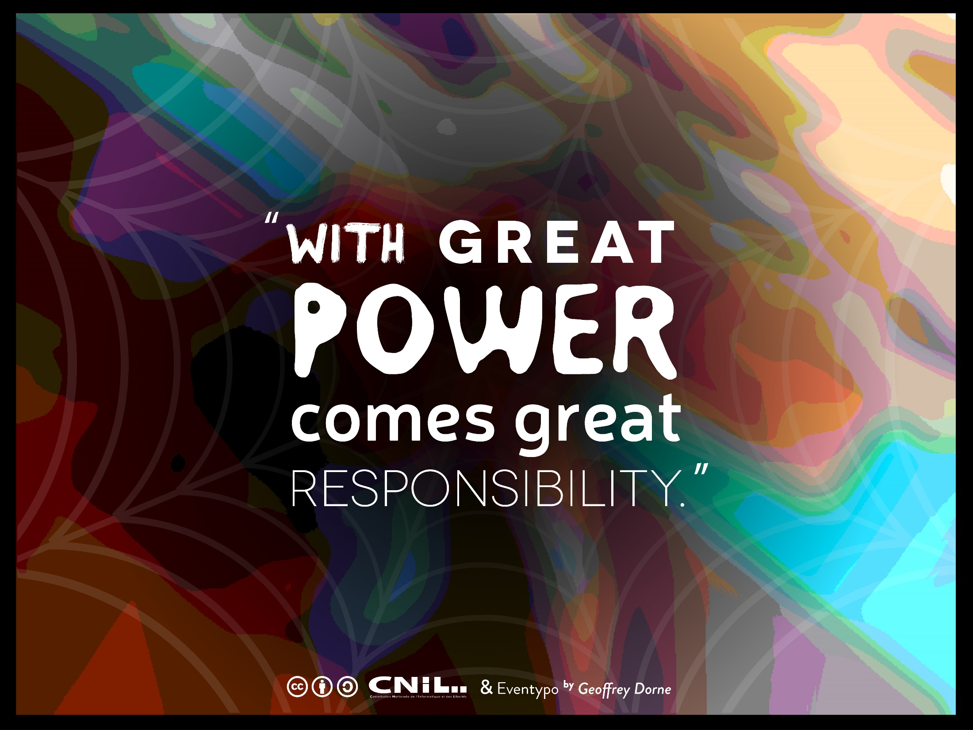

Slide 14
The right to data portability in a nutshell
Basically, portability is about making the personal data "usable" directly by the individual or under his control and at his initiative beyond the control of the controller who collected it.
→ Data controllers don’t “own” personal data.
One of the rare embodiment in GDPR of the « data self-determination principle ».

Slide 15
2 (and a half) rights
A right to receive data
A right to transmit those data to another controller without hindrance
  → (and a right to direct transmission between data controllers where technically feasable)

Slide 16




In practice
Directly share with authorized controller
Share with controller authorized by the data suject
Intermediary
service provider
Provides personal data in a structured, commonly used and machine-readable format
Store data and help
to prove data subject identity as well as data integrity
Data controller 1
Data controller 2
Share
Store
Data subject
Personal storage

Slide 17
Looking at portability with the eye of a foresight practitioner…
I don’t think it’s great because I’m 100% sure it will go in the direction I desire
Great because it makes possible a lot of very different futures…
Show how difficult it is to create efficient empowerment and enhance individual agency.
It takes much more than a provision in an EU regulation : necessary, but not enough…
    Convenience issue
    Usefulness issue
    Technical infrastructure / backbone issue

Slide 18
Plausible scenarios for portability right now
Most probable :
  Vast majority of data controllers don’t believe in the opportunities of portability, only see the risks (churn) and costs (API). Most of them seems to adopt a minimalist « defensive » strategy.
  Convenience and usefulness stays low : not a lot of mainstream use cases, « geek » thing
  But newcomers (for example startups) or activists use portability to create Proof of concepts for their business model or to create transparency in data processings) → indirect « consumer » / « citizen » uses.
  Portability became one of the nightmares of DPO : their bosses don’t want to allow/finance any tool to automate it, and they have to answer manually to complicated requests.
  Big companies try to create sectorial silos in order to « protect the data » ie. to protect their business models and walled gardens.
  Some companies that don’t have that kind of problem / mindset create the technical backbone without focusing too much on the use cases, expecting to create de facto standards (I’m looking at you, data transfer project ☺)

Slide 19
This may not end well…
Not a lot of use cases outside large platforms
Reject/ denial by DPOs and privacy professionals
No « decentralization of data » but
      in fact more duplication
      and more concentration of power

Slide 20
Notes:
RCR
Présentation rapide de la démarche : pourquoi smart city (et pourquoi pas smart city)

Slide 21
Scenarios for data sharing that restore the balance between public and private spheres
  Data produced outside the organic scope of the public service (direct management, concession) would be valuable to fulfill missions of general interest.
  Design data sharing scenarios for public service missions, while respecting the rights of the data subjects.
Notes:
RCR

Slide 22
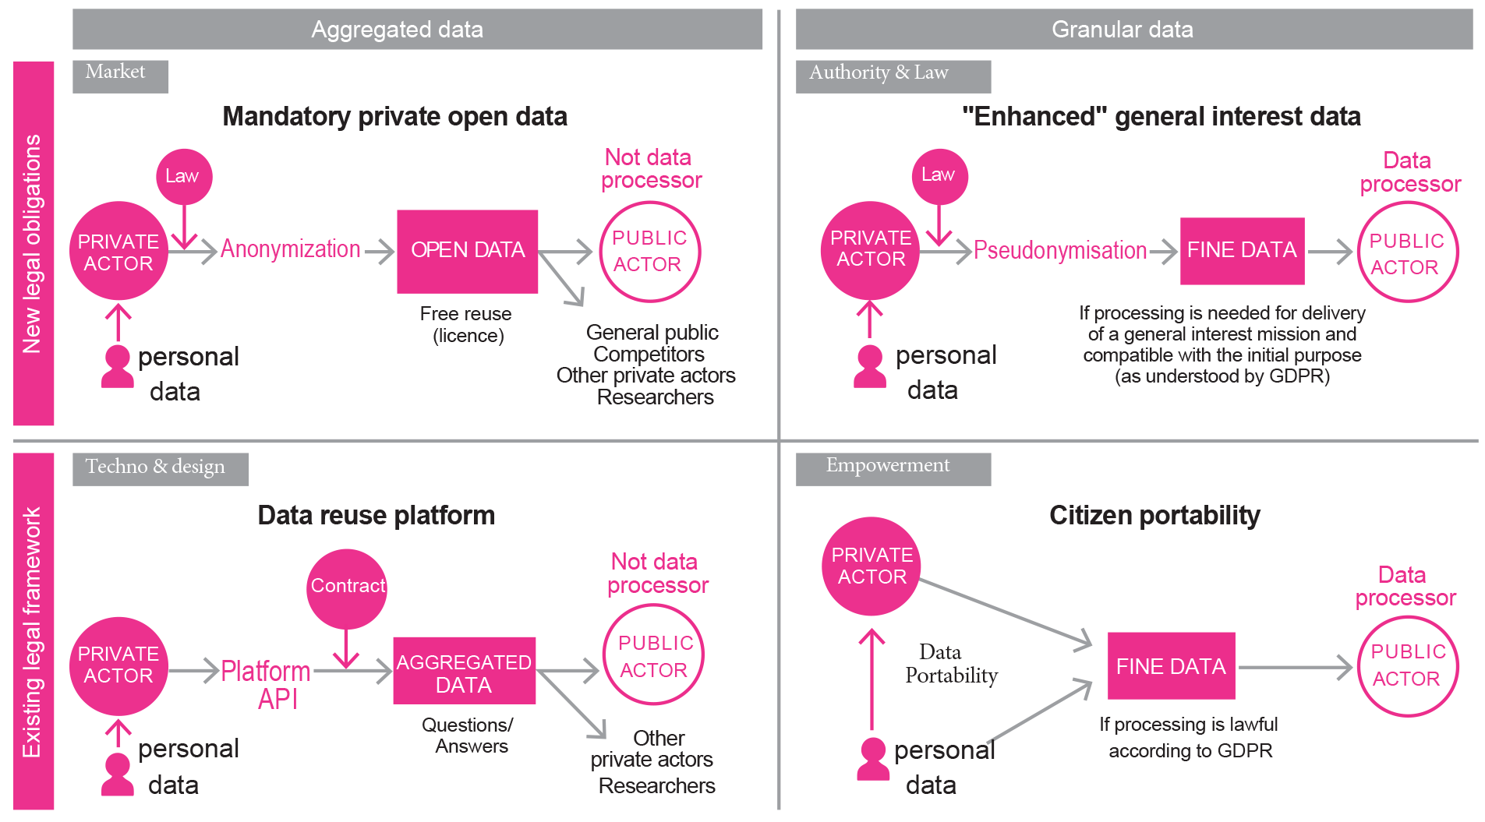
Scenarios for data sharing that restore the balance between public and private spheres
Notes:
RCR

Slide 23
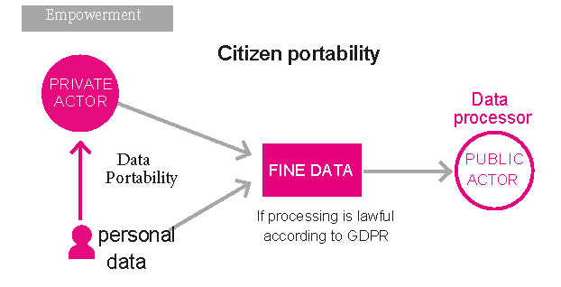
Portability “might also enable them to opt in to citizen portability to beneﬁt general interest missions.
Communities of users could exercise their portability rights in relation to a service in order to provide a public actor with access to their data for a speciﬁc purpose relating to a public service mission. The public actor is then responsible for data processing and is therefore also required to respect the principles of data protection.
Such a mechanism would have the advantage of creating new datasets for use in public service but without imposing new legal restrictions on private actors. The drawback for this scenario is the critical mass required as widespread acceptance and participation will be needed to constitute relevant datasets. The incorporation of simpliﬁed, innovative and non-restrictive opt-in systems should help ramp up participation levels.
In a more future-forward vision, a process such as this could lead to bottom-up creation of an information commons, built by individuals in the general interest. This would entail building governance processes for the information commons, perhaps in the form of publically owned and managed local data corporations.
Notes:
RCR

Slide 24
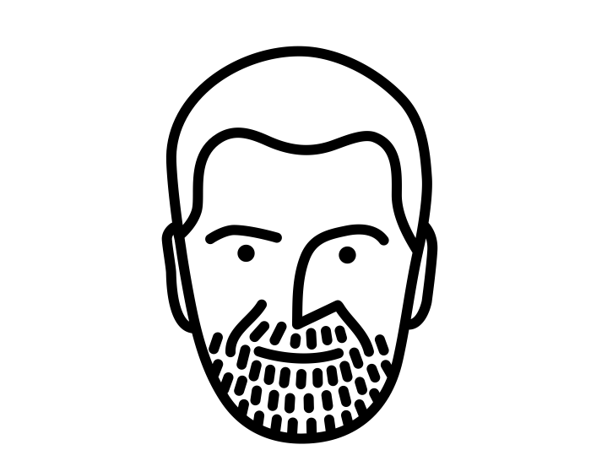
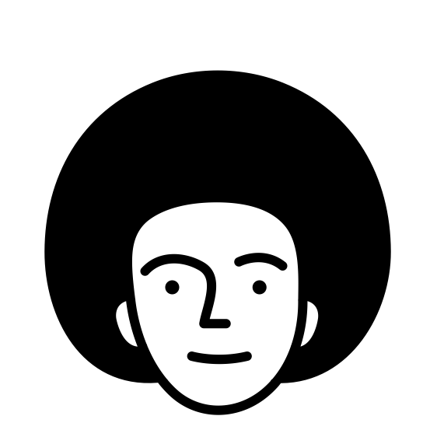
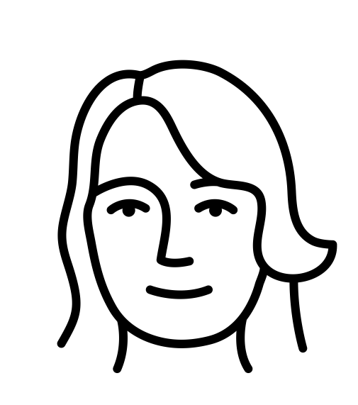
A scenario for data commons : my+our data
(Valérie Peugeot) « develop a sphere of data in common, that is to say of data which can be considered as a collective resource, and which do not enter the regime of the goods managed by the public authorities stricto sensu, nor in a regime of market. This system of Commons relies on a management by a community of the resource considered, which organizes its rules of governance, relying on a "bundle of rights".
We’re in 2025, in Helsinki. Citizens can share several types of data with different actors for general interests purposes, or purposes that fit with their personal values
Antti shares sensitive health data (that includes behavioral, sensors and genetic data from various sources) with researchers, because members of his family have encountered this issue. He is heavily involved in the governance of the research, not only by giving data. The data is shared with researchers through a not-for-profit technical infrastructure audited by public institutions
Sille participates in a local self-consumption project : food and energy are produced and used locally, and each participating building is equipped with a personal cloud system where data is stored. A system of APIs and some edge computing / AI makes it possible to fine tune the supply and demands without ever centralizing the data
Salla shares geolocation data from Uber and her telco operator with Helsinki transportation department for urban planning (new stops for ridesharing cars, new bike lanes) in a locally-owned data corporations governed by the city council and a board of users. Helsinji city don’t have the right to reidentify her or use the data for anything else
Personas by Yu luck from the Noun Project CC BY
Notes:
RCR

Slide 25

http://linc.cnil.fr
@LINCnil
@geoffdelc
Merci
Thanks
Kiitos

