Slide 1
Data portability in practice
« Where are we after 3 months ? »
MyData 2018
Helsinki, August 29th 2018

Slide 2
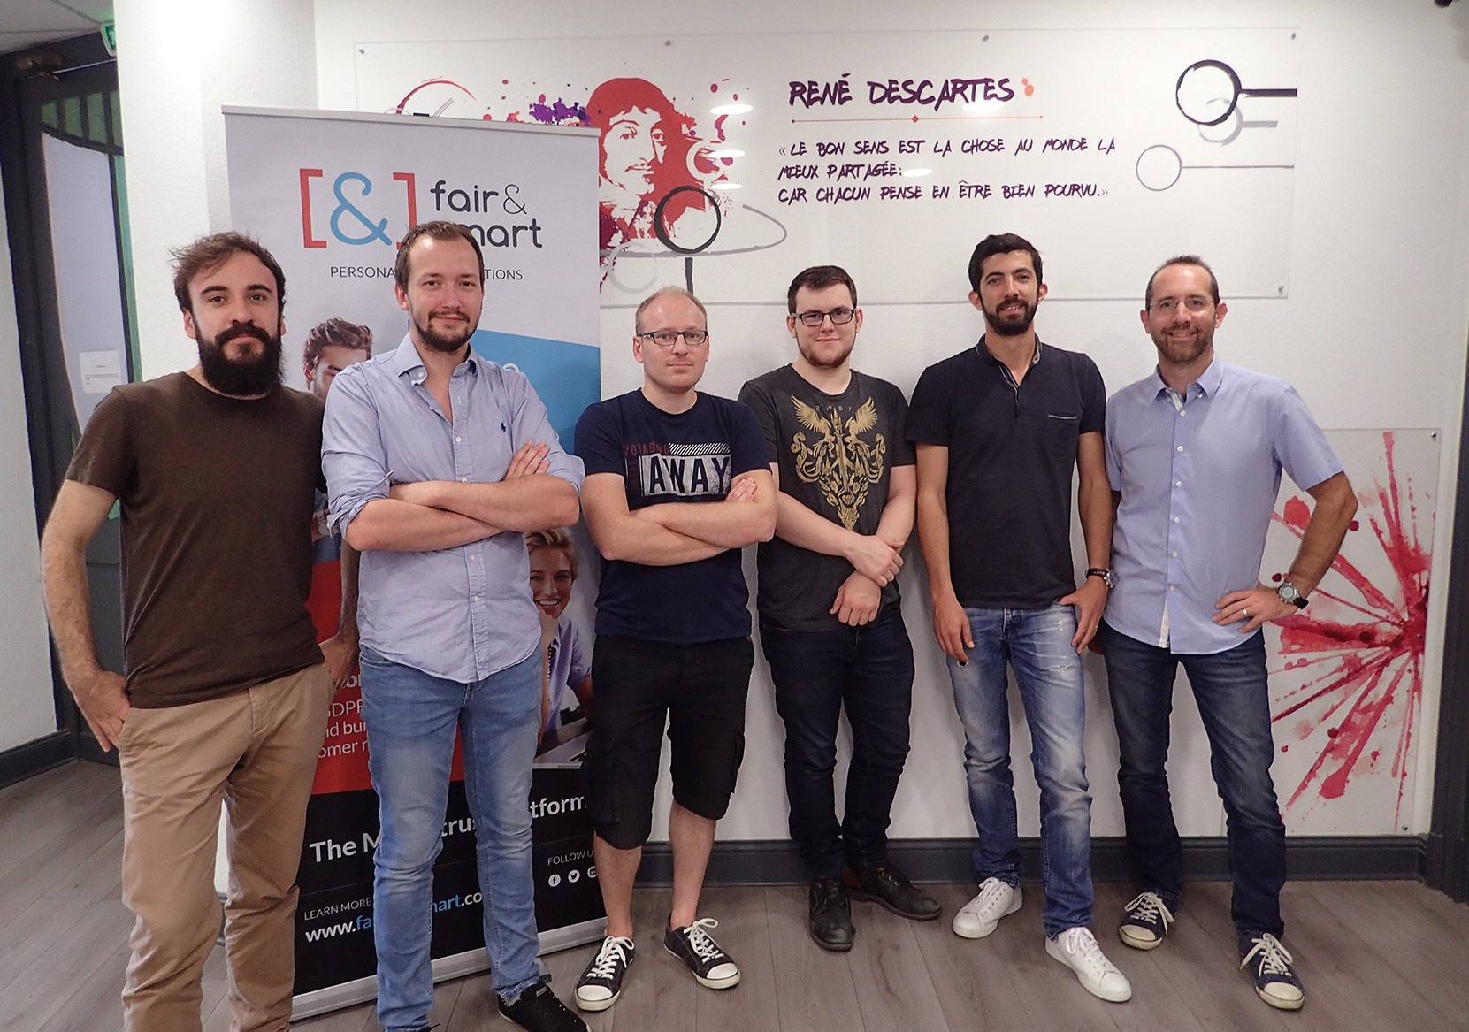
Who are we?
FAIR AND SMART
French company (SAS) founded in 2016
Software company specialised in personal data solutions
Dedicated to offering premium experience in B2C data interactions
Seed funding : 1,05M€ closed in February 2018
Team (08/18) : 8 employees + 2 consultants (France & Luxemburg)
3 Products :
B2C :
PIMS : Personal Data Store – GDPR Rights Enforcement Tool
B2B :
GDPR Rights Requests Management Tool
Consent Management Suite
Institutional
R&D

Slide 3
Right to Data Portability : back to GDPR Article 20
(…) the right to receive the personal data (…) in a structured, commonly used and machine readable format
(…) the right to transmit those data to another data controller
(…) transmitted directly where technically feasable
Portability is Human-centred
Portability is not EDI or 3rd party data sharing

Slide 4
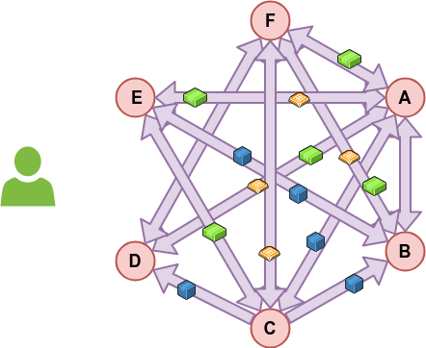
A pure data controller to data controller approach may lead to more problems
Less control
More data widespread
Expensive
Enhance data concentration
Distort competition

Slide 5
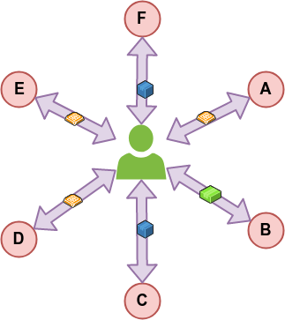
The « hub and spokes » model : simple & efficient
Human-centric
Transparent
Fair for all
Unleash all the potential of value creation
From « Data subject » to « Data actor »

Slide 6
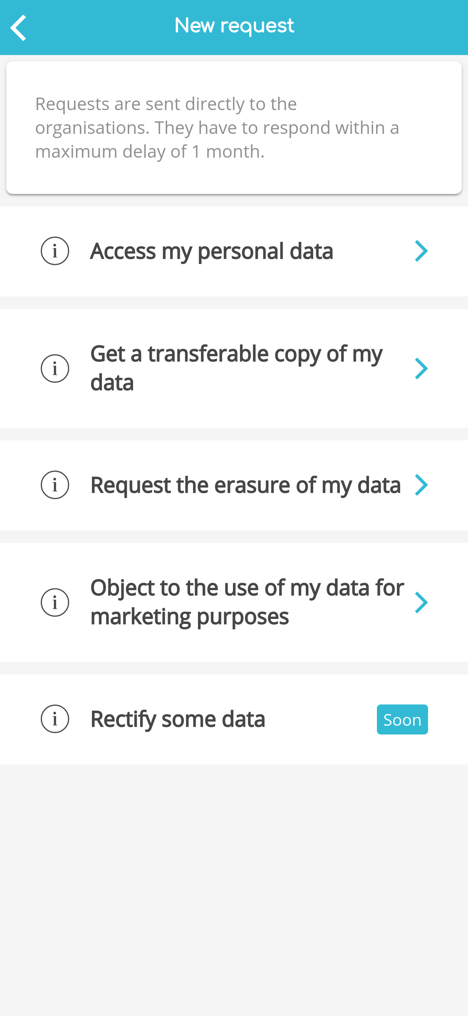
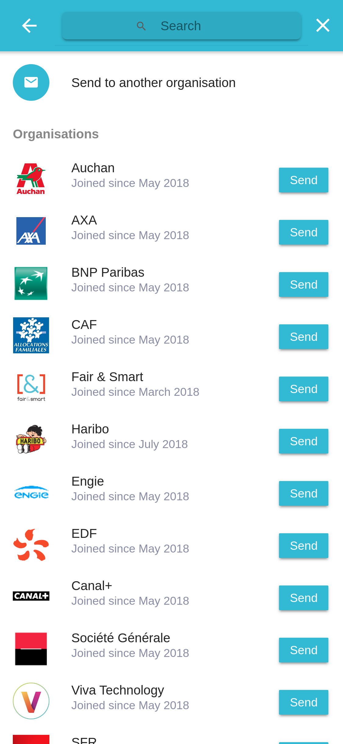
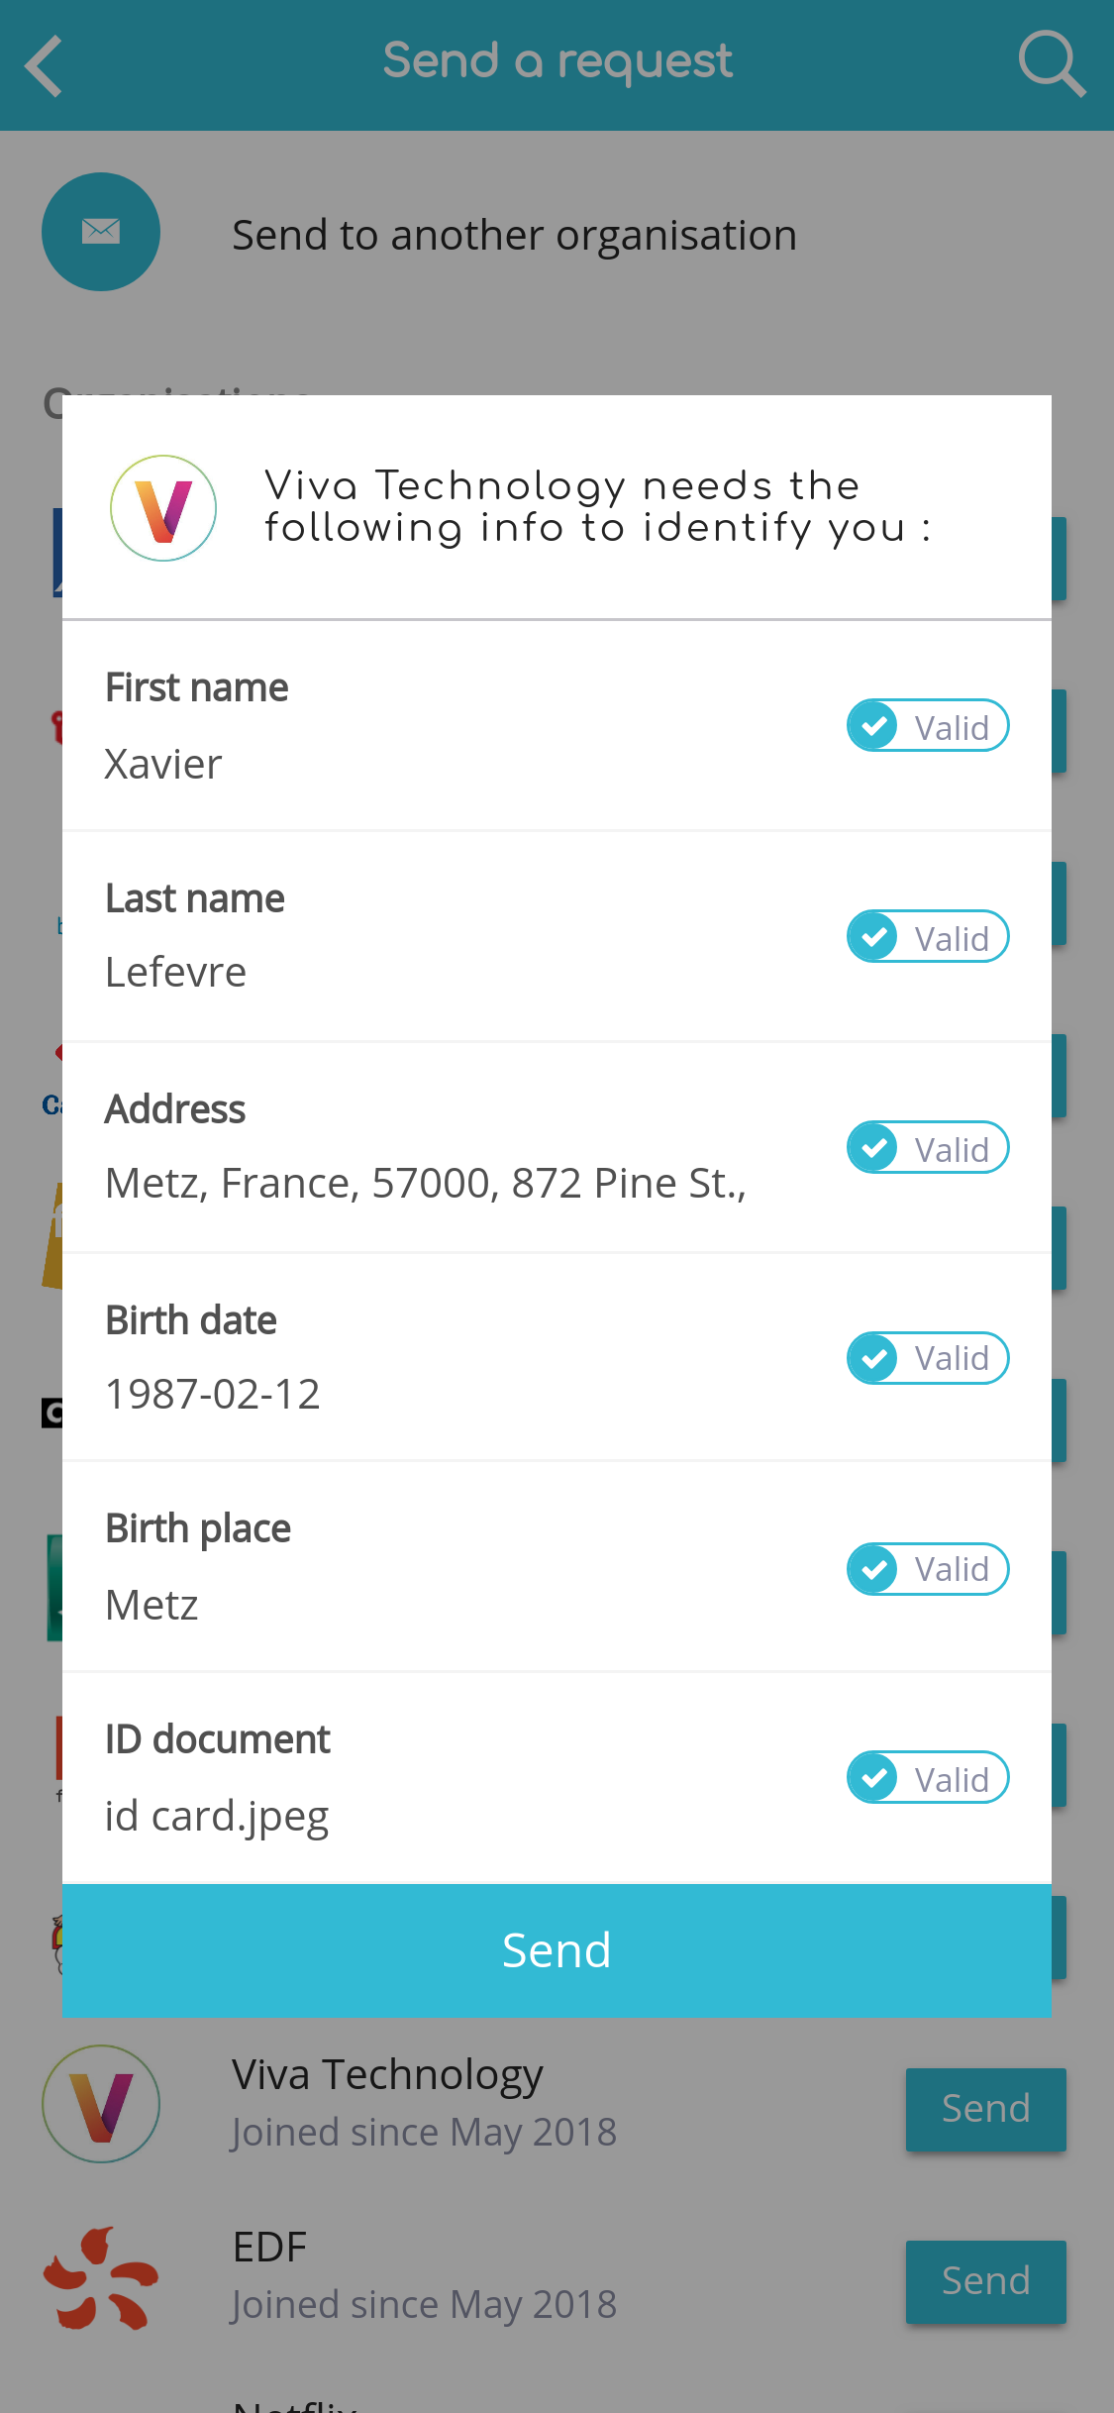
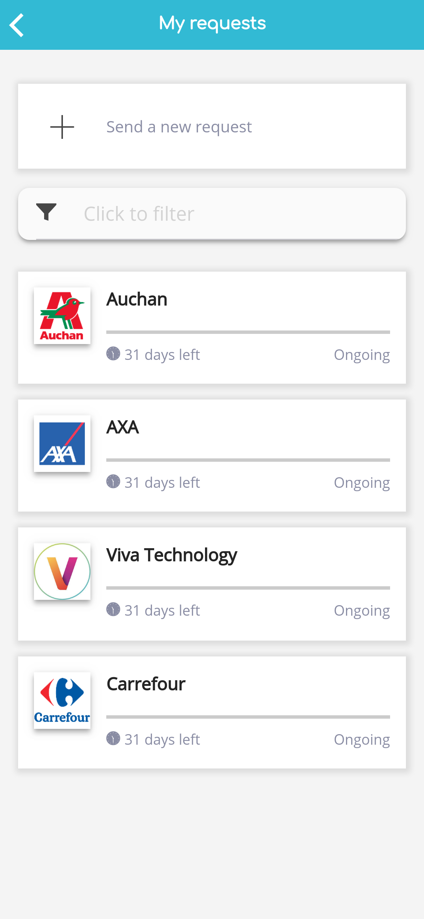
Right to Data Portability : even when easy and simple…

Slide 7
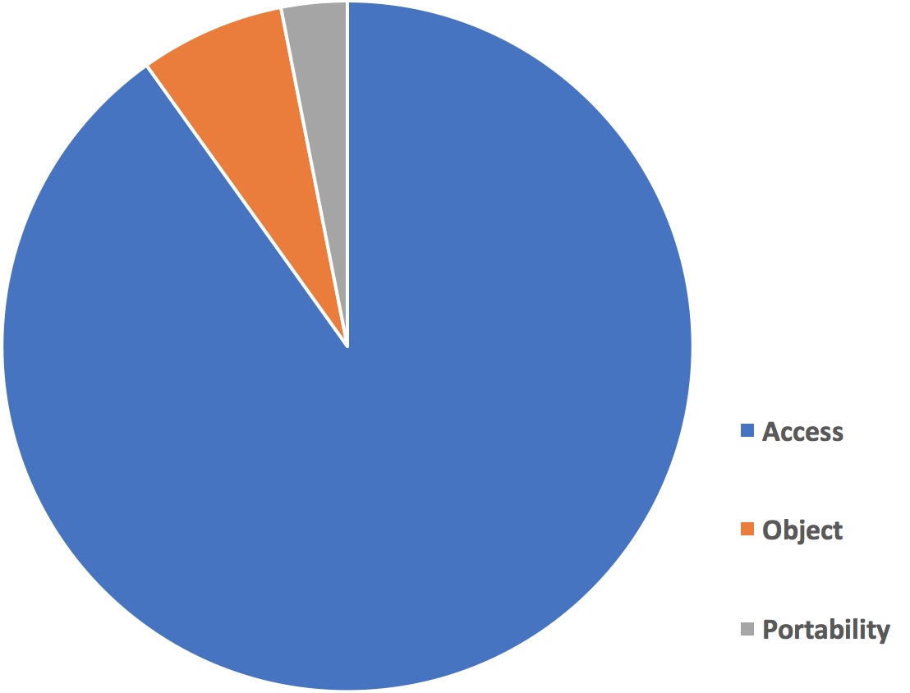
…Data Portability requests are really few : first lessons learned
Only 3% of the requests sent
Unknown by the individuals
« Pointless »
56% of people in France say they are not aware of their rights on their data (Source : ifop 04/18)
Attractive initial value proposal
Source : fair&smart – July 2018
Notice : 0 erasure request
Notes:
Even made very easy, portability requests only account for 3% of all requests sent. A lot of information towards people is still to be provided. Portability « alone » does not make sense, it needs a reason. > An attractive initial value proposal is crucial to trigger a portablity request.

Slide 8
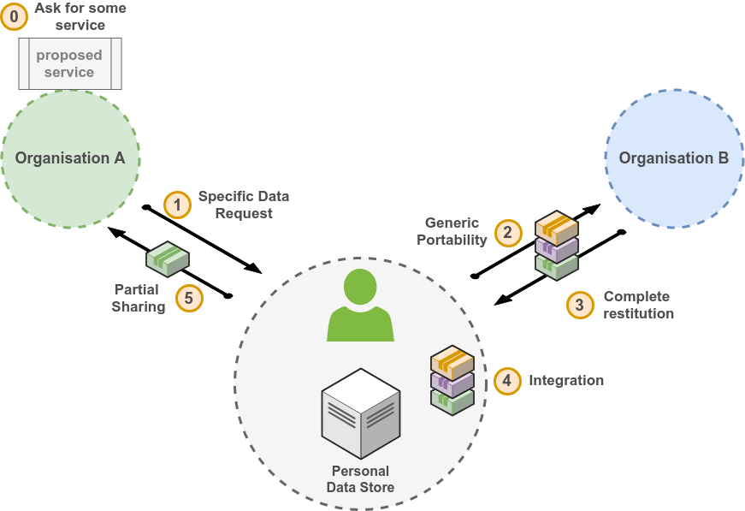
Right to Data Portability in practice: the initial value proposal is key
No API
Selective portability ?
Huge heterogeneity (when replied)
Fee for repetitive requests ? (Art.12)

Slide 9
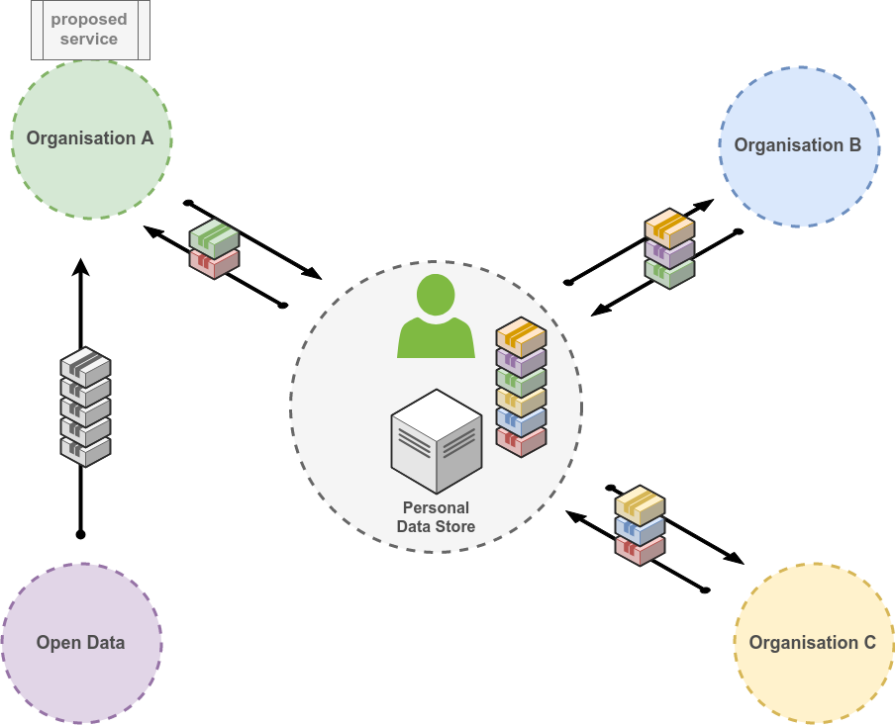
Human-centric approach allows compliant data portability and fosters innovation
Compliant pre-processing under the control of the individual
(convert – select – transfer)

Slide 10
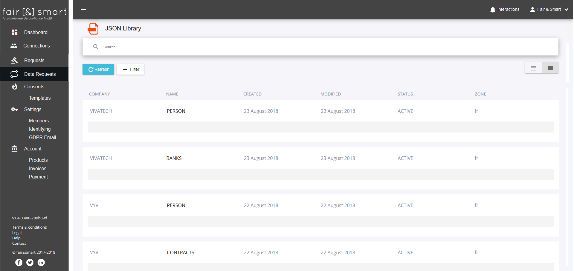
Waiting for interoperability and standards : a pragmatic approach
Notes:
At fair&smart, we convert everything into json. Little by little, we are building a json library with the structure and exemple datasets of more and more data controllers. We make this library available to other data controllers to select the appropriate data they need from one or more data controllers and prepare a data request to the individual.

Slide 11
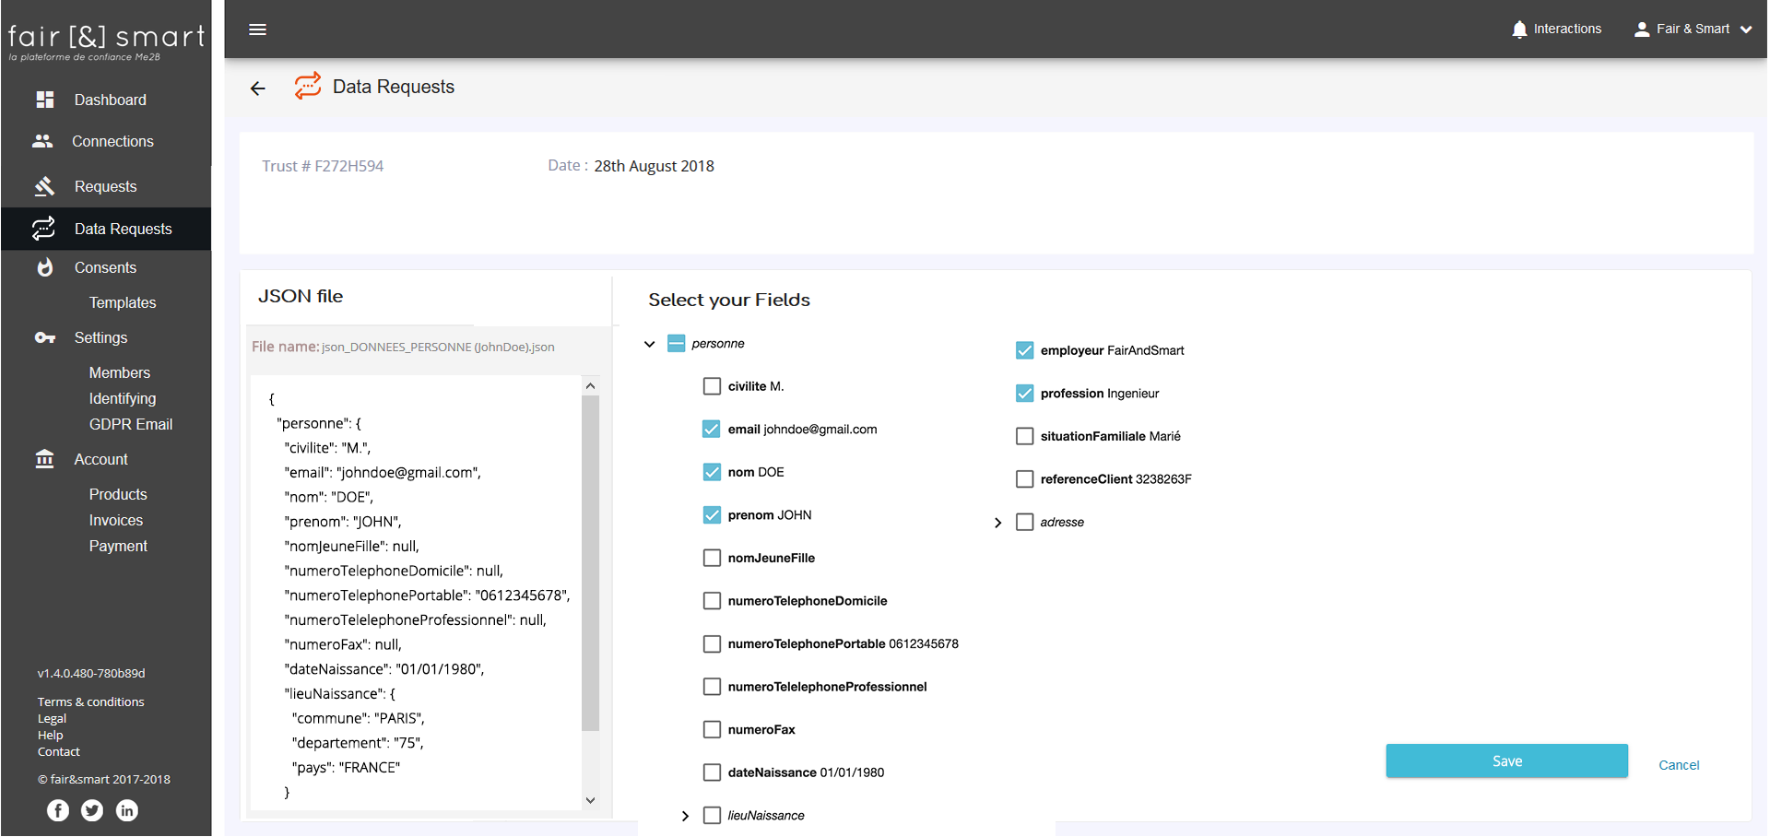
Data minimization compliance requires selective data requests
Notes:
We work on different methods to select data like jsonPath or semantic annotations (RDF based using schema.org or foaf)

Slide 12
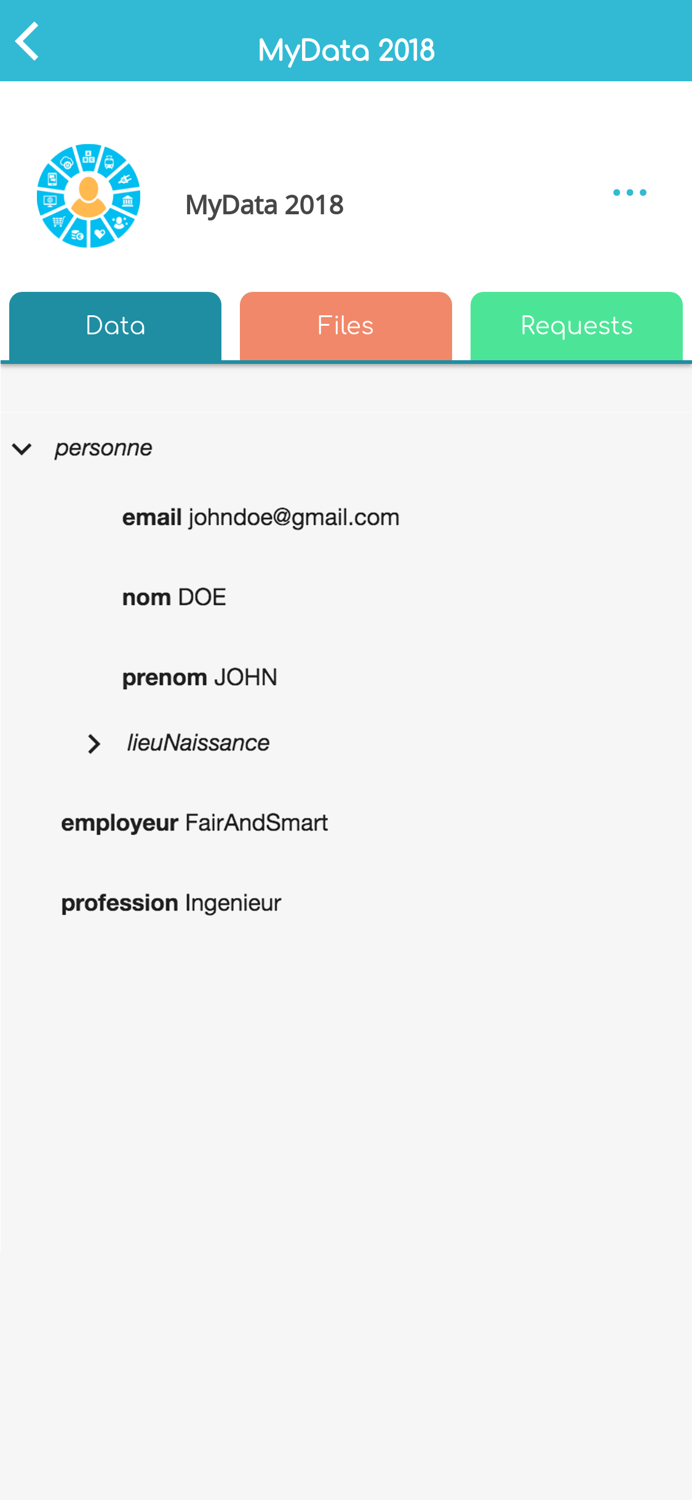
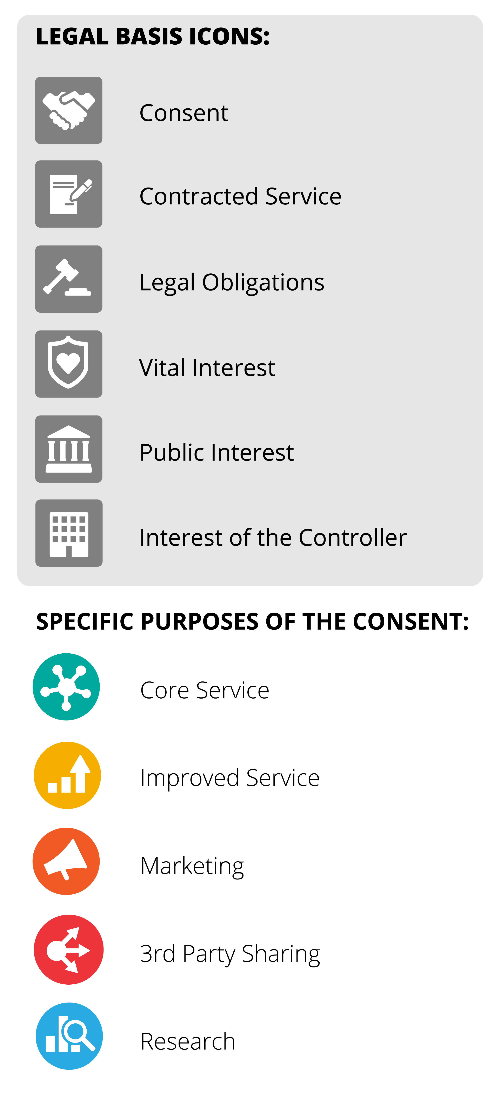
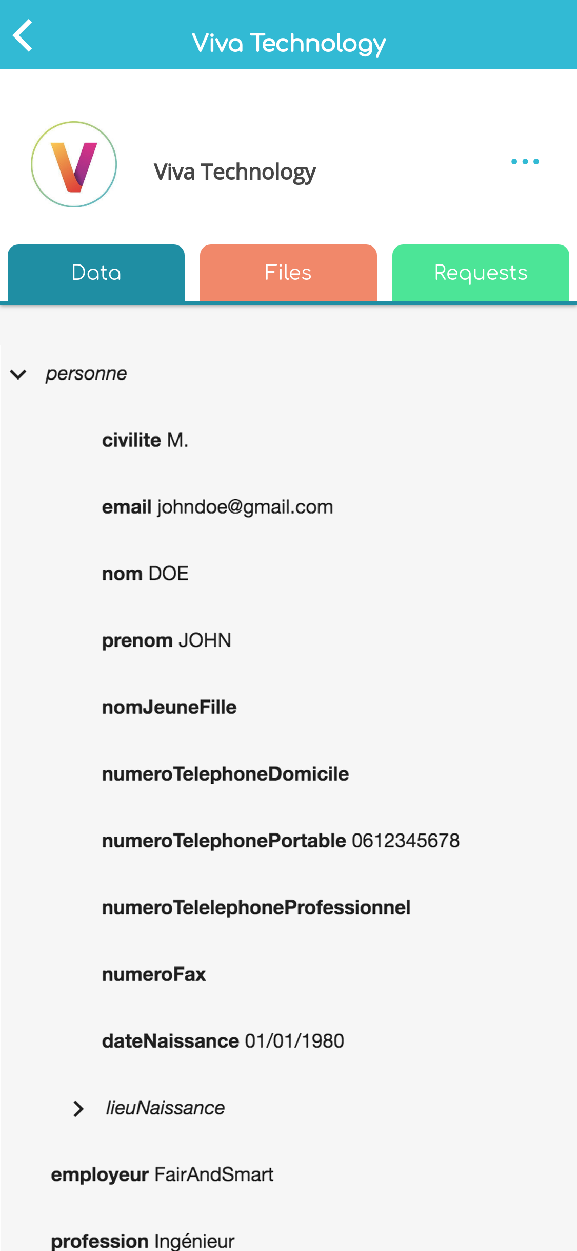
Auditability & full transparency for the individual
Source : Open Knowledge Finland
Notes:
If the data request is accepted, we keep track of all transfers and give the individual a clear view of what data has been transferred to whom and what for.

Slide 13
How to make it a good and compliant experience ?
Transparency (information & explanation)
Regular feedback (acknowledgement… more a conversation than a workflow)
Auditability (hash & timestamps)
Appropriate Security
No email attachment
Download link with secure code
Encryption
Coming next :
“How Human-centric data portability enabled the design of innovative value proposals.”

Slide 14
Thank you !
Contact : Xavier Lefevre
Email : xavier.lefevre@fairandsmart.com
Mobile : +33 6 14 69 78 74
Twitter : @fairandsmart

