Slide 1
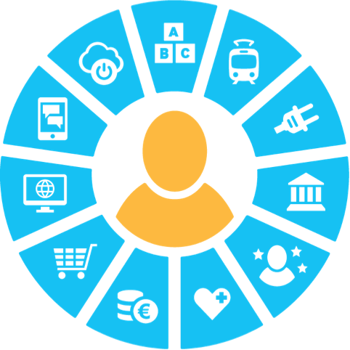
Algorithmic fairness meets the GDPR
How the GDPR helps us fight algorithmic biases
Jussi Leppälä, August 2018

Slide 2
Content
Fairness in the GDPR
Group fairness
Algorithmic discrimination and fairness paradox
Conclusions

Slide 3
Definitions of fairness
Algorithmic fairness often refers to non-discrimination of individuals
Directive 2000/43/EC^{[1]}, Race Equality Directive:
“direct discrimination shall be taken to occur where one person is treated less favourably than another is, has been or would be treated in a comparable situation on grounds of racial or ethnic origin;”
“indirect discrimination shall be taken to occur where an apparently neutral provision, criterion or practice would put persons of a racial or ethnic origin at a particular disadvantage compared with other persons, unless that provision, criterion or practice is objectively justified by a legitimate aim and the means of achieving that aim are appropriate and necessary.”
Other laws define other attributes
Fairness can also have wider interpretations:
GDPR appears to use a broad definition but recital 71 also talks about non-discrimination.

Slide 4
What is algorithmic discrimination?
General definitions can be applied. Avoiding
direct discrimination can be straightforward.
indirect discrimination can be challenging: big datasets and proxy attributes.
Proposed criteria for non-discrimination:
Statistical parity
Outcome test
Equal false positive and false negative rate

Slide 5
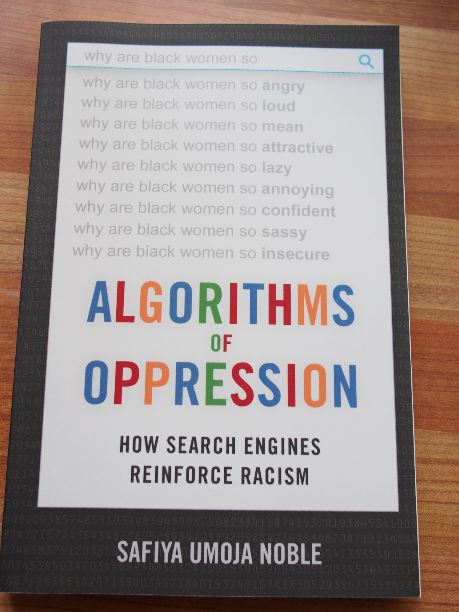
Search engine bias
Encyclopedias, library catalogues, and editorial oversight
Search engines may emphasize popularity more than quality.
Race bias and gender bias^{[2]} =>
Search engines not exposed to the same criteria as more traditional publishing
Bias against a group, not an individual

Slide 6
Fairness in the GDPR
GDPR is all about the rights of an individual, it may not be effective for fighting all algorithmic fairness.
Fairness is listed as one of the mandatory data processing principles under Article 5 of the GDPR. There is no definition but it can be illustrated by three points^{[3]}:
Effects considered
No deception
Expected, explained

Slide 7
Algorithmic Grading of Student Essays
Several US states already use automated grading of essays on standardized tests^{[4]}.
Cost savings, speed, and impartiality.
Utah lets machines be the sole judge of the vast majority of essays. In about 20 % of cases, human oversight is flagged.
Limitations
Les Perelman designed a program called the Babel Generator which creates essays that make no sense, but earn top scores from robo-graders.
Human interaction supports learning.
Algorithmic grading can help expose human biases.
*Basic Automatic B.S. Essay Language

Slide 8
Automated decision making and the GDPR
The GDPR Article 22
“…the right not to be subject to a decision based solely on automated processing, including profiling, which produces legal effects concerning him or her or similarly significantly affects him or her”
Exceptions
“Necessary for a contract
Safeguards
“…the right to obtain human intervention on the part of the controller, to express his or her point of view and to contest the decision.”
Is authorized by Union or Member State law
Is based on explicit consent”

Slide 9
Informing obligations under the GDPR
All processing
Strong informing: purposes of processing etc.
Article 22 processing
…meaningful information about the logic involved, as well as the significance and the envisaged consequences of such processing for the data subject
Questions
“right to explanation” vs. “meaningful information”[6], system functionality vs. individual decision.
Trade secrets and fraud detection
explainable in human terms (deep learning)?

Slide 10
Insurance and sharing risks
If we have a vast amount of data about everyone, how is risk sharing going to work, e.g. genetic testing and private health insurance?
The decisions may be based on well-grounded science, but they can create an unacceptable situation from an individual’s point of view.
Sometimes we may not want to use all data we have. It would not be “fair” => who determines the limits?

Slide 11
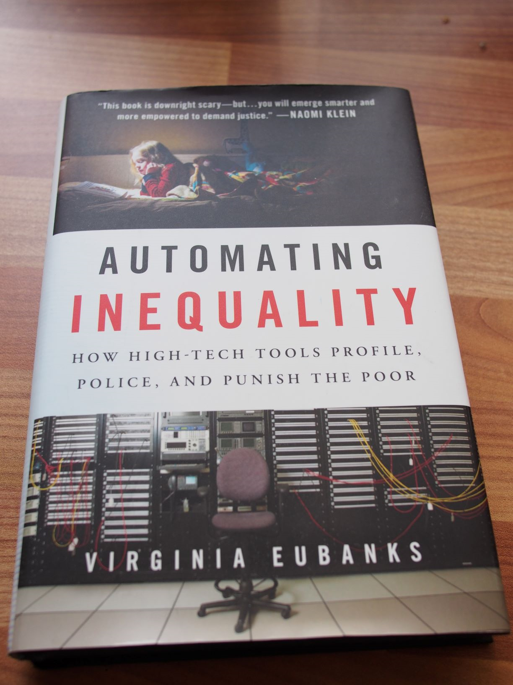
Loss of information and support because of algorithmic decisions
Sometimes human interaction has immense value when making decisions.
Virginia Eubanks’ book, Automating Inequality^{[7]},
City of Espoo has been investigating scoring to predict the need for child protective services^{[8]}

Slide 12
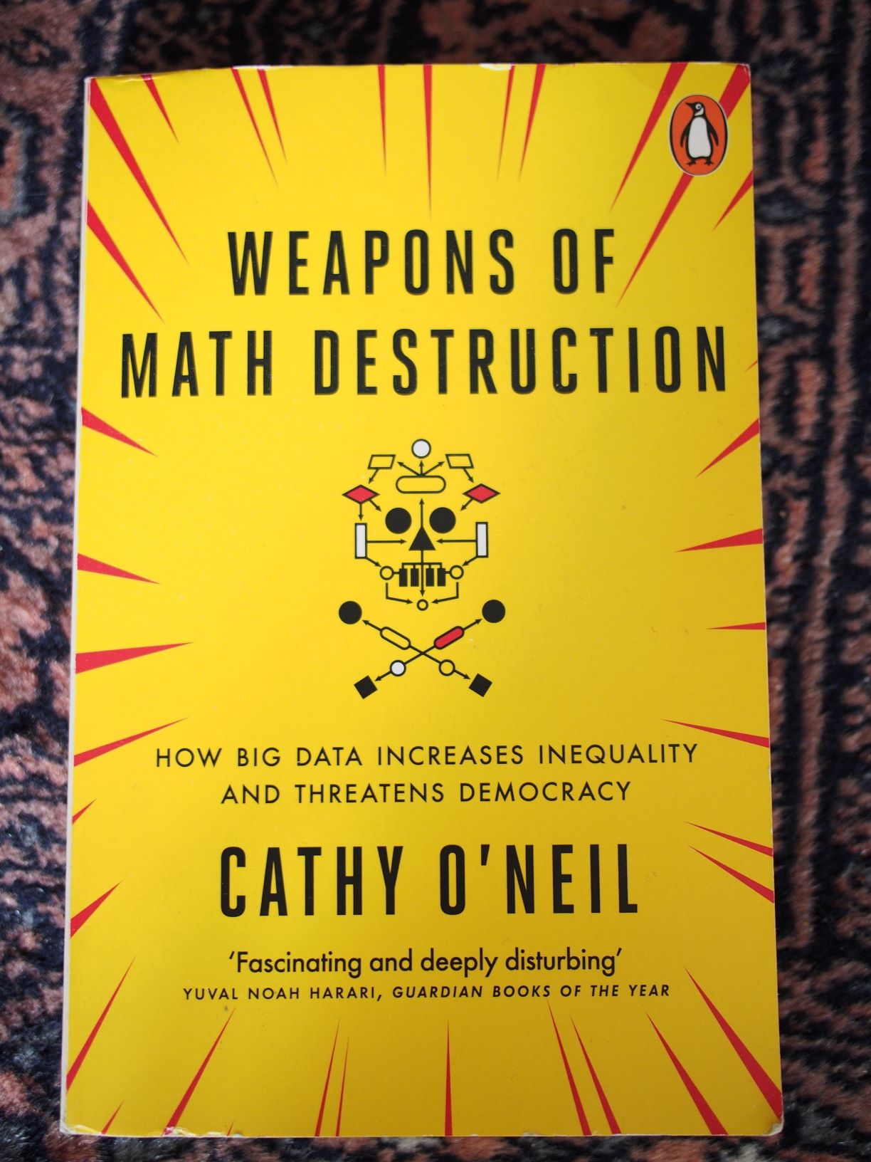
Other examples^{[9]}
Recruitment
Getting to the university
Credit scores
Online advertising: targeting the vulnerable
Problems: data quality, transparency, inappropriate sharing

Slide 13
Law enforcement - recidivism risk
COMPAS* is a program for assessing recidivism risk.
137 variables, some given by the defendant, some acquired elsewhere like data about criminal history.
Race is not an input variable
Supports human decision-making. The algorithm is proprietary, the logic is not disclosed.
Scores for each defendant ranged from 1 to 10, with ten being the highest risk. Scores 1 to 4 were labeled by COMPAS as “Low”; 5 to 7 were labeled “Medium”; and 8 to 10 were labeled “High.”
Propublica journalists decided to investigate the algorithm for accuracy and biases[10]. They acquired the risk scores and related data from Broward county, Florida.
*Correctional Offender Management Profiling
for Alternative Sanctions by Northpointe,

Slide 14
What did they find out?

Slide 15
Was this algorithm racially biased?
The actual outcomes conditional to COMPAS risk scores were the same for black and white defendants. Northpoint stated that this was their design criterion, the algorithm was “well calibrated”.
Two methods reflect two different fairness criteria:
Equal rate of wrong predictions (group fairness)
Calibration (individual fairness)
It turns out that it is impossible to satisfy both criteria if the base rates or score distributions of the groups are different^{[11]}.

Slide 16
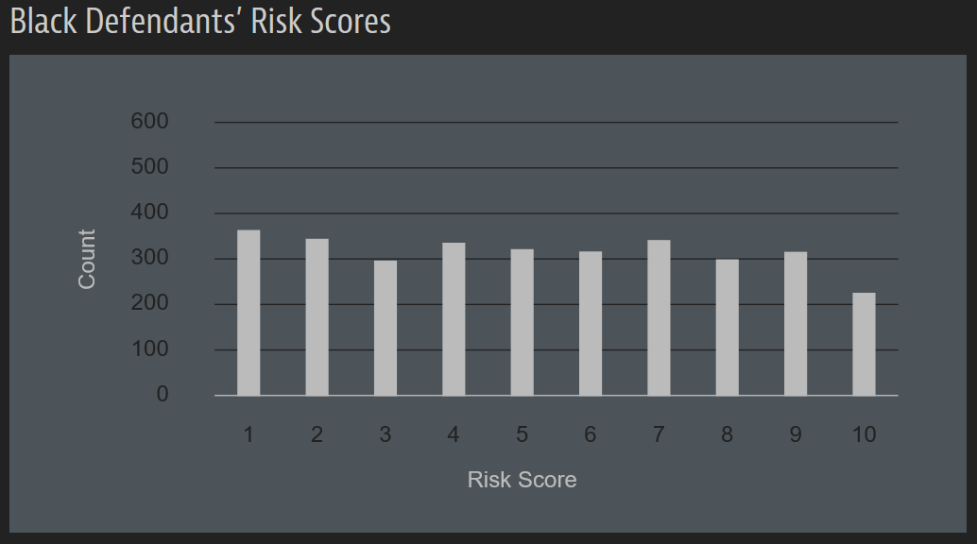
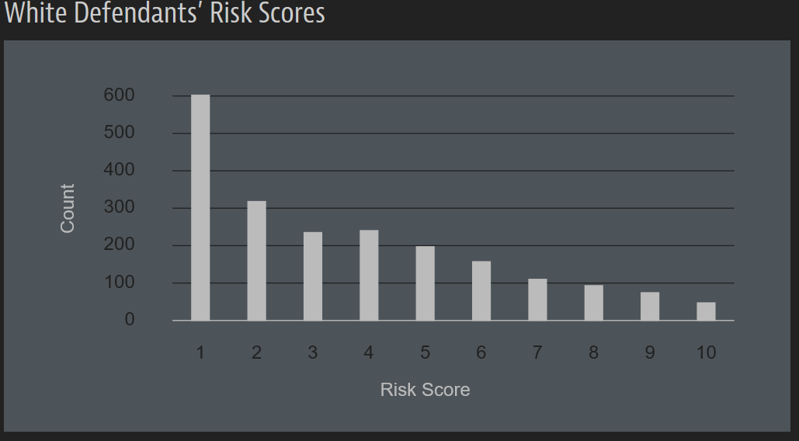
Score distributions

Slide 17
Other observations
A possible group fairness criterion could be “statistical parity”, each group having equal percentage of high risk predictions. However, this is likely to lead to problems.
Having a well calibrated algorithm minimizes future crime
While the Broward county data did not show miscalibration in relation to race, there was miscalibration in relation to gender: women were systematically less likely to reoffend than their score indicated^{[12].}
This would be easy to fix by adding gender as an input variable. Would using a protected variable as an input be lawful?

Slide 18
Epilogue
Two researches used a popular crowdsourcing marketplace to recruit volunteers from the Internet to assess Broward county data and got the following result^{[13]:}
“With considerably less information than COMPAS (only 7 features compared to COMPAS’s 137), a small crowd of nonexperts is as accurate as COMPAS at predicting recidivism .”
“…a linear classifier based on only 2 features—age and total number of previous convictions—is all that is required to yield the same prediction accuracy as COMPAS.”

Slide 19
What about the European law?
Law Enforcement Directive
Directive (EU) 2016/680
Explicit ban on discrimination
The GDPR
Regulation (EU) 2016/679
Only allows processing of the personal data relating to criminal convictions “under the control of official authority or when the processing is authorised by Union or Member State law”.
Does not include “meaningful information of the logic involved”

Slide 20
Takeaways of algorithmic fairness
Deciding what is fair can be very difficult. The area is developing quickly.
Two fair algorithms working together can yield an unfair result.
The GDPR can help, but there are limitations.
Using protected attributes is likely to improve accuracy and can facilitate fairness, but it may not always be allowed or advisable.
Codes of conduct and certifications defined in the GDPR could be used for algorithmic transparency and trust.

Slide 21
Thank you!

Slide 22
References 1/2
[1] Council Directive 2000/43/EC of 29 June 2000 implementing the principle of equal treatment between persons irrespective of racial or ethnic origin
https://eur-lex.europa.eu/LexUriServ/LexUriServ.do?uri=CELEX:32000L0043:en:HTML
[2] Safiya Umoja Noble (2018): Algorithms of Oppression, How Search Engines Reinforce Racism, New York University Press
[3] Information Commissioner’s Office: Guide to the GDPR
https://ico.org.uk/for-organisations/guide-to-the-general-data-protection-regulation-gdpr/principles/lawfulness-fairness-and-transparency/
[4] Tovia Smith:More States Opting To 'Robo-Grade' Student Essays By Computer
https://www.npr.org/2018/06/30/624373367/more-states-opting-to-robo-grade-student-essays-by-computer
[5] Article 29 Data Protection Working Party (2017): Guidelines on Automated individual decision-making and Profiling for the purposes of Regulation 2016/679
http://ec.europa.eu/newsroom/article29/item-detail.cfm?item_id=612053
[6] Andrew D. Selbst, Julia Powles: Meaningful Information and the Right to Explanation 7(4) International Data Privacy Law 233 (2017)
http://paperity.org/p/88216728/meaningful-information-and-the-right-to-explanation

Slide 23
References 2/2
[7] Virginia Eubanks (2017): Automating Inequality, How High-tech Tools Profile, Police, and Punish the Poor
[8] https://www.tivi.fi/Kaikki_uutiset/espoo-panostaa-tekoalyyn-palvelut-pystytaan-tarjoamaan-entista-paremmin-juuri-oikeaan-osoitteeseen-6722817
[9] Cathy O´Neil (2016): Weapons of Math Destruction, How Big Data Increases Inequality and Threatens Democracy, Penguin Books
[10] Julia Angwin, Jeff Larson, Surya Mattu and Lauren Kirchner (May 23, 2016): Machine Bias, Propublica https://www.propublica.org/article/machine-bias-risk-assessments-in-criminal-sentencing https://www.propublica.org/article/how-we-analyzed-the-compas-recidivism-algorithm
[11] Richard Berka, Hoda Heidari, Shahin Jabbari, Michael Kearns, Aaron Roth (2017): Fairness in Criminal Justice Risk Assessments: The State of the Art, University of Pennsylvania https://crim.sas.upenn.edu/sites/default/files/2017-1.0-Berk_FairnessCrimJustRisk.pdf
[12] Sam Corbett-Davies, Sharad Goel (2018): The Measure and Mismeasure of Fairness: A Critical Review of Fair Machine Learning https://5harad.com/papers/fair-ml.pdf
[13] Julia Dressel and Hany Farid (2018): The accuracy, fairness, and limits of predicting recidivism, Science Advances http://advances.sciencemag.org/content/4/1/eaao5580.full

Slide 24
For more information
Nick Srnicek (2017): Platform Capitalism, Polity Press
Victor Demiaux, Yacine Si Abdallah (2017): How Can Humans Keep the Upper Hand? The ethical matters raised by algorithms and artificial intelligence, CNIL, Commission Nationale Informatique&Libertés https://www.cnil.fr/en/how-can-humans-keep-upper-hand-report-ethical-matters-raised-algorithms-and-artificial-intelligence
Shai Danziger, Jonathan Levav, Liora Avnaim-Pesso (2011): Extraneous factors in judicial decisions http://www.pnas.org/content/pnas/108/17/6889.full.pdf
Amit Datta*, Michael Carl Tschantz, and Anupam Datta (2015): Automated Experiments on Ad Privacy Settings, A Tale of Opacity, Choice, and Discrimination https://www.andrew.cmu.edu/user/danupam/dtd-pets15.pdf
Michal Kosinski, David Stillwell, and Thore Graepel (2013): Private traits and attributes are predictable from digital records of human behavior http://www.pnas.org/content/110/15/5802
Finnish Non-discrimination Act, 1325/2014 https://www.finlex.fi/en/laki/kaannokset/2014/en20141325.pdf

