Slide 1
Demonstration of Interoperable Consent Receipts MyData Conference August 29th 2018
Ethics & Conformance Trust Marked

Slide 2
Standardized Consent Receipts issued to a data subject whenever they consent to personal data processing will help enable a product ecosystem that assists the data subject to exercise their data rights…
Notes:
to see and understand privacy - so that people can exercise privacy rights - in a way that is meaningful, operational, useful etc.. - its the operational piece of exercising rights which is currently missing - aka the user side infrastructure that CISWG has focused on (see CISWG Charter).

Slide 3
Because ‘data subjects’ are humans and their memories are not databases

Slide 4
Imagine in a few years:
you have consented to 500 services

Slide 5
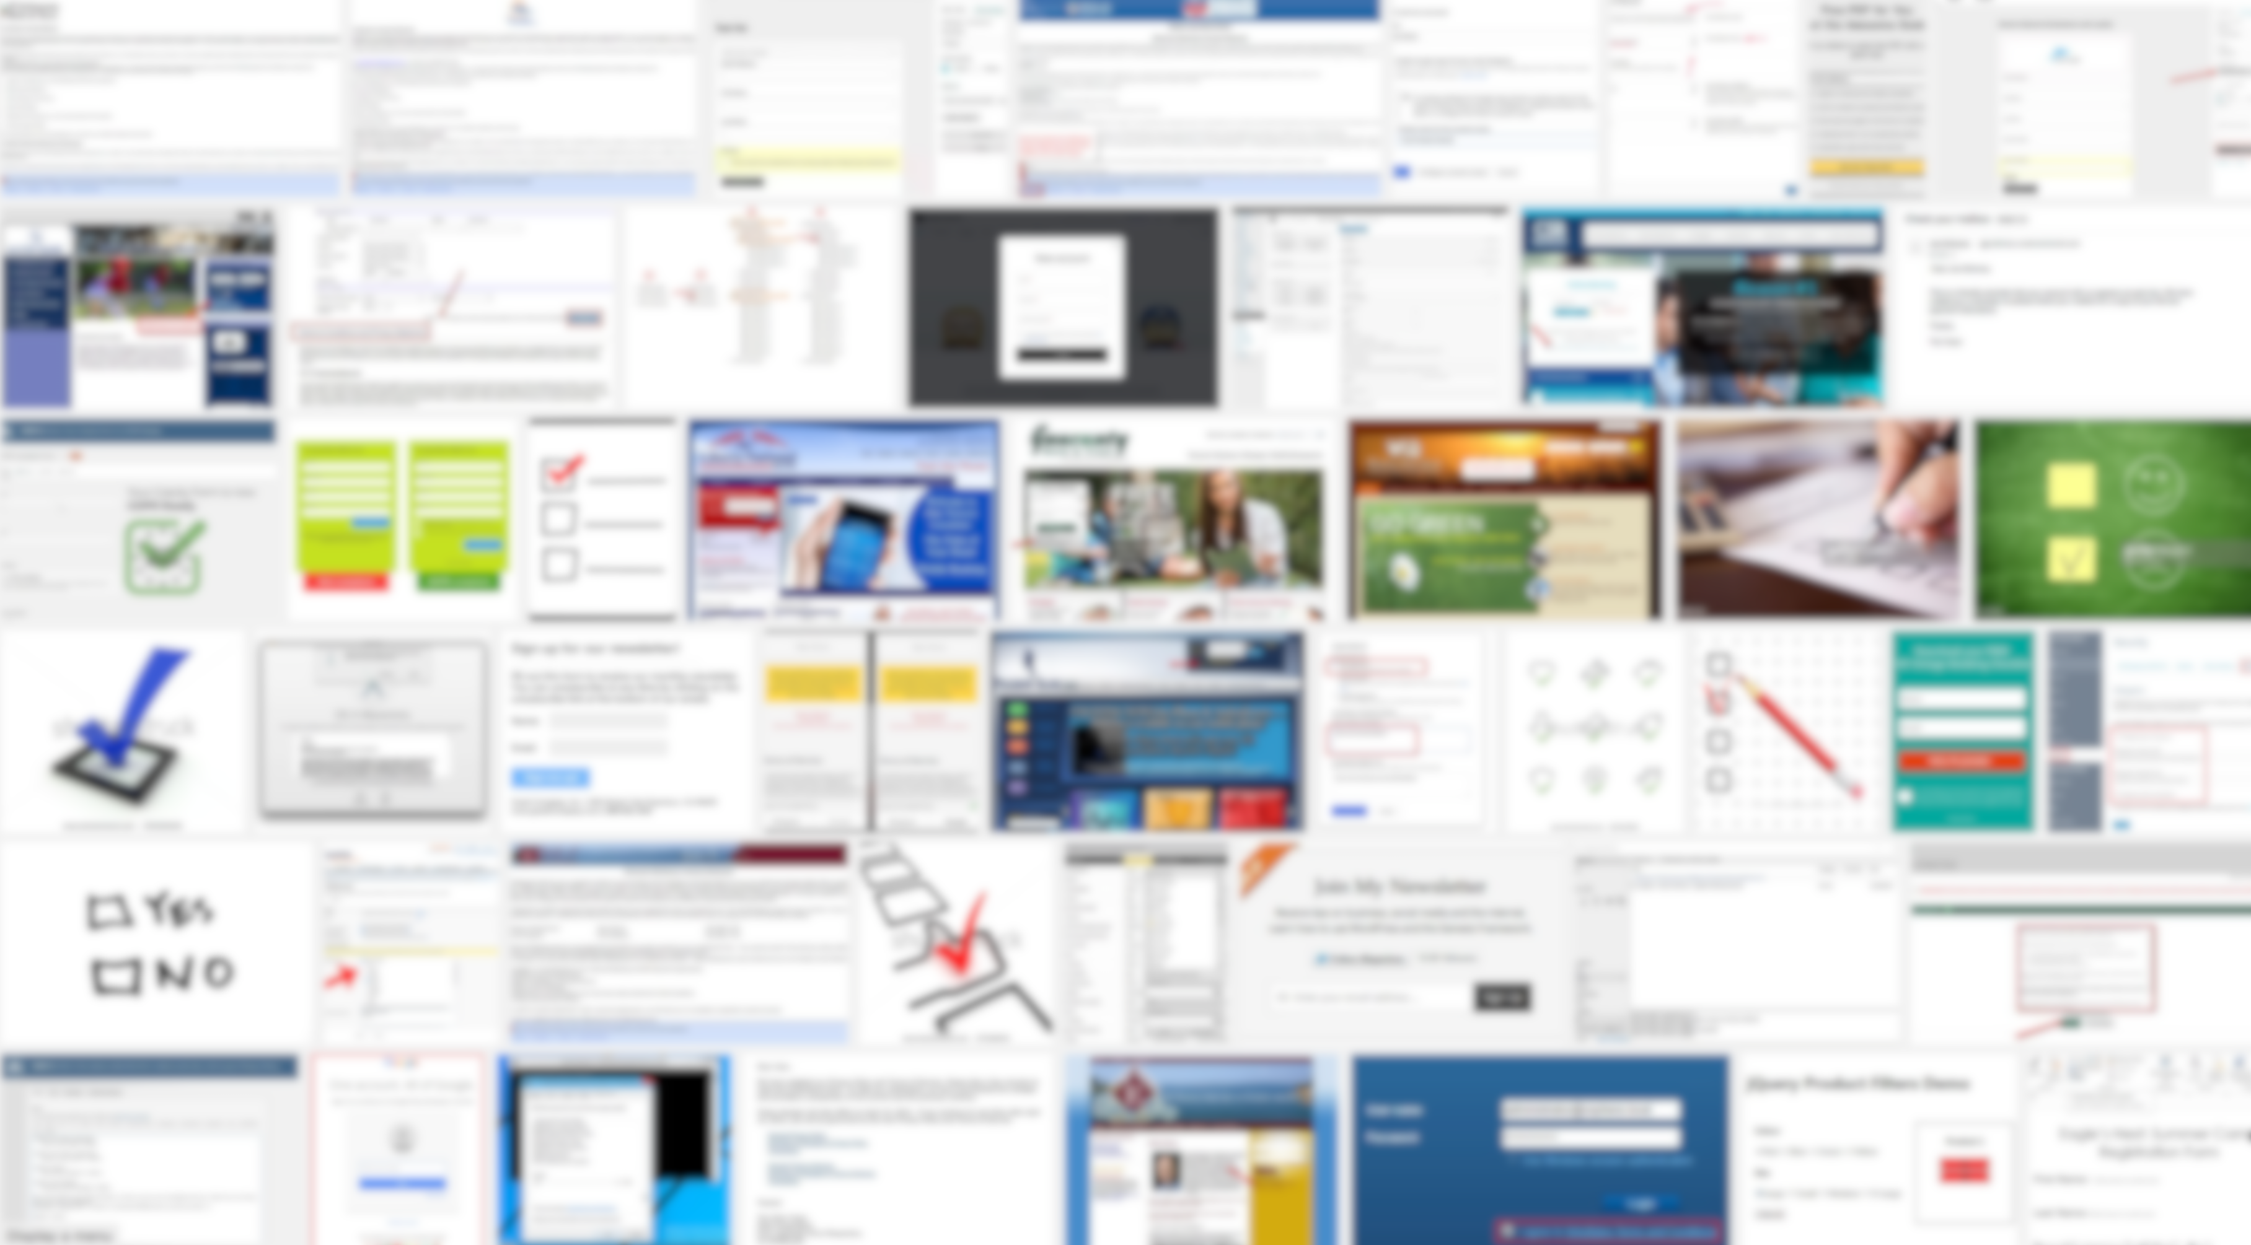
Now What?

Slide 6
A SOLUTION Your own “privacy dashboard” to manage your data rights and act when you choose
Notes:
Icon source: https://openclipart.org/search/?query=dannya

Slide 7
An open ecosystem
of privacy dashboards & tools REQUIRES standard data formats in order to be viable

Slide 8
A Consent Receipt ;-)
{"version":"KI-CR-v1.1.0","jurisdiction":"GB","consentTimestamp":1513086888,"collection Method":"Consentua","consentReceiptID":"132553a7-5599-46c7-8af1-7975a50f6a5c", "piiPrincipalId":"Coops","piiControllers":[{"piiController":"Kames Capital","contact":"Iain Henderson","address":{"streetAddress":"Kames Capital plc PO Box 3733 Royal Wootton Bassett SN4 4BG United Kingdom ","addressLocality":null,"post OfficeBoxNumber": null,"postalCode": null,"addressCountry": null},"email": "iain.henderson@ kamescapital.com", "phone":"0800 358 3009 "}],"services":[{"service":"Kames Capital", "purposes":[{"purpose":"Used by the financial regulator","consent Type":"EXPLICIT", "purposeCategory":["Sales Tracking"],"piiCategory":["Sales Tracking"],"termination": "www.consentua.com/terminaton","thirdPartyDisclosure":false,"thirdPartyName":""}, {"purpose":"Used by Aegon Asset Management to encourage you to see if their products can help you meet your financial goals and objectives.","consentType” :"EXPLICIT","purposeCategory":["Marketing"],"piiCategory":["Marketing"],"termination": "www.consentua.com/terminaton","thirdPartyDisclosure":false,"thirdPartyName":"Aegon Asset Management"}]}], "policyUrl":"https://www.kamescapital.com/privacy.aspx", "sensitive":false,"spiCat":null}

Slide 10
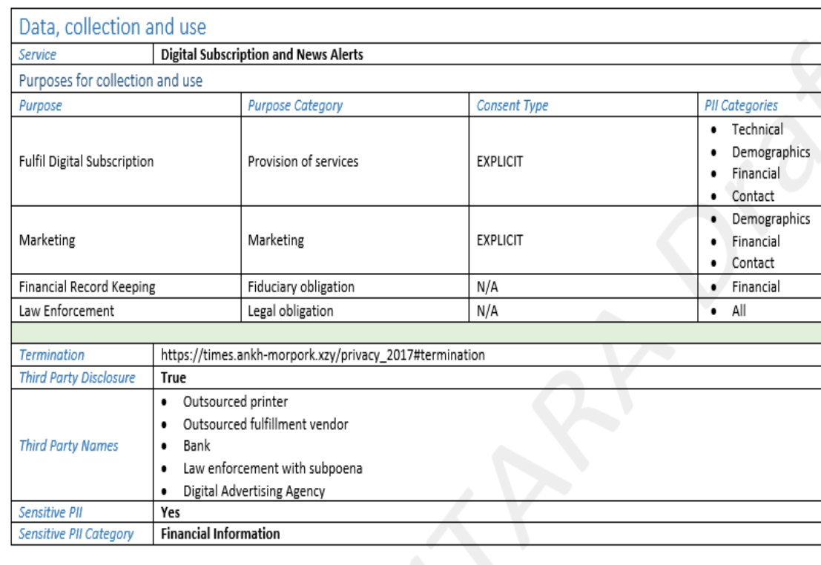

Slide 11
The Demonstration

Slide 12
Kantara Members in Demonstration

Slide 13
The Demo
GET
STORE
VIEW
Notes:
» Site gives the user a consent receipt
» User stores it somewhere
» User views it in a viewer
That’s It! (for this iteration of demo)

Slide 14
Switch to the Live Demo

Slide 15
Future Work

Slide 16
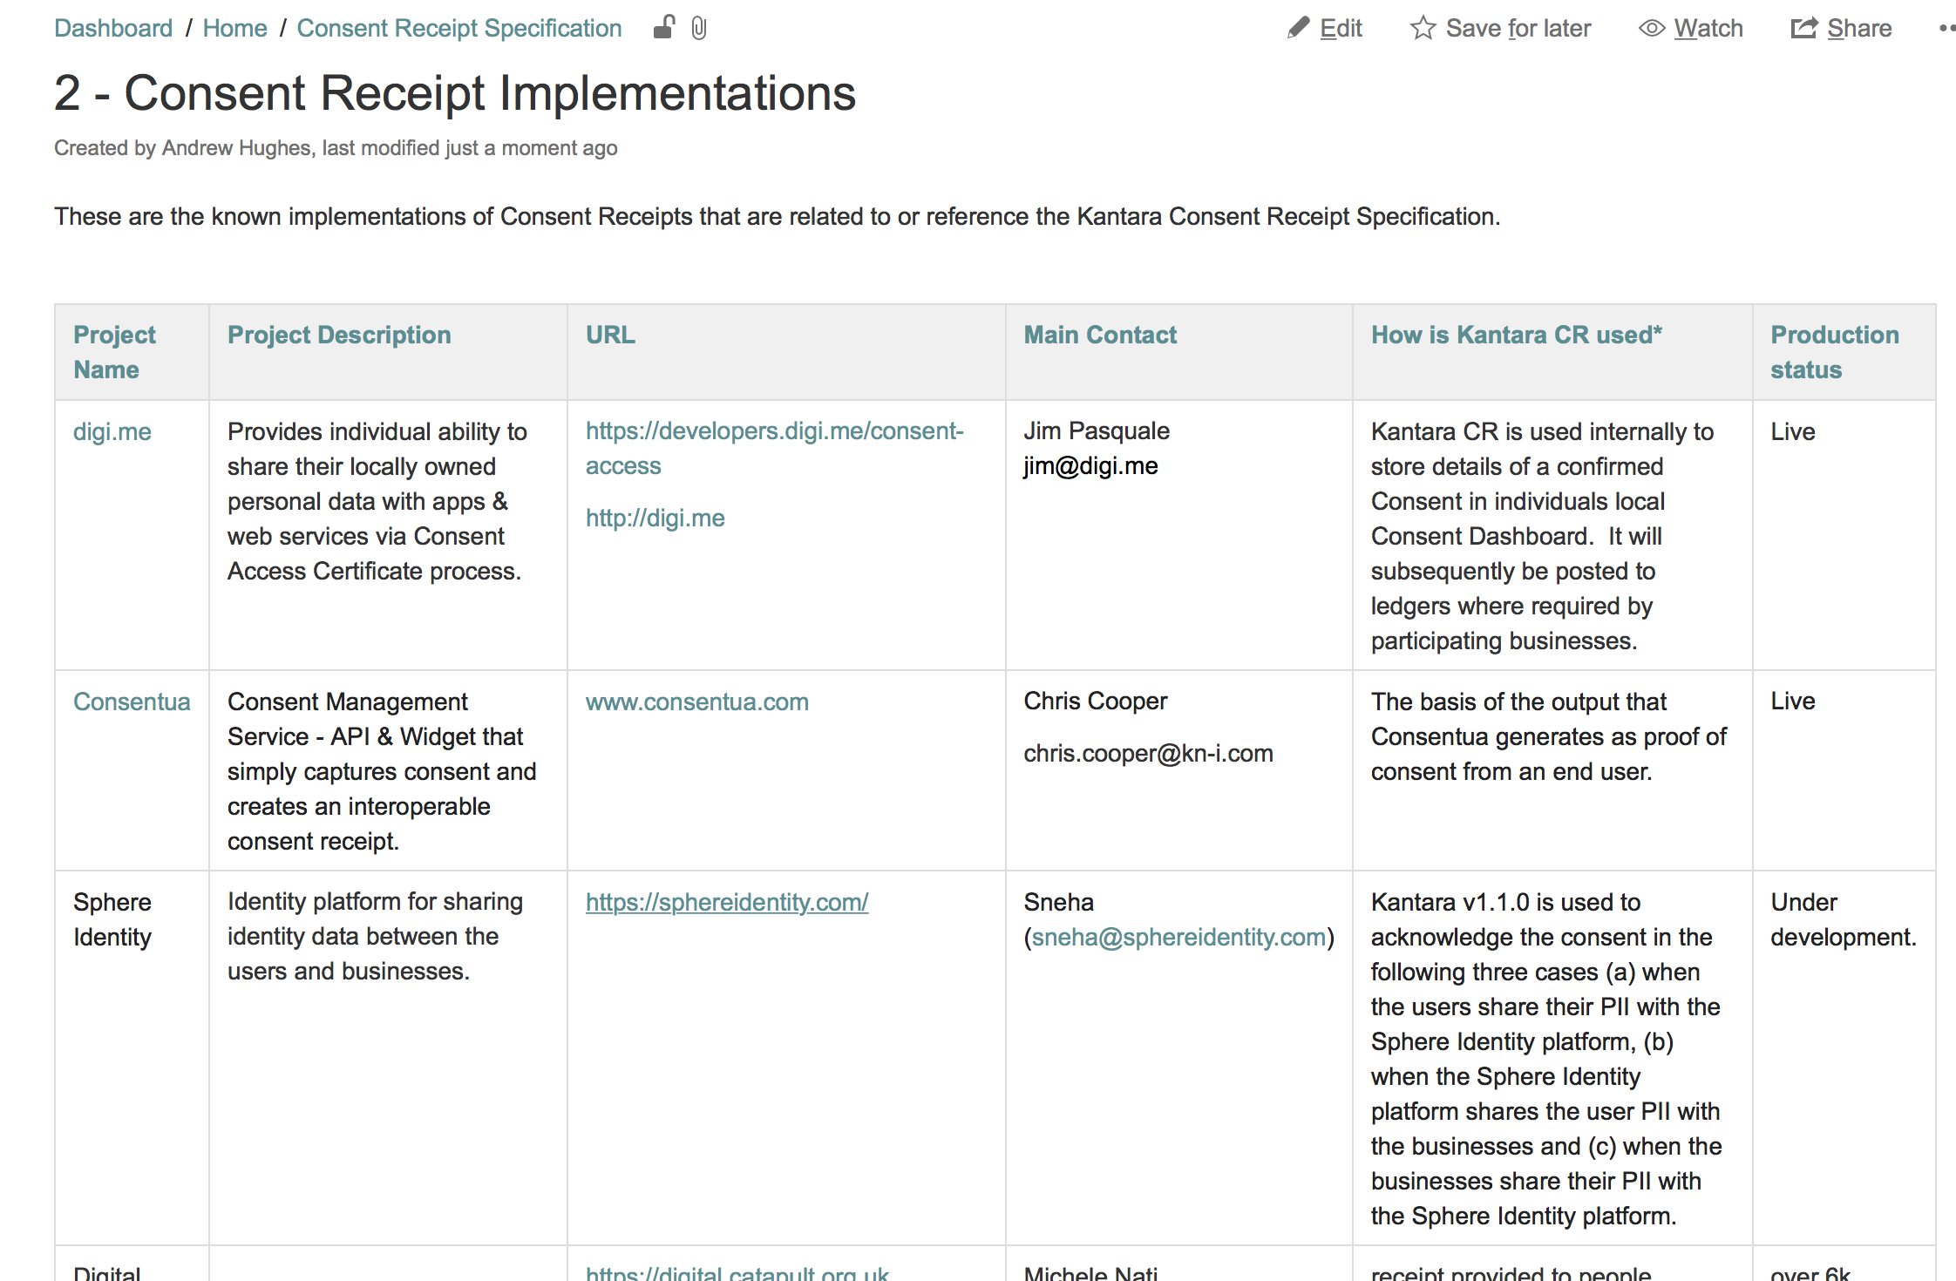

Slide 17
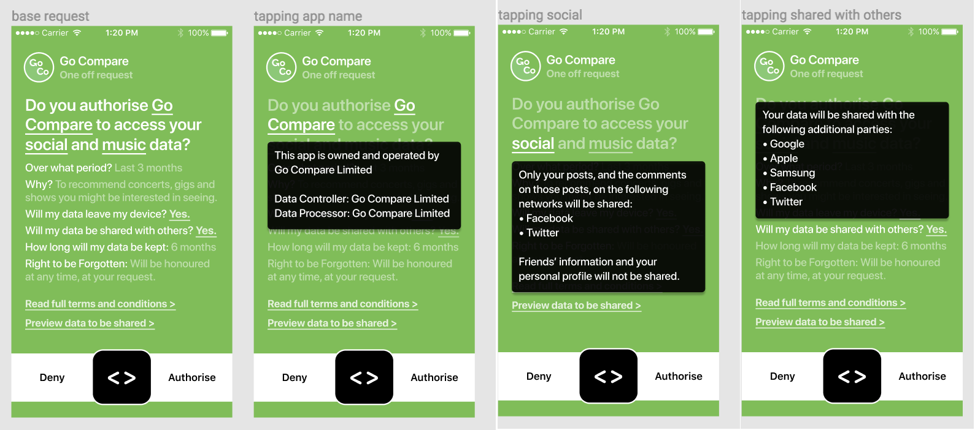
User Experience: Layered Notice

Slide 18
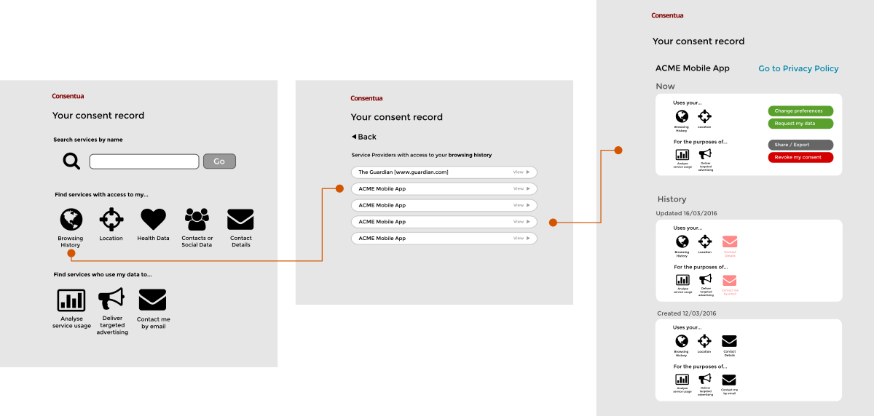
Dashboard

Slide 19
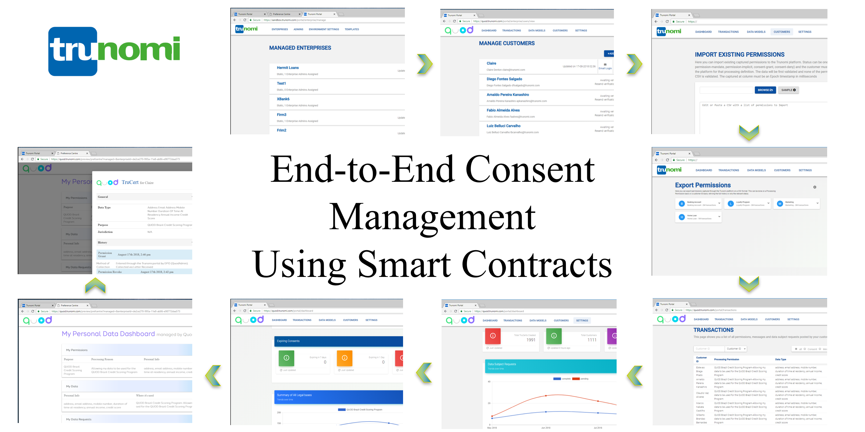

Slide 20
» Update specification
» Templates for multi-jurisdiction
» Make it a ‘privacy receipt’
» Coordinate with Consent Practices WG

Slide 21
» Add demo functionality
» Add demo organizations
» Establish test lab

Slide 22
» Encourage inclusion in codes of practice
» Conformity assessment scheme
» Issue trust marks

Slide 23
Your Organisation!
Nurture
the ecosystem
Your Organisation!
Your Organisation!

Slide 24
Organisation | Contact
Kantara Initiative: the global consortium improving trustworthy use of identity and personal data | kantarainitiative.org kantarainitiative.org/membership/ colin@kantarainitiative.org
Consent & Information Sharing WG: Consent Receipt specification Interop demo development Data sharing specifications | kantarainitiative.org/confluence/display/infosharing andrewhughes3000@gmail.com
Consent Practices WG: Common practices for consent management | kantarainitiative.org/confluence/display/consentmanagement andrewhughes3000@gmail.com

Slide 25
Nurture. Develop. Operate. – that’s what we do
Ethics & Conformance Trust Marked
Colin Wallis, Executive Director colin@kantarainitiative.org
Twitter: @KantaraColin, @KantaraNews
Join us at https://kantarainitiative.org/membership/

