Slide 1
Not Your Father’s Identity Standards
Why SSI (Self-Sovereign Identity) Standards Will Not Look Like What Has Gone Before
Drummond Reed
Chief Trust Officer, Evernym
Trustee, Sovrin Foundation
MyData2018
Helsinki
30 August 2018

Slide 2
Who Am I?
Years
20 years in Internet Identity
13 years (all 26 instances) of Internet Identity Workshop
15 years in Internet Identity standards
W3C
OASIS
IETF
OpenID Foundation

Slide 3
Who Am I?
Hats
Chief Trust Officer, Evernym
Trustee, Sovrin Foundation
Chair, Sovrin Trust Framework
Co-Chair, Decentralized Identity Foundation ID WG
Co-Chair, OASIS XDI TC
Principle Investigator, U.S DHS DID and DKMS Projects
Co-Editor, W3C DID Spec

Slide 4
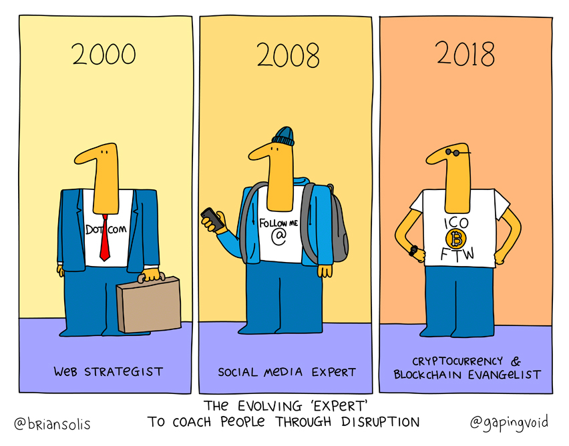

Slide 5
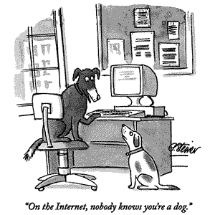
© The New Yorker

Slide 6
Internet Identity Workshop

Slide 9
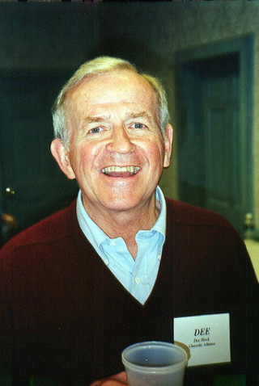

Slide 11
SSI (Self-Sovereign Identity) standards will not be like conventional identity standards because they must incorporate:
Decentralization
Governance

Slide 12
First, decentralization means SSI technical standards will be a combination of de jure (standards bodies) and de facto (community adoption)

Slide 13
De Jure Standards: The Three Models of Digital Identity

Slide 14
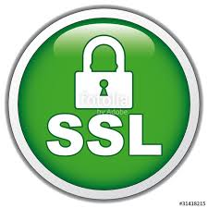
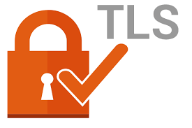
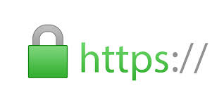
#1: Siloed (Centralized) Identity
Org
You
Account
Standards:

Slide 15
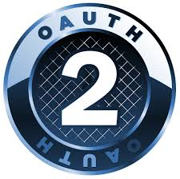
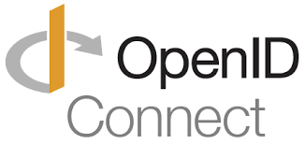
#2: Third-Party IDP (Federated) Identity
IDP
Org
You
Account
Standards:

Slide 16
#3: Self-Sovereign Identity (SSI)
You
Peer
Connection
Distributed Ledger (Blockchain)

Slide 17
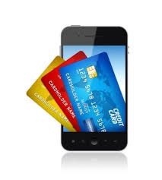
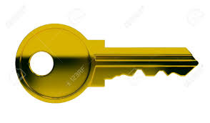
#3: Self-Sovereign Identity (SSI)
Get credential
Digital wallet
Peer
#4 Verifiable Credentials
#2 DKMS
#3 DID Auth
Connection
Show credential
#1 DIDs
Distributed Ledger (Blockchain)

Slide 18
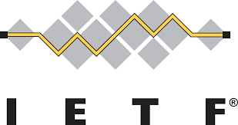
Emerging De Jure Standards for SSI
Verifiable Credentials
DID Auth
DKMS (Decentralized Key Management System)
DID (Decentralized Identifier)

Slide 19
De Facto Standards: The SSI Protocol

Slide 20
SSI Architecture
You
Peer
Connection
Distributed Ledger (Blockchain)

Slide 21
SSI Protocol
How agents talk to each other…
Agent
Agent
Connection
…and understand each other
Distributed Ledger (Blockchain)

Slide 22
The SSI protocol is evolving so rapidly enough that it will become a de facto standard long before de jure

Slide 24
Governance Standards: The Role of Trust Frameworks

Slide 25
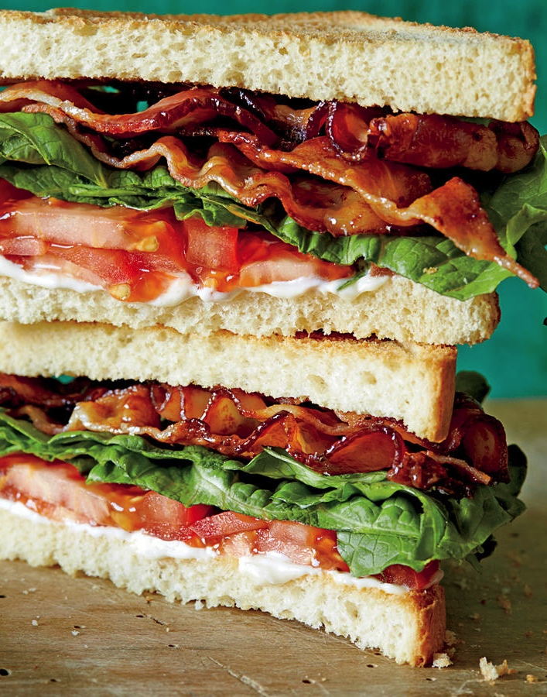
Business Policies
Legal Policies
Technical Policies

Slide 26
A trust framework is…
A set of business, legal, and technical rules which members of a community agree to follow in order to achieve trust online

Slide 27
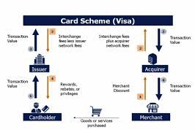
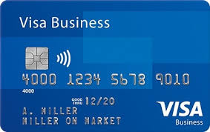
Example: a credit card network relies on a trust framework to establish trust between the parties

Slide 28
Similarly, the trust in any SSI digital credential will depend on the trust framework under which it is issued
Digital Credential

Slide 29
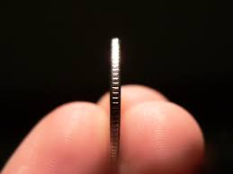
Digital Credential
Trust Framework

Slide 30
This is why SSI is going to lead to an explosion of trust frameworks

Slide 31
The Sovrin Trust Framework: 3 Layers of Enablement

Slide 32
Cryptographic Trust
Public
Payment
Layer One: Sovrin Public Ledger
Main
Internal
Pool
Config

Slide 33
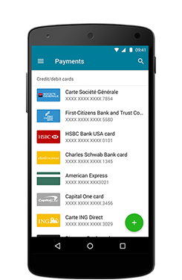
Layer Two: Agent-to-Agent Protocol
Connection
Agent + Wallet
Agent + Wallet
Cryptographic Trust
Public
Payment
Layer One: Sovrin Public Ledger
Main
Internal
Pool
Config

Slide 34
Layer Two: Agent-to-Agent Protocol
Connection
Agent + Wallet
Agent + Wallet
Cryptographic Trust
Public
Payment
Layer One: Sovrin Public Ledger
Main
Internal
Pool
Config

Slide 35
✔
Verifiable Credential
Proof
Layer Three: Credential Exchange
Holder
Human Trust
Trust
Issuer
Verifier
Layer Two: Agent-to-Agent Protocol
Connection
Agent + Wallet
Agent + Wallet
Cryptographic Trust
Public
Payment
Layer One: Sovrin Public Ledger
Main
Internal
Pool
Config

Slide 36
✔
Verifiable Credential
Proof
Layer Three: Credential Exchange
Holder
Human Trust
Trust
Issuer
Verifier
Layer Two: Agent-to-Agent Protocol
Connection
Agent + Wallet
Agent + Wallet
Cryptographic Trust
Public
Payment
Layer One: Sovrin Public Ledger
Main
Internal
Pool
Config

Slide 37
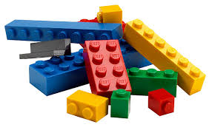
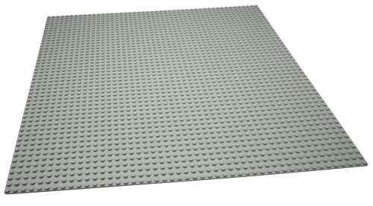
Domain-Specific Trust Frameworks
Sovrin Trust Framework

Slide 38
The future of SSI—the “trust layer for the Internet”—is domain-specific trust frameworks

Slide 39
A Specific Example: CULedger and MyCUID

Slide 40
CULedger is…
A consortia created to build blockchain solutions for the credit union industry and its 235M members worldwide

Slide 42
MyCUID is…
The first initiative coming from CULedger:
a global digital credential of credit union membership

Slide 44
Questions?
drummond.reed@evernym.com
drummond.reed@sovrin.org

